Slide 1
Inhalation Injury Management
Presented by: Nicole McClure RRT, RRT-ACCS

Slide 2
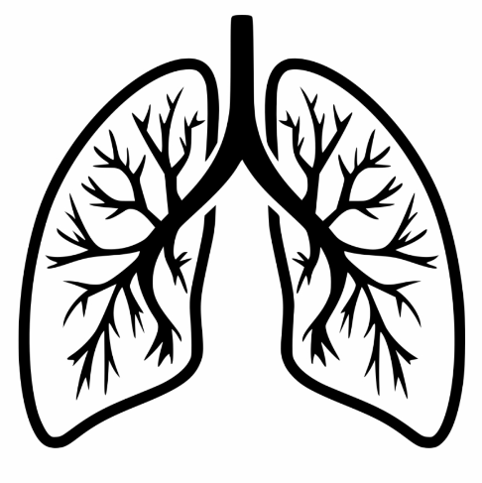
Overview
Review
    Inhalation injuries
Management
    First responder care
    Upon arrival to hospital
    Acute care and stabilization
    Long term care
Respiratory Resources
    Esophageal Monitoring Catheter
    PV Tool

Slide 3
Disclosures
I have no conflicts of interest in relation to this program and no financial interest in any product mentioned in this presentation

Slide 4
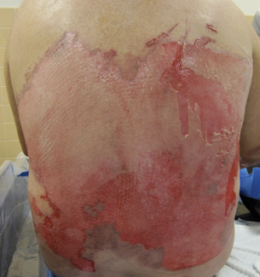
Burns
Burn injuries are responsible for over 486,000 visits to the emergency department every year.
For those admitted to a burn center:
  Survival rate: 96.8%
  Gender: 68% male and 32% were female
  Ethnicity: 59% Caucasian, 20% African-American, and 14% were Hispanic
  Injury location: 73% of injuries occurred at home
[7]

Slide 5
4 Major Types
Thermal
Electrical
Chemical
Inhalation
Primary Survey and initial care is the same for all mechanisms of injury.
Secondary Survey will differ based on the type injury.

Slide 6
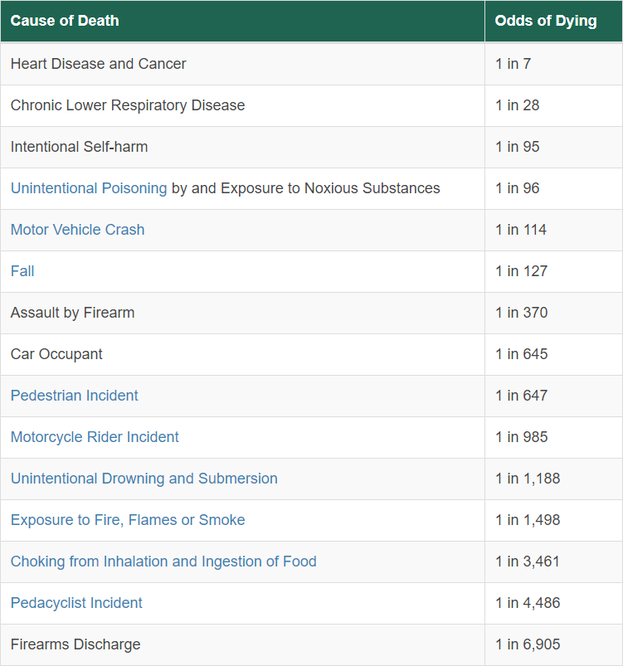
Survival Rates
The odds of a person dying from exposure to fire, flames, or smoke is about 1 in 1,498.
Survivability of 96% for the moderate to severely-injured burn victim that receives care are a burn center.
Early interventions are key!
  Pre-hospital treatment and stabilization greatly improve survivability.
[8]

Slide 7
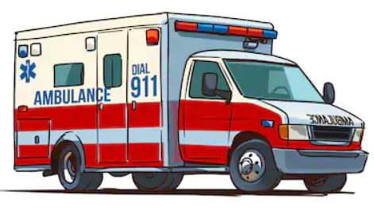
Pre-Hospital Management
Crucial to patient outcome
Don’t let the shock of the wound take away from other injuries that the patient may have.
For example: Did the patient jump from a second story window? Was the patient in an explosion and suffered a penetrating wound?
Main goals for EMS:
    ABC’s
    Keep the patient warm
    Start fluid resuscitation

Slide 8

Pre-Hospital: Airway/Breathing
Primary Survey
Signs of a possible inhalation injury
  Burns to face or neck
  Singed hair
  Soot in upper airways
  Voice changes, stridor, wheezing, coughing
Brief history of injury
  Type of fire
  Location and duration of exposure
  Loss of consciousness
IMPORTANT: Just because the patient does not have any of the physical symptoms mentioned, the patient could still have some degree of inhalation injury!
[11,12]

Slide 9
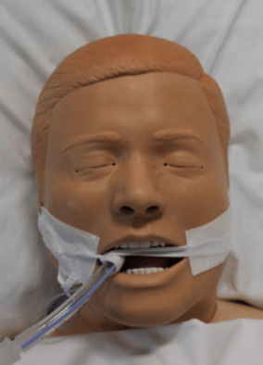
Pre-Hospital: Intubation Considerations
Be mindful of cervical injuries
  Consider the mechanism of injury in addition to fire exposure.
Use large diameter ETT if possible
  7.5 or larger in adult patients
  Easier to bronch
  Easier to suction
  Reduces RAW
Tube securement
  Burns weep a lot!
  Cloth ties recommended
Better safe then sorry!

Slide 10
Other Considerations Pre-Hospital: Carbon Monoxide Poisoning
Produced from partial combustion from carbon-containing materials
Colorless, odorless
Binds to Hb creating Carboxyhemoglobin (COHb)
*CO has a 300 times greater binding affinity than Oxygen*
Causes tissue hypoxia
Can cause cardiac injury in “healthy” patients
Carboxyhemoglobin Saturation (COHb) | Signs/Symptoms
0 to 9% | None. Smokers and those in areas with heavy smog may normally present with 5 to 10% COHb.
10 to 20% | Tension in forehead and dilation of skin vessels.
20 to 30% | Headache and pulsating temples.
30 to 40% | Severe headache, vision changes, nausea, vomiting, fatigue.
40 to 50% | Same as above with tachypnea, tachycardia. Risk for asphyxiation.
50 to 60% | Same as above plus coma, seizures, and Cheyne-Stokes respirations.
Greater than 60% | Coma, seizures, weak respirations, and weak pulse. Death is possible.
[13]
[12]
Most fatalities related to trauma from fire are from asphyxiation and/or CO poisoning.
[9]

Slide 11
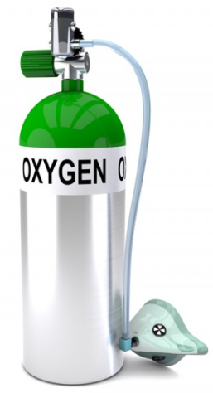
Special Considerations/ Treatment
Don’t trust the Pulse Oximeter!
  Hemoglobin reflects light back to the pulse ox to give an estimate of how saturated it is. CO and O2 bind the same to Hb. The pulse ox cannot differentiate between the two.
  ABGs are needed to show true oxygen content and COHB
Treatment- 100 % oxygen wash out
Additional testing- Since CO can cause cardiac events, testing cardiac enzyme levels and/or electrocardiograms can be beneficial in the management long lasting effects.
Hyperbaric therapy?
[12]

Slide 12
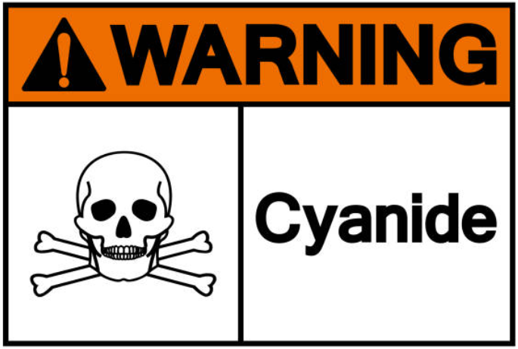
Cyanide Poisoning
Caused by combustion of chemicals or synthetic materials
Induces anaerobic metabolism and eventually hypoxemia [10]
Can cause restlessness, fatigue, headaches, dizziness but other wise are non-specific
Lactate above 10 mmol/L can indicate possible cyanide poisoning [14]
Treatment-
  100% oxygen
  Hydroxocobalamin
  Amyl nitrite/sodium thiosulfate [15]

Slide 13

Upon Arrival: Airway/Breathing
Secondary Survey
Vitals
  Unless the ABG shows a normal COHB for that patient, keep the patient on 100% FiO2 even if the SpO2 is normal
CT
  Full body trauma scan to see any additional injuries
Calculate true TBSA
Initial Bronchoscopy
  Needs to be performed for all fire/ smoke exposures even if there are no signs of inhalation injuries.

Slide 14
Inhalation Injuries
Defined as:
Aspiration of superheated gasses, steam, and/or noxious chemical compounds [16]
Upper airways usually sustain the most thermal injuries
Lower airways more effected by irritants

Slide 15
Inhalation Injuries
Thermal Injuries
Concerns for obstruction of airway due to significant swelling [12]
Best to obtain airway immediately if there is suspicion of upper airway injury even if the patient still appears to be clinically stable
  Edema will occur with burn patients due to the aggressive fluid resuscitation protocols
Amount of fluid given is wound and body weight dependent.
Half of the needed mls normally given in the first 8 hours.
Fluid needs in mL = mL x body weight in kg x percent of 2nd and 3rd degree burns
Type of burn or patient: | ML is equal to:
Thermal or chemical burn | 2 mL
High-voltage electrical burn | 4 mL
Pediatric burn (14 years or younger and less than 40 kg) | 3 mL

Slide 16
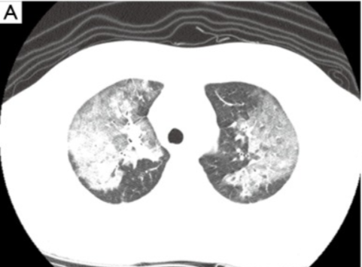
Inhalation Injuries
Chemical Injuries
Patients usually start to have a significant decline 24-36 hours post exposure event
Triggers inflammatory response
  Bronchospasms and increased sputum production [12]
Impairs oxygenation
  Increased sputum production
  Carbon monoxide or cyanide poisoning (systemic)
[16]
Inhalation injury 24 hours post admission

Slide 17
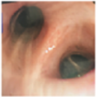
Grading Inhalation Injuries
Bronchoscopy
Abbreviated Injury Score (AIS)
Needs to be preformed ASAP
Diagnostic 1st
Pulmonary Hygiene 2nd
Multiple or scheduled bronchs may be necessary during the patient’s hospital stay
Normal Findings
[17]

Slide 18
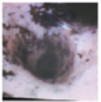
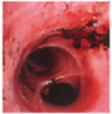
Grading Inhalation Injuries
Grade 1- Mild
Minor or patchy erythema
Minor or patchy carbonaceous deposits
Proximal to bronchi
Grade 2- Severe
Moderate erythema
Moderate carbonaceous deposits
May have some degree of bronchi compromise
[17]

Slide 19
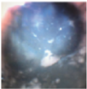
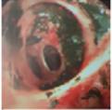
Grading Inhalation Injuries
Grade 3- Severe
Severe inflammation
Moderate friability
Copious carbonaceous deposits/ obstructions
Moderate bronchorrhea
Grade 4- Severe
Mucosal sloughing
Necrosis
Complete obstructions
Note: Due to necrosis and sloughing of epithelium, bacterial invasion and pneumonias are common with severe inhalation injuries along with the formation of casts.
[12]
[17]

Slide 20
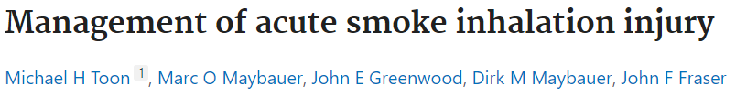
Inhalation Injuries
Study looked at morbidity and mortality with burn victims with inhalation injuries.
20% of burn victims have some degree of an inhalation injury
70% of inhalation injuries will lead to respiratory failure
30% of patients suffering respiratory failure due to an inhalation injury will expire
[10]

Slide 21
Treatment
Since every exposure is different, it is difficult to treat inhalation burns.
Initial injury (exposure)
Secondary injury (clinicians provide support and protection)
  Fluid resuscitation efforts
  Trauma from mechanical ventilation
  Infection
Food for thought…….
Outcomes have improved for patients suffering from inhalation injuries more from improved critical care interventions and less due to better inhalation injury management.
Goal:
Treat ARDs
Aggressive pulmonary toilet
Prevent/treat infection
[12]

Slide 22
Treatment
Options:
Improvements in management of ventilated patients in the critical scare setting have greatly decreased ventilator days: Prevention strategies work!
Heparin Protocol
Pronation therapy
PC, APRV, Ardsnet
Inhaled INO
HFOV
ECMO
[12]
Routine oral care
Elevate head of bed
Securement of vent circuit with arm
Reduce the use of saline for suctioning
Routine repositioning of patient
Limit disconnection of ventilator
Being an advocate

Slide 23
Possible Alternatives
Preclinical evaluation of epinephrine nebulization to reduce airway hyperemia and improve oxygenation after smoke inhalation injury
Matthias Lange, MD, Atsumori Hamahata, MD, Daniel L. Traber, PhD, Robert A. Cox, PhD, Gabriela A. Kulp, PhD, Yoshimitsu Nakano, MD, Lillian D. Traber, RN, David N. Herndon, MD, and Perenlei Enkhbaatar, MD, PhD
Looked at the effectiveness of nebulizing epinephrine to sheep to treat bronchoconstriction due to inhalation injuries
Showed decreased airway pressures and improved PaO2/FiO2 ratios
Continuous nebulized albuterol attenuates acute lung injury in an ovine model of combined burn and smoke inhalation
Tina L Palmieri ¹, Perenlei Enkhbaatar, Robert Bayliss, Lillian D Traber, Robert A Cox, Hal K Hawkins, David N Herndon, David G Greenhalgh, Daniel L Traber
Nebulized TPA was utilized as a fibrinolytic agent in sheep subjected to inhalation injuries
Showed marked improvement in respiratory status (decreased secretion production, improved oxygenation, decreased airway pressures, etc.)
[19]
[18]

Slide 24
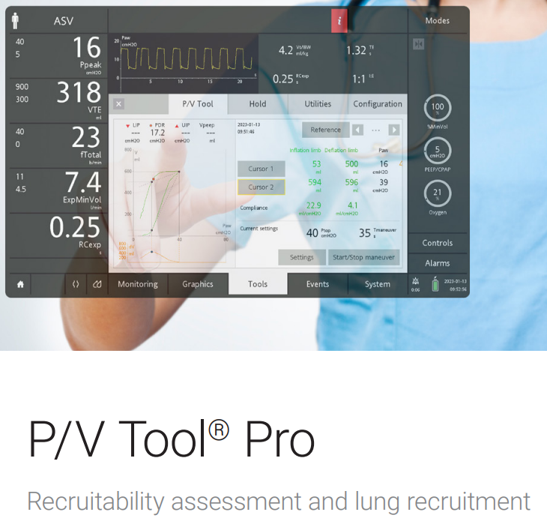
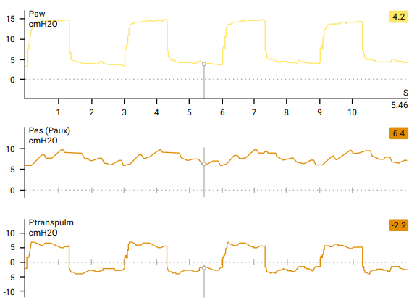
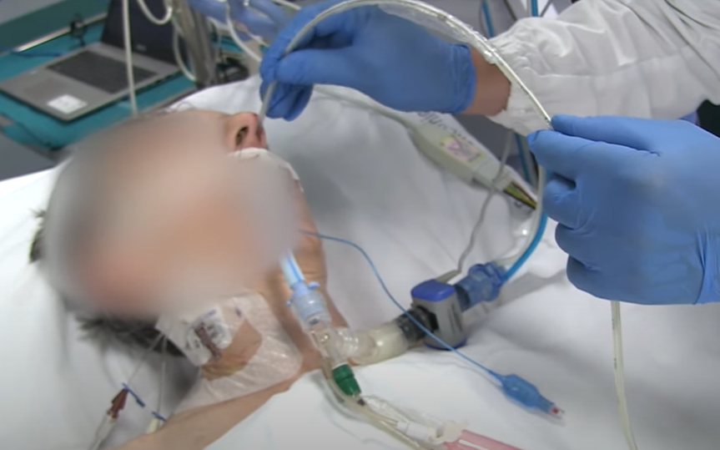
Finding Optimal PEEP
Early implementation of appropriate PEEP settings can be critical when oxygenating and preserving lung integrity.
  P/V Tool
  Esophageal Pressure Monitoring Catheter

Slide 25
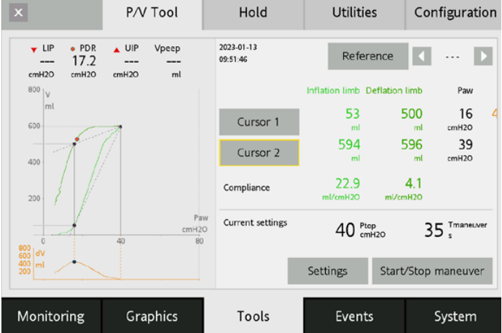
P/V Tool
Assesses lung recruitability
Determines lower inflection point (optimal Peep)
Provides consistent recruitment maneuvers
Note: The patient must be completely passive to obtain accurate data for diagnostic maneuvers

Slide 26
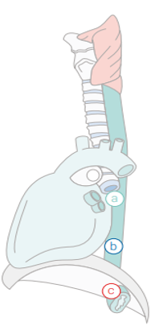
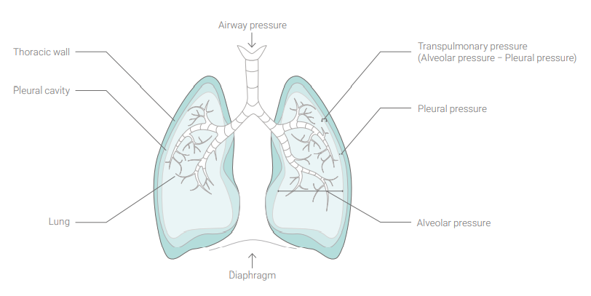
Transpulmonary Pressure
Small catheter inserted into the esophagus.
Uses the esophageal pressure as a fill-in for the plural pressure.
Shows real time pressures vs. diagnostic maneuvers that shows only snap shots.

Slide 27
Transpulmonary Pressure
PEEP (alveolar pressure at the end of exhalation)
Esophageal pressure (being used to represent plural pressure at the end of exhalation)
Transpulmonary pressure (difference between the PEEP and Pes)
[20]

Slide 28

P/V TOOL, EPM, and Transpulmonary Pressure
Allows for more appropriate PEEP settings
Lowers the number of vented days
Allows trending and quicker response to deteriorating respiratory status
Great for patients with circumferential burns to their torso and/or patients that have been aggressively resuscitated.

Slide 29
Final Thoughts
Early and consistent intervention is key to treating inhalation injuries
A push for new strategies in treating inhalation injuries will continue to highlight the importance of the interdisciplinary team in the critical care setting.
Big thank you for everyone that has encouraged and gently bullied me to be a better RT than I was the day before!

Slide 30
References
Burn Incidence and Treatment in the United States: 2016. American Burn Association. Webpage: http://ameriburn.org/who-we-are/media/burn-incidence-fact-sheet/. Accessed: September 2, 2020 [7]
Chart developed from the following data: What are the odds of dying from… National Safety Council. Webpage: http://www.nsc.org/learn/safety-knowledge/Pages/injury-facts-chart.aspx. Accessed: September 3, 2020. [8]
American Burn Association’s® Advanced Burn Life Support (ABLS) course manual [9]
Toon MH, Maybauer MO, Greenwood JE, Maybauer DM, Fraser JF. Management of acute smoke inhalation injury. Critic Care Resusc. 2010;12:53–61 [10]
Mandel J, Hales CA. Smoke inhalation. Waltham, MA: UpToDate; 2014. Available from: www.uptodate.com/contents/smoke-inhalation. Accessed 2014 Dec 8. [11]
Dries DJ, Endorf FW. Inhalation injury: epidemiology, pathology, treatment strategies. Scand J Trauma Resusc Emerg Med. 2013;21:31. [12]
Carbon Monoxide | NIOSH | CDC, July 2018 [13]
Schwartz LR, Balakrishnan C. Thermal burns. In: Tintinalli JE, Stapczynski SJ, Ma JO, Cline DM, Cydulka RK, Meckler GD, editors. Tintinalli’s emergency medicine: a comprehensive study guide. 7th ed. New York, NY: The McGraw-Hill Companies; 2011. pp. 1374–80. [14]
Anseeuw K, Delvau N, Burillo-Putze G, De Iaco F, Geldner G, Holmström P, et al. Cyanide poisoning by fire smoke inhalation: a European expert consensus. Eur J Emerg Med. 2013;20(1):2–9. [15]
Kim CH, Woo H, Hyun IG, Song WJ, Kim C, Choi JH, Kim DG, Lee MG, Jung KS. Pulmonary function assessment in the early phase of patients with smoke inhalation injury from fire. J Thorac Dis. 2014 Jun;6(6):617-24. doi: 10.3978/j.issn.2072-1439.2014.04.11. PMID: 24976982; PMCID: PMC4073388. [16]
Charles, Walton & Collins, Declan & Mandalia, Sundhiya & Matwala, Kabir & Dutt, Atul & Tatlock, Jason & Singh, Suveer. (2021). Impact of inhalation injury on outcomes in critically ill burns patients: 12-year experience at the London regional burns centre. Burns. 48. 10.1016/j.burns.2021.11.018. [17]
Enkhbaatar P, Murakami K, Cox R, Westphal M, Morita N, Brantley K, Burke A, Hawkins H, Schmalstieg F, Traber L, Herndon D, Traber D. Aerosolized tissue plasminogen inhibitor improves pulmonary function in sheep with burn and smoke inhalation. Shock. 2004;22:70–75. doi: 10.1097/01.shk.0000129201.38588.85 [18]
Lange M, Hamahata A, Traber DL, Cox RA, Kulp GA, Nakano Y, Traber LD, Herndon DN, Enkhbaatar P. Preclinical evaluation of epinephrine nebulization to reduce airway hyperemia and improve oxygenation after smoke inhalation injury. Crit Care Med. 2011;39:718–724. doi: 10.1097/CCM.0b013e318207ec52 [19]
Dr. Jean-Michel Arnel, Dr. Aude Garnero, Munir Karjaghli (July 2015) 13 Expert Tips: Esophageal Pressure Measurement in ARDs Patients. 2nd Edition . Hamiltonmedicalcollage.com[20]

