Slide 1


Empowering Medical Staff with New Knowledge
What’s on the Streets? Drugs.
Presenter: J. Chad Curry LP, FP-C
Training Chief
UMC EMS in Lubbock

Slide 2
Objectives:
Examine the most recent information on drug use in schools and across the county.
Examine several devices used to hide drug use and the signs/symptoms associated with overdose.
Explore the risks associated with THC, delta-8, vaping, opioids, stimulants, and synthetics.

Slide 3

Financial Disclosure
I have no actual or potential conflict of interest in relation to this program, and no financial interest in any product mentioned in this presentation.
Trade names may be mentioned, but this is to provide clarification on products or devices commonly encountered by the medical community. No endorsement should be implied. Any opinions expressed during this presentation are of my own and do not reflect the opinion or position of University Medical Center, its agents, or any of its affiliates.

Slide 4

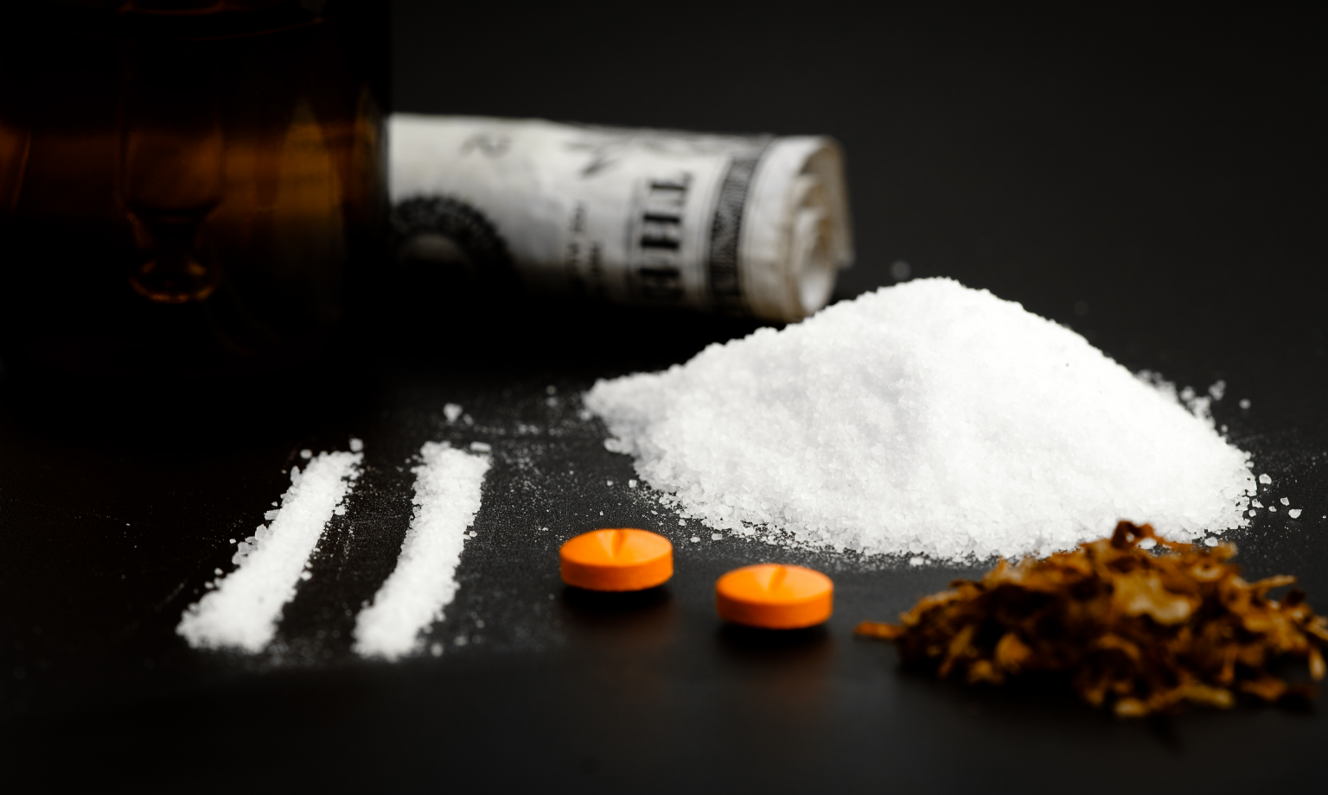
What is a drug?
Definitions
From Merriam-Webster:¹
“A substance other than food intended to affect the structure or function of the body”.
Drug Abuse (as defined by the DEA):² “When controlled substances are used in a manner or amount inconsistent with the legitimate medical use, it is called drug abuse”.
Drug. Merriam-Webster.com Dictionary. Merriam-Webster. Available from https://www.merriam-webster.com/dictionary/drug. Accessed May 9. 2022.
Drugs of Abuse. United States Drug Enforcement Administration. April 13, 2020. Available from: https://www.dea.gov/sites/default/files/2020-04/Drugs%20of%20Abuse%202020-Web%20Version-508%20compliant-4-24-20_0.pdf. Accessed on May 9, 2022.

Slide 5

“Drug abuse isn’t a big deal…”
Drug Overdose Facts
Drug overdose deaths per 100,000 population: 27.9 people each year.¹
    Majority were opioid overdose deaths at 20.8 per 100,000 people.¹
The age-adjusted rate of drug overdose deaths was higher in urban than in rural counties (22.0 and 20.0 per 100,000 people, respectively).²
Drug Overdoses. Centers for Disease Control and Prevention. Reviewed: January 24,2022. Available from https://www.cdc.gov/nchs/fastats/drug-overdoses.htm. Accessed on May 8, 2022.
Urban–rural Differences in Drug Overdose Death Rates, by Sex, Age, and Type of Drugs Involved, 2017. Centers for Disease Control and Prevention. Reviewed: Aug 2019. Available from https://www.cdc.gov/nchs/products/databriefs/db345.htm. Accessed May 8, 2022.

Slide 6
A look at vape…

Slide 7
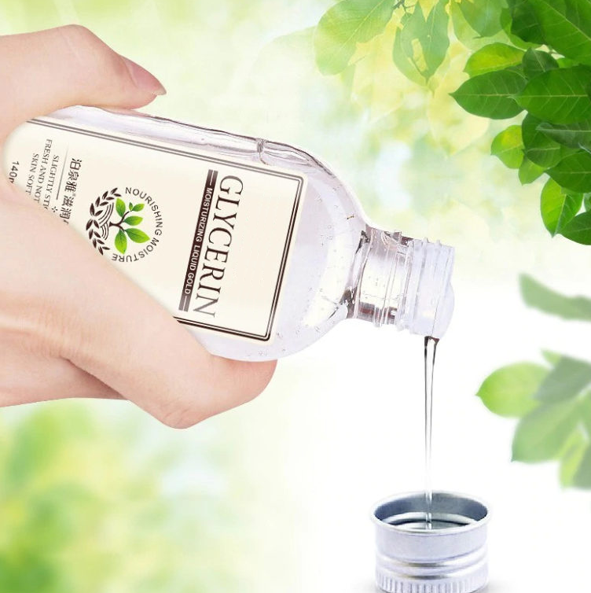
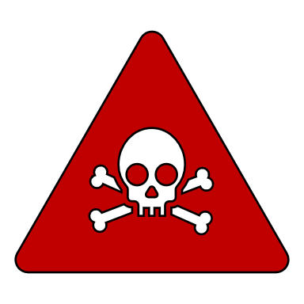
90% is VG and/or PG
What am I inhaling?
Substances such as vegetable glycerin (VG) and propylene glycol (PG) are consider safe in low concentrations for food, drinks, skin care, and even medications.
However, they create toxic pulmonary irritants and carcinogens when heated, including formaldehyde, acetaldehyde, and acrolein.¹
Cao DJ, Aldy K, Hsu S, et al. Review of Health Consequences of Electronic Cigarettes and the Outbreak of Electronic Cigarette, or Vaping, Product Use-Associated Lung Injury. J Med Toxicol. 2020;16(3):295-310. doi:10.1007/s13181-020-00772-w

Slide 8
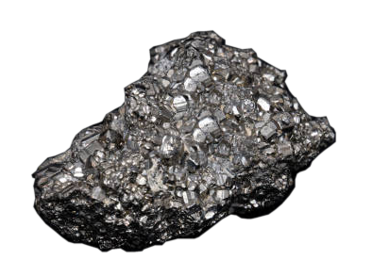
What’s really in vape juice?
What am I really inhaling?
Maybe not so harmless
after all? ¹
Propylene glycol
Nicotine
Contributes to addition and affects brain development.
In food, but also antifreeze, paint solvent, and artificial smoke in fog machines.
Diacetyl
Acrolein
Benzene
Causes bronchiolitis obliterans, also known as “popcorn lung”.
An herbicide used to kill weeds; Will damage lungs.
A volatile organic compound (VOC) found in car exhaust.
Diethylene glycol
Cadmium
A toxic chemical used in antifreeze that’s linked to lung disease.
A toxic metal found in regular cigarettes.
Heavy metals
Carcinogens
Heavy metals such as nickel, tin, lead.
Includes acetaldehyde and formaldehyde.
What's in an E-Cigarette? American Lung Association. Last update: July 13, 2020. Available from https://www.lung.org/quit-smoking/e-cigarettes-vaping/whats-in-an-e-cigarette. Accessed on May 9, 2022.

Slide 9
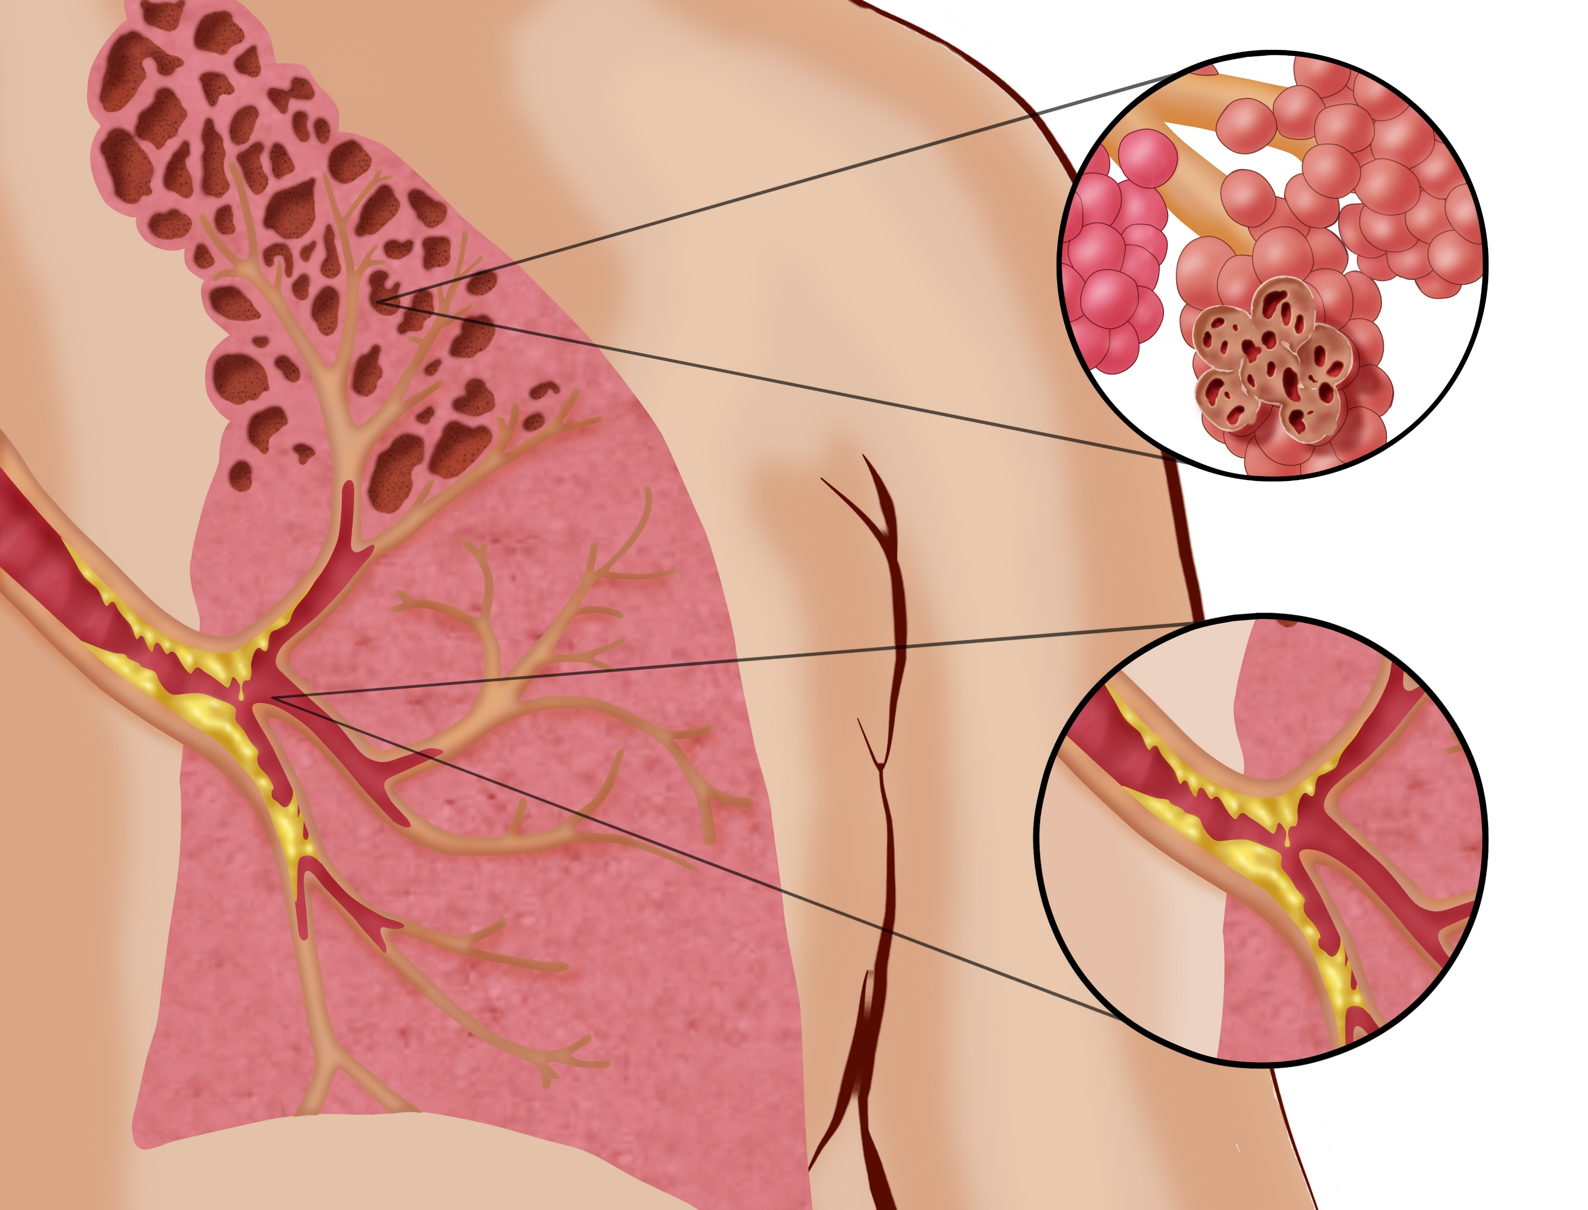
“Popcorn Lung”?
Bronchiolitis obliterans
Diacetyl (butanedione) is a chemical with an intense buttery flavor. Years ago, it was found to be a cause of bronchiolitis obliterans or “popcorn lung” in microwave popcorn workers who inhaled the airborne chemical.¹
The lungs’ smallest airways (bronchioles) become inflamed, narrow, and develop fibrosis. It is permanent.
Cao DJ, Aldy K, Hsu S, et al. Review of Health Consequences of Electronic Cigarettes and the Outbreak of Electronic Cigarette, or Vaping, Product Use-Associated Lung Injury. J Med Toxicol. 2020;16(3):295-310. doi:10.1007/s13181-020-00772-w

Slide 10
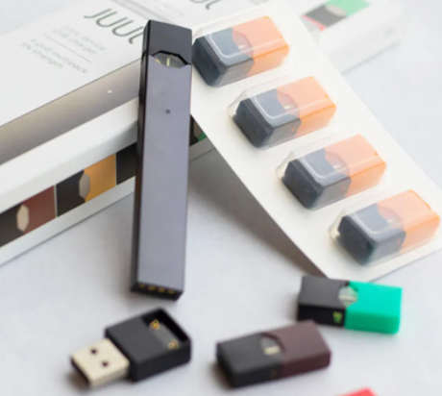
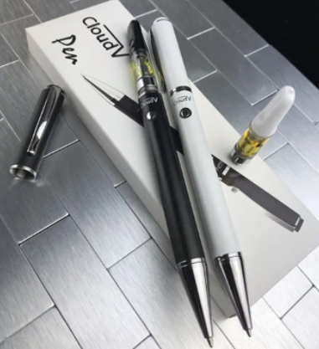
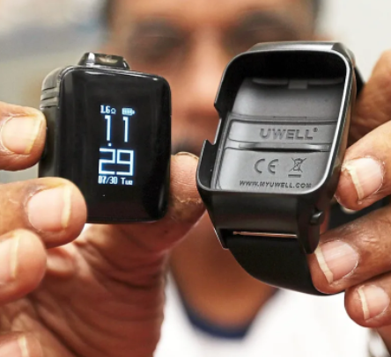
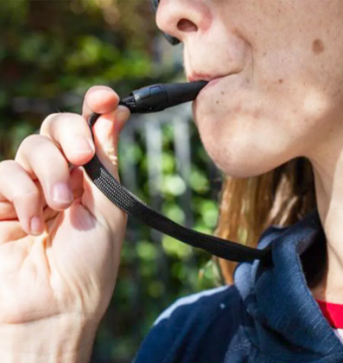
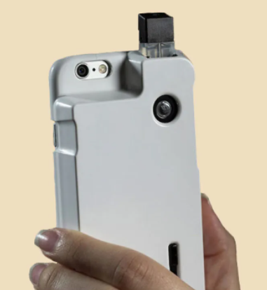
Stealth mode
Hiding vape use
Vaping is easier and easier to hide, thanks to good ol’ American ingenuity and overseas mass production. Some of the more common methods:
Vape pens (they do contain ink)
Vape hoodie straps
Vape USB drives
Vape “smart watches”
Vape phone covers

Slide 11
Aunt Mary, Bud, Dope, Ganja, Hash, Hydro, Kif, Marijuana, Pot, Reefer, Skunk, Yerba, Weed…
Cannabis

Slide 12
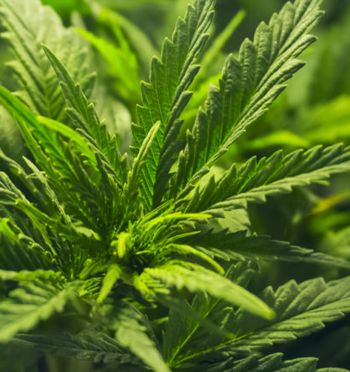
Phytocannabinoids
Cannabis
There are over 100 known phytocannabinoids. The most famous (and controversial) is tetrahydrocannabinol (THC), which is known for its psychotropic effects.¹
It wasn’t until the 1980s where we learned that THC binds to specific endocannabinoid receptors within the central and peripheral nervous system, affecting mood, sleep, appetite, memory, and reproduction.¹
Schilling S, Melzer R, McCabe PF. Cannabis sativa. Curr Biol. 2020;30(1):R8-R9. doi:10.1016/j.cub.2019.10.039

Slide 13
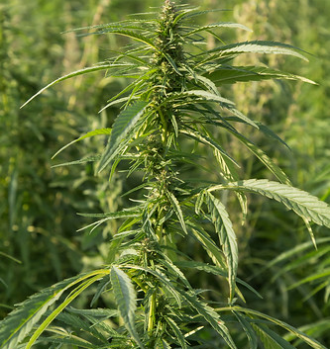
Cannabidiol (CBD)
Cannabis
Often confused with THC, cannabidiol (CBD) is another cannabinoid found in both hemp and marijuana, but it has no psychotropic effects.¹ Hemp is cultivated for its CBD and fiber.²
Medically, it may offer analgesic (pain relieving), anti-inflammatory, anti-epileptic (seizure) control, and is being researched for its possibility in preventing certain cancers.¹
Cannabidiol. NCI Thesaurus - National Cancer Institute. Available from https://ncithesaurus.nci.nih.gov/ncitbrowser/ConceptReport.jsp?dictionary=NCI_Thesaurus&ns=ncit&code=C118452. Accessed on May 10, 2022.
Schilling S, Melzer R, McCabe PF. Cannabis sativa. Curr Biol. 2020;30(1):R8-R9. doi:10.1016/j.cub.2019.10.039

Slide 14
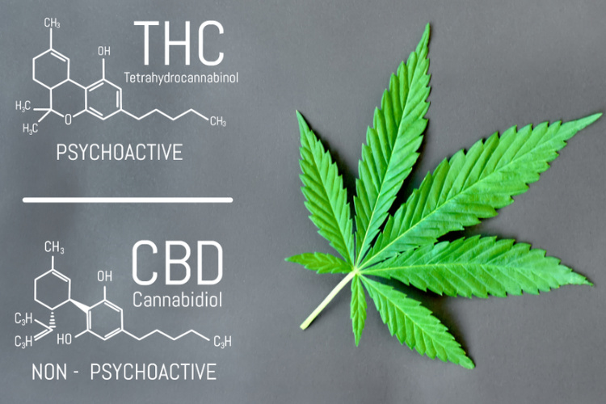
Marijuana versus hemp:
Differences
Marijuana:
THC is the main cannabinoid (this has psychotropic effects);¹
THC levels can reach up to 20 to 30% of the dry female flower mass. ¹
Hemp:
CBD is main cannabinoid (no psychotropic effect).¹
THC content must be minimal: 0.3% or less of the dried flower mass.¹
Plant cannot have any hallucinogenic effects.¹
Schilling S, Melzer R, McCabe PF. Cannabis sativa. Curr Biol. 2020;30(1):R8-R9. doi:10.1016/j.cub.2019.10.039

Slide 15
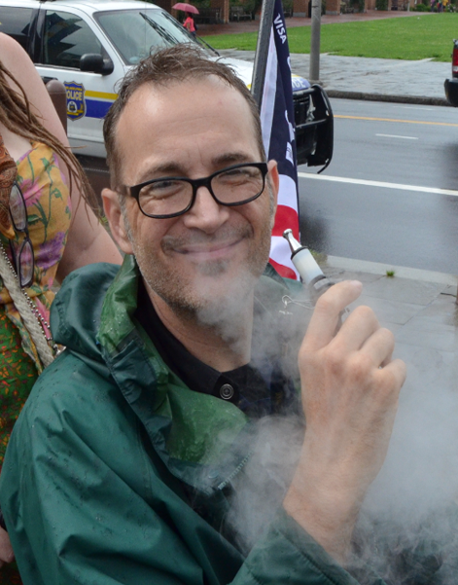
The goal of marijuana use:
THC Effects
The person who consumes or smokes marijuana usually experiences some of the following:
The Expectations
Euphoria and sense of relaxation;
Heightened sensory perception (e.g., brighter colors);
Laughter/overly happy;
Altered perception of time;
Increased appetite/decreased nausea.

Slide 16

The signs and symptoms of an overdose:
THC Effects
Overdose is uncommon with light smoking of “regular weed”. However, concentrated forms and edibles do contribute to overdose.¹
Fear, depression, or paranoia
Elevated heart rate
Postural hypotension
CNS depression
Motor control problems
Cyclic vomiting
Respiratory depression
Turner AR, Spurling BC, Agrawal S. Marijuana Toxicity. [Updated 2021 Aug 2]. In: StatPearls [Internet]. Treasure Island (FL): StatPearls Publishing; 2022 Jan-. Available from: https://www.ncbi.nlm.nih.gov/books/NBK430823/

Slide 17
Budder, Honey Oil, Wax, Dab, 710, Butane Hash Oil, Errl, Shatter
Concentrated THC

Slide 18
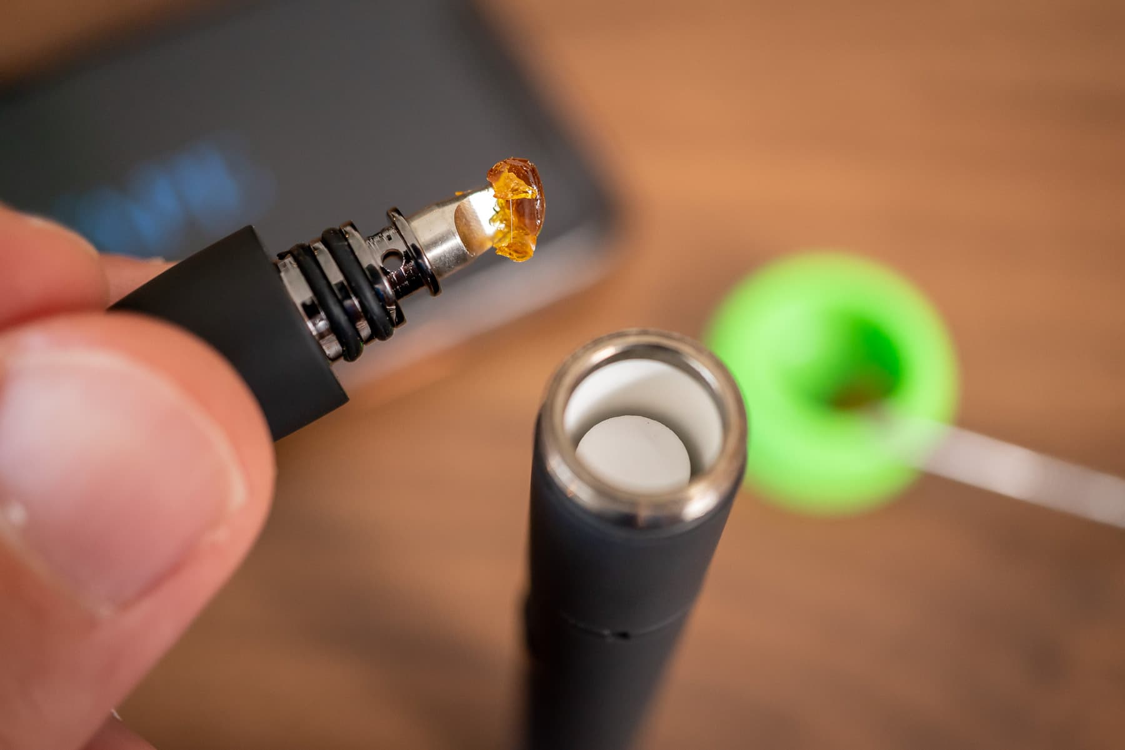
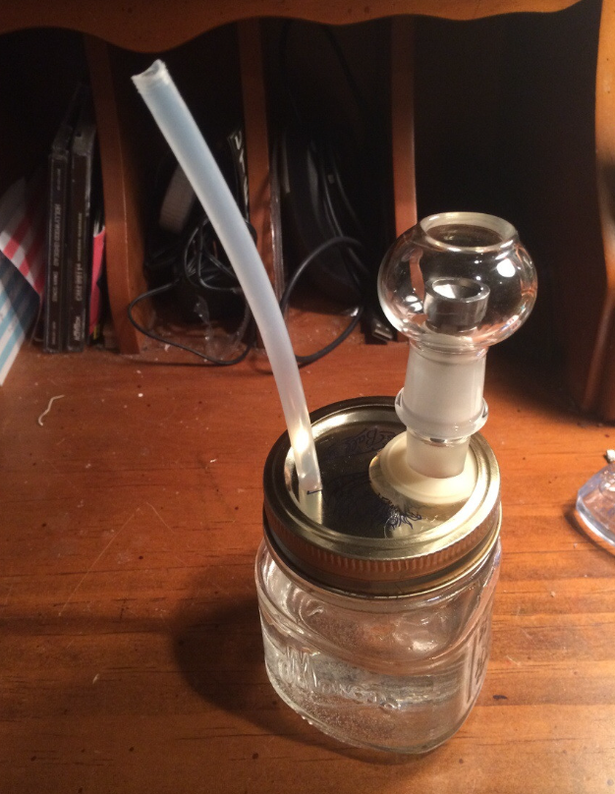
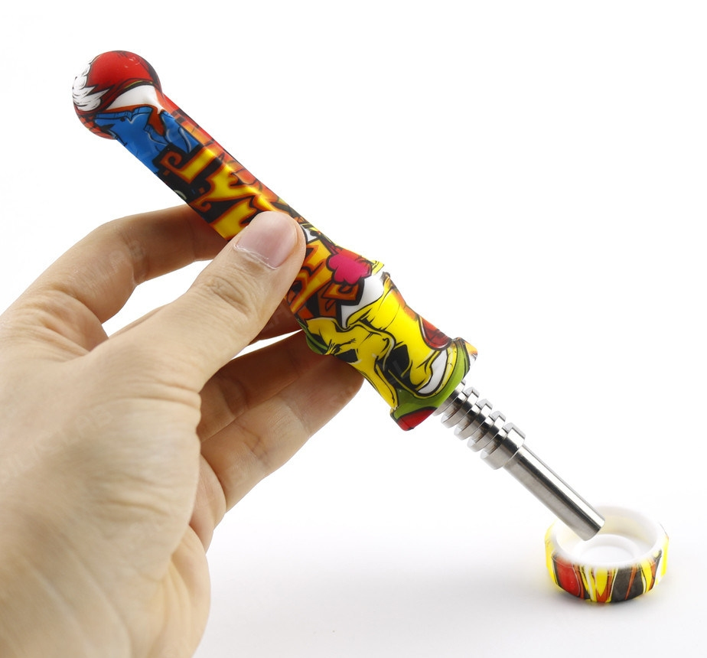
Seen these devices?
Concentrated THC
Marijuana concentrates can be mixed with various food or drink, but smoking or vaporizing remains the most popular route.¹
Drugs of Abuse. United States Drug Enforcement Administration. April 13, 2020. Available from https://www.dea.gov/sites/default/files/2020-04/Drugs%20of%20Abuse%202020-Web%20Version-508%20compliant-4-24-20_0.pdf. Accessed on May 9, 2022.

Slide 19
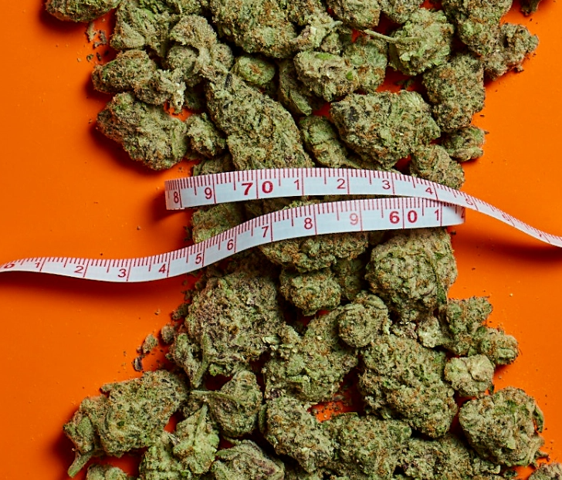
Delta-8 THC
Another THC: Delta-8
Delta-9 tetrahydrocannabinol is the “THC” we think of with marijuana. This is the compound that causes the psychotropic effect.
Delta-8 tetrahydrocannabinol (delta-8 THC) is an analogue to delta-9. It has psychotropic effects as well, but just not as potent as delta-9 THC. It’s sometimes call “diet weed” or “marijuana lite”.

Slide 20
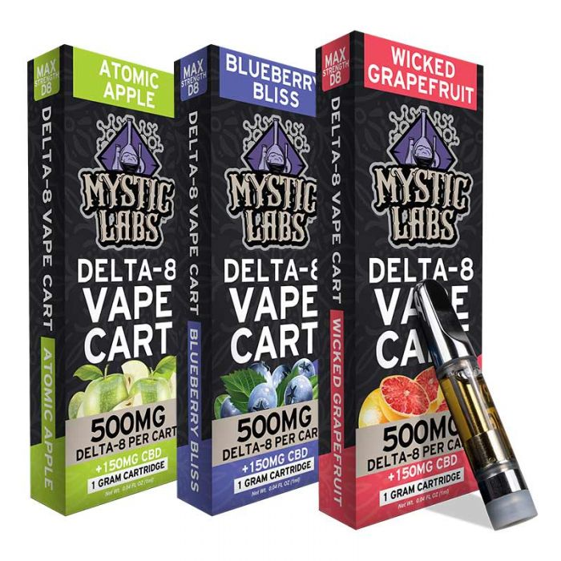
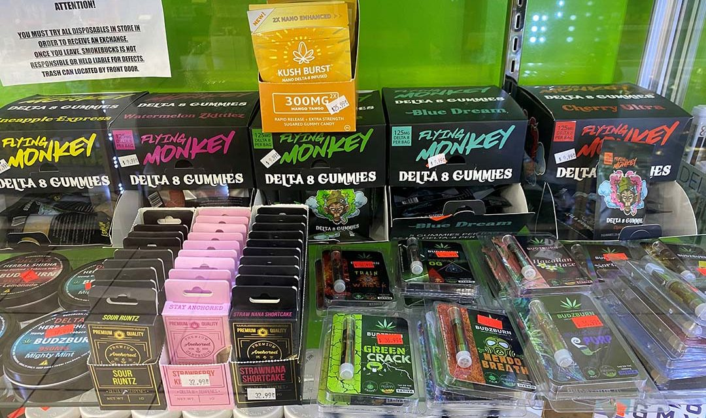
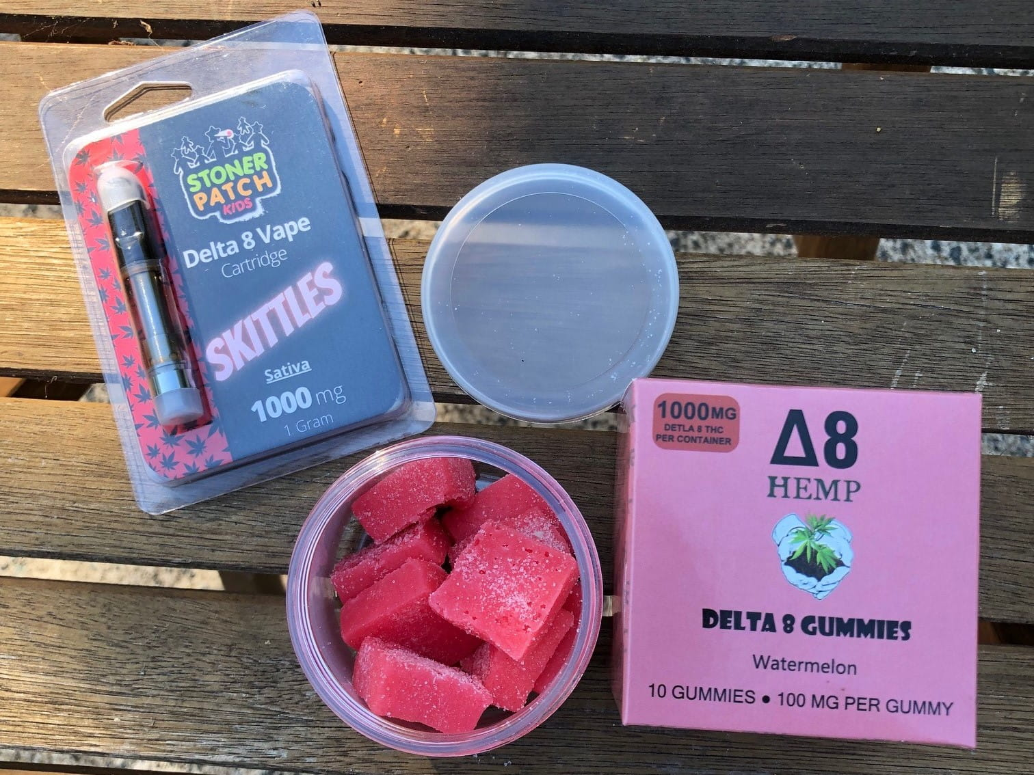
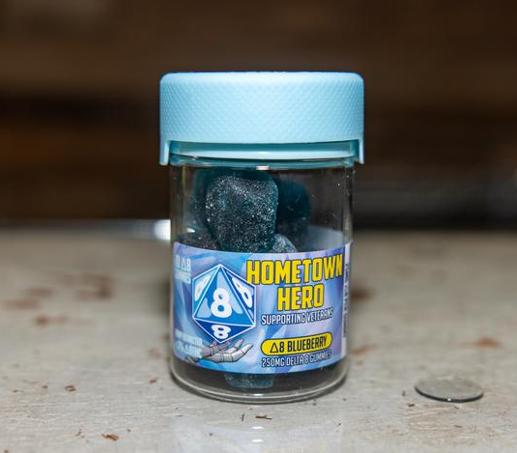
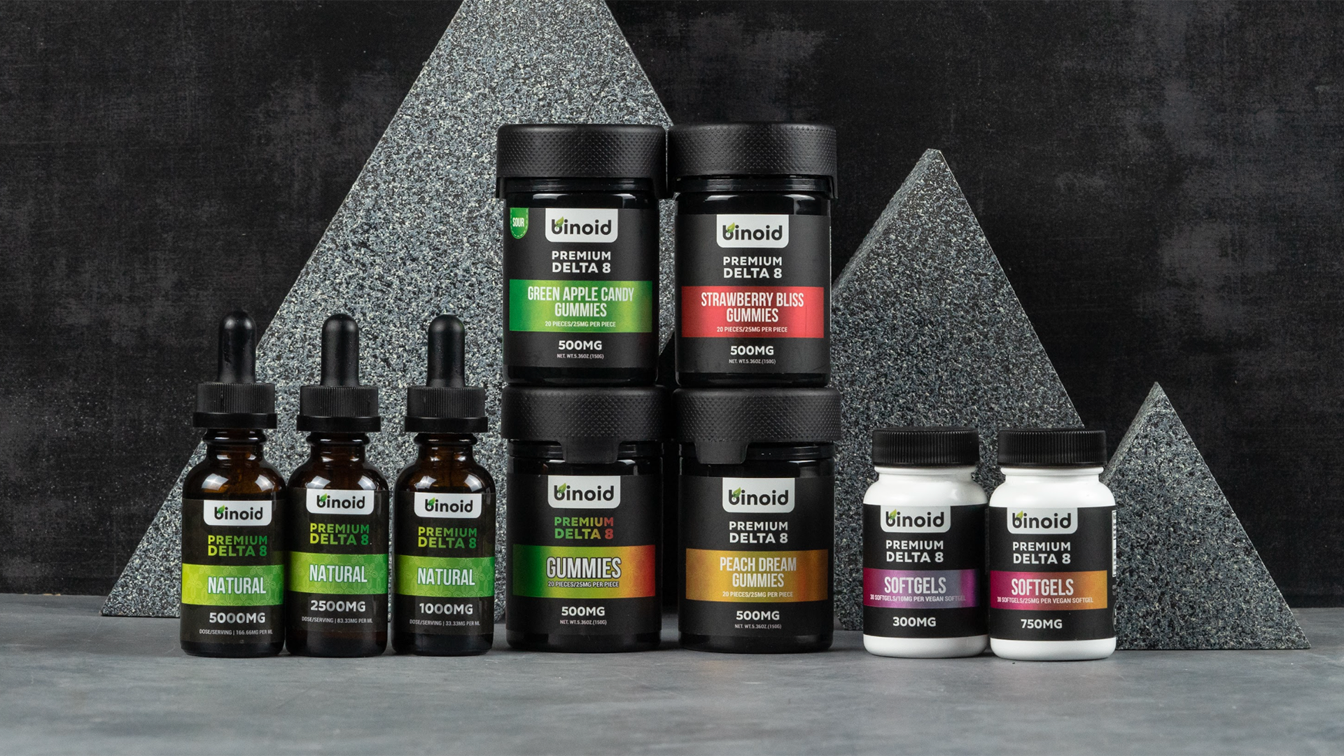
A few examples of delta-8 products:
Munchies anyone?

Slide 21
Amphetamines, Cocaine, Crack, Crank, Crystal, Ice, Khat, Meth, Speed, Trash, Tweak…
Stimulants

Slide 22
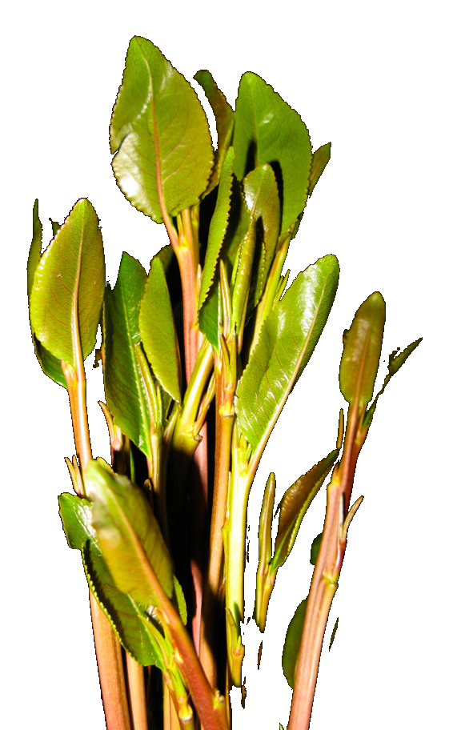
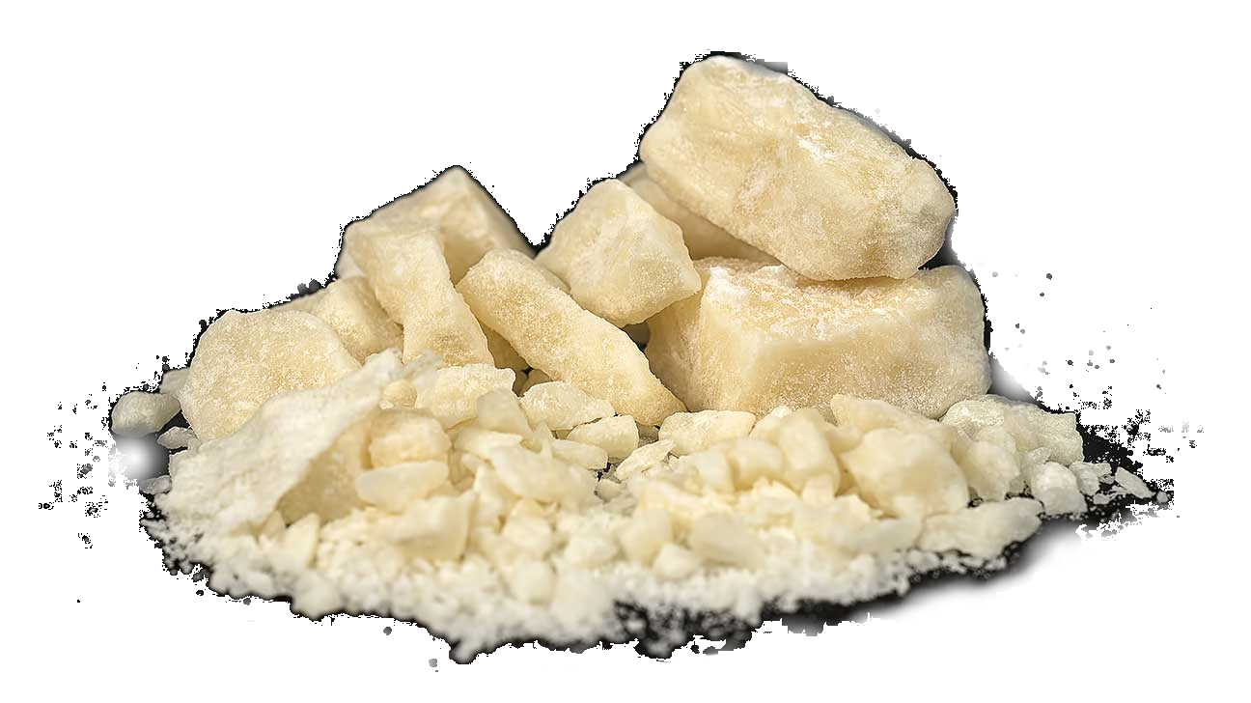
Stimulants in general
Definitions
Stimulants include both physician prescribed medications (amphetamines) and illegal drugs (diverted amphetamines, methamphetamine, khat, and crack/cocaine).
Khat, a native plant primarily found in Africa and the Middle East.
Crack. Made everywhere.

Slide 23
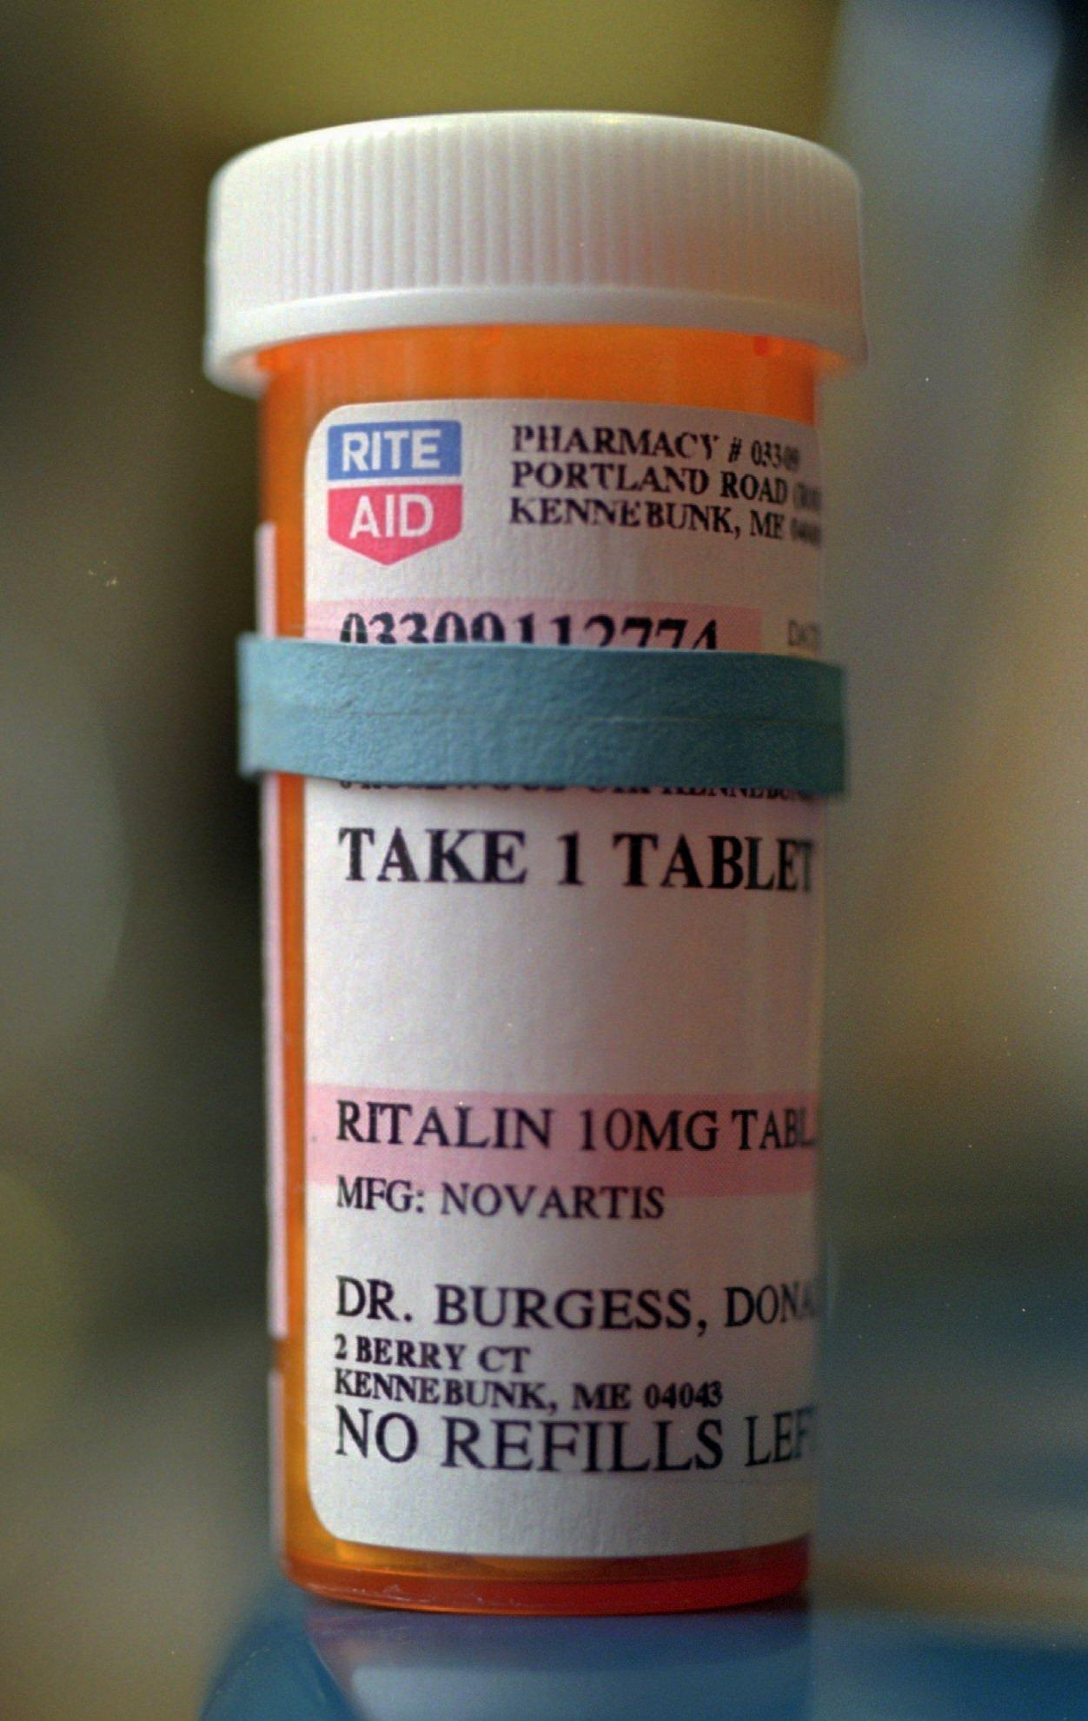
Stimulants in general
Stimulants
Stimulants may be prescribed to children at a young age (usually over six years old) to help treat attention deficit hyperactivity disorder (ADHD) or narcolepsy if behavior therapy alone is not effective.
Early treatment may improve symptoms, performance in school, and social interactions at home and school.^{1,2}
Methylphenidate (Ritalin®): A stimulant that may be prescribed to children for ADHD.
Harstad E, Shults J, Barbaresi W, et al. α2-Adrenergic Agonists or Stimulants for Preschool-Age Children With Attention-Deficit/Hyperactivity Disorder [published correction appears in JAMA. 2021 Oct 12;326(14):1440]. JAMA. 2021;325(20):2067-2075. doi:10.1001/jama.2021.6118
Mechler K, Banaschewski T, Hohmann S, Häge A. Evidence-based pharmacological treatment options for ADHD in children and adolescents. Pharmacol Ther. 2022;230:107940. doi:10.1016/j.pharmthera.2021.107940

Slide 24
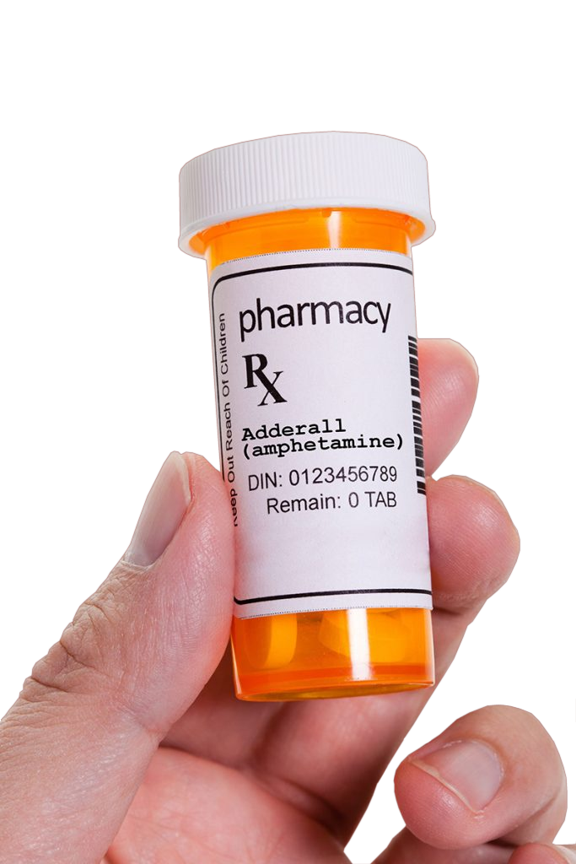
Amphetamines
Prescription amphetamines
ADHD is a neurodevelopmental disorder with an average onset at about six years of age. About one-third of affected children will carry the disorder into adulthood.¹
Amphetamines improve the availability of synaptic dopamine. In children, this may produce a paradoxical relaxing effect. However, adults may react differently to this medication, especially if abused.
Baird D, Hoffman A. Use of Amphetamines for Attention Deficit/Hyperactivity Disorder in Adults. Am Fam Physician. 2019;100(5):278-279.

Slide 25
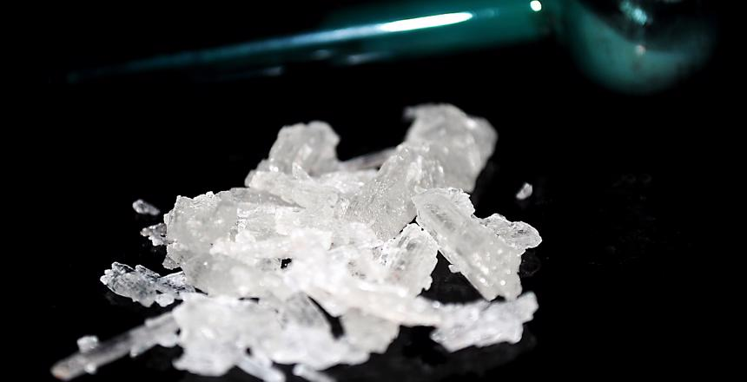
Methamphetamine
What is meth?
What’s the difference between amphetamine and methamphetamine?
Methamphetamine (METH) is very closely related to amphetamine. However, it has a more prolonged effect on dopamine availability and affects other neural receptors.
METH sends the sympathetic “flight or fight” response into overdrive, which can lead to life-threatening problems.

Slide 26
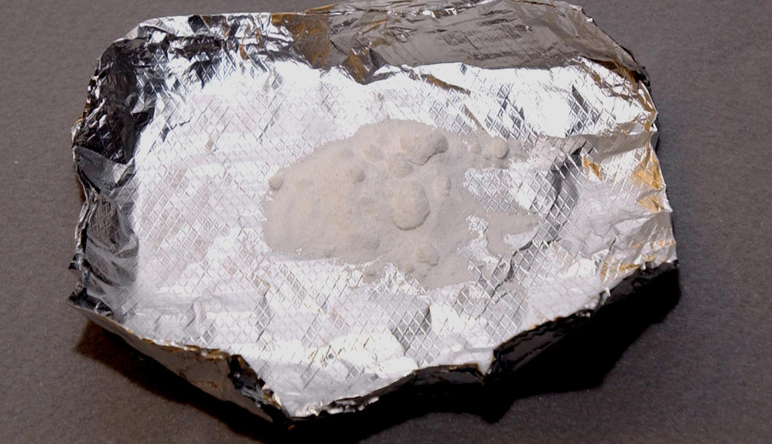
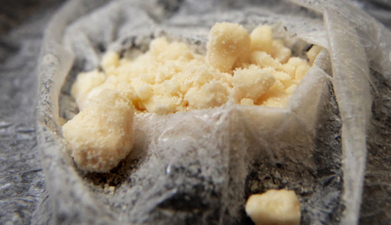
Types of methamphetamines:
Meth in its different forms
Methamphetamines can be made into several different forms:
Common form | Description | Example image
Powdered. Also known as “speed” | Least potent. Usually a white powder (may discolor depending on solvent used) that is usually snorted, injected, or swallowed.
Base | Yellowish or brownish paste-like substance that can be vaped, injected, or swallowed. More potent than powdered form.
Crystal / Ice | Highest potency methamphetamine. Translucent to white crystal appears that’s usually smoked or injected.

Slide 27
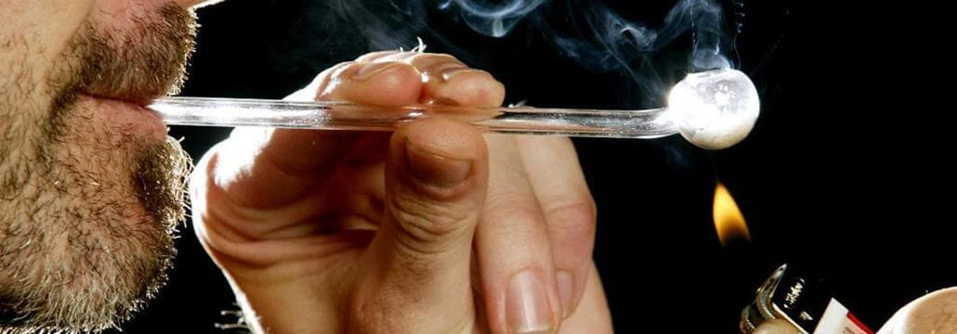
What is crack?
Crack versus cocaine
“Crack” is cocaine powder that’s mixed with a base, then boiled to remove the hydrochloride salt. This creates a more concentrated form of the drug that is suitable for smoking.
It’s called “crack” because of the crackling sound it makes when heated in a pipe or other device.

Slide 28
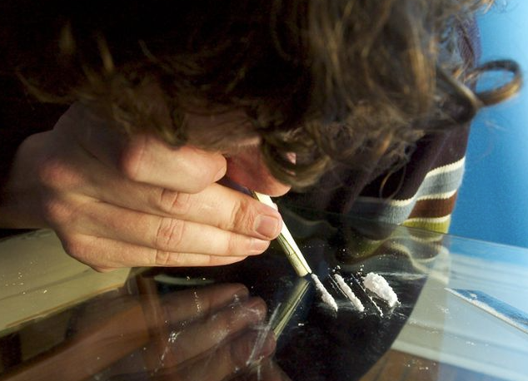
Cocaine and crack
Definitions
Powdered cocaine can be snorted or injected into the veins after dissolving in water. Cocaine may also be combined with an opiate like heroin or morphine. This is known as “speedballing” ¹ and is used to balance the effects of each drug.
Crack may be smoked either alone or top dressed on marijuana or tobacco.
Drugs of Abuse. United States Drug Enforcement Administration. April 13, 2020. Available from https://www.dea.gov/sites/default/files/2020-04/Drugs%20of%20Abuse%202020-Web%20Version-508%20compliant-4-24-20_0.pdf. Accessed on May 9, 2022.

Slide 29
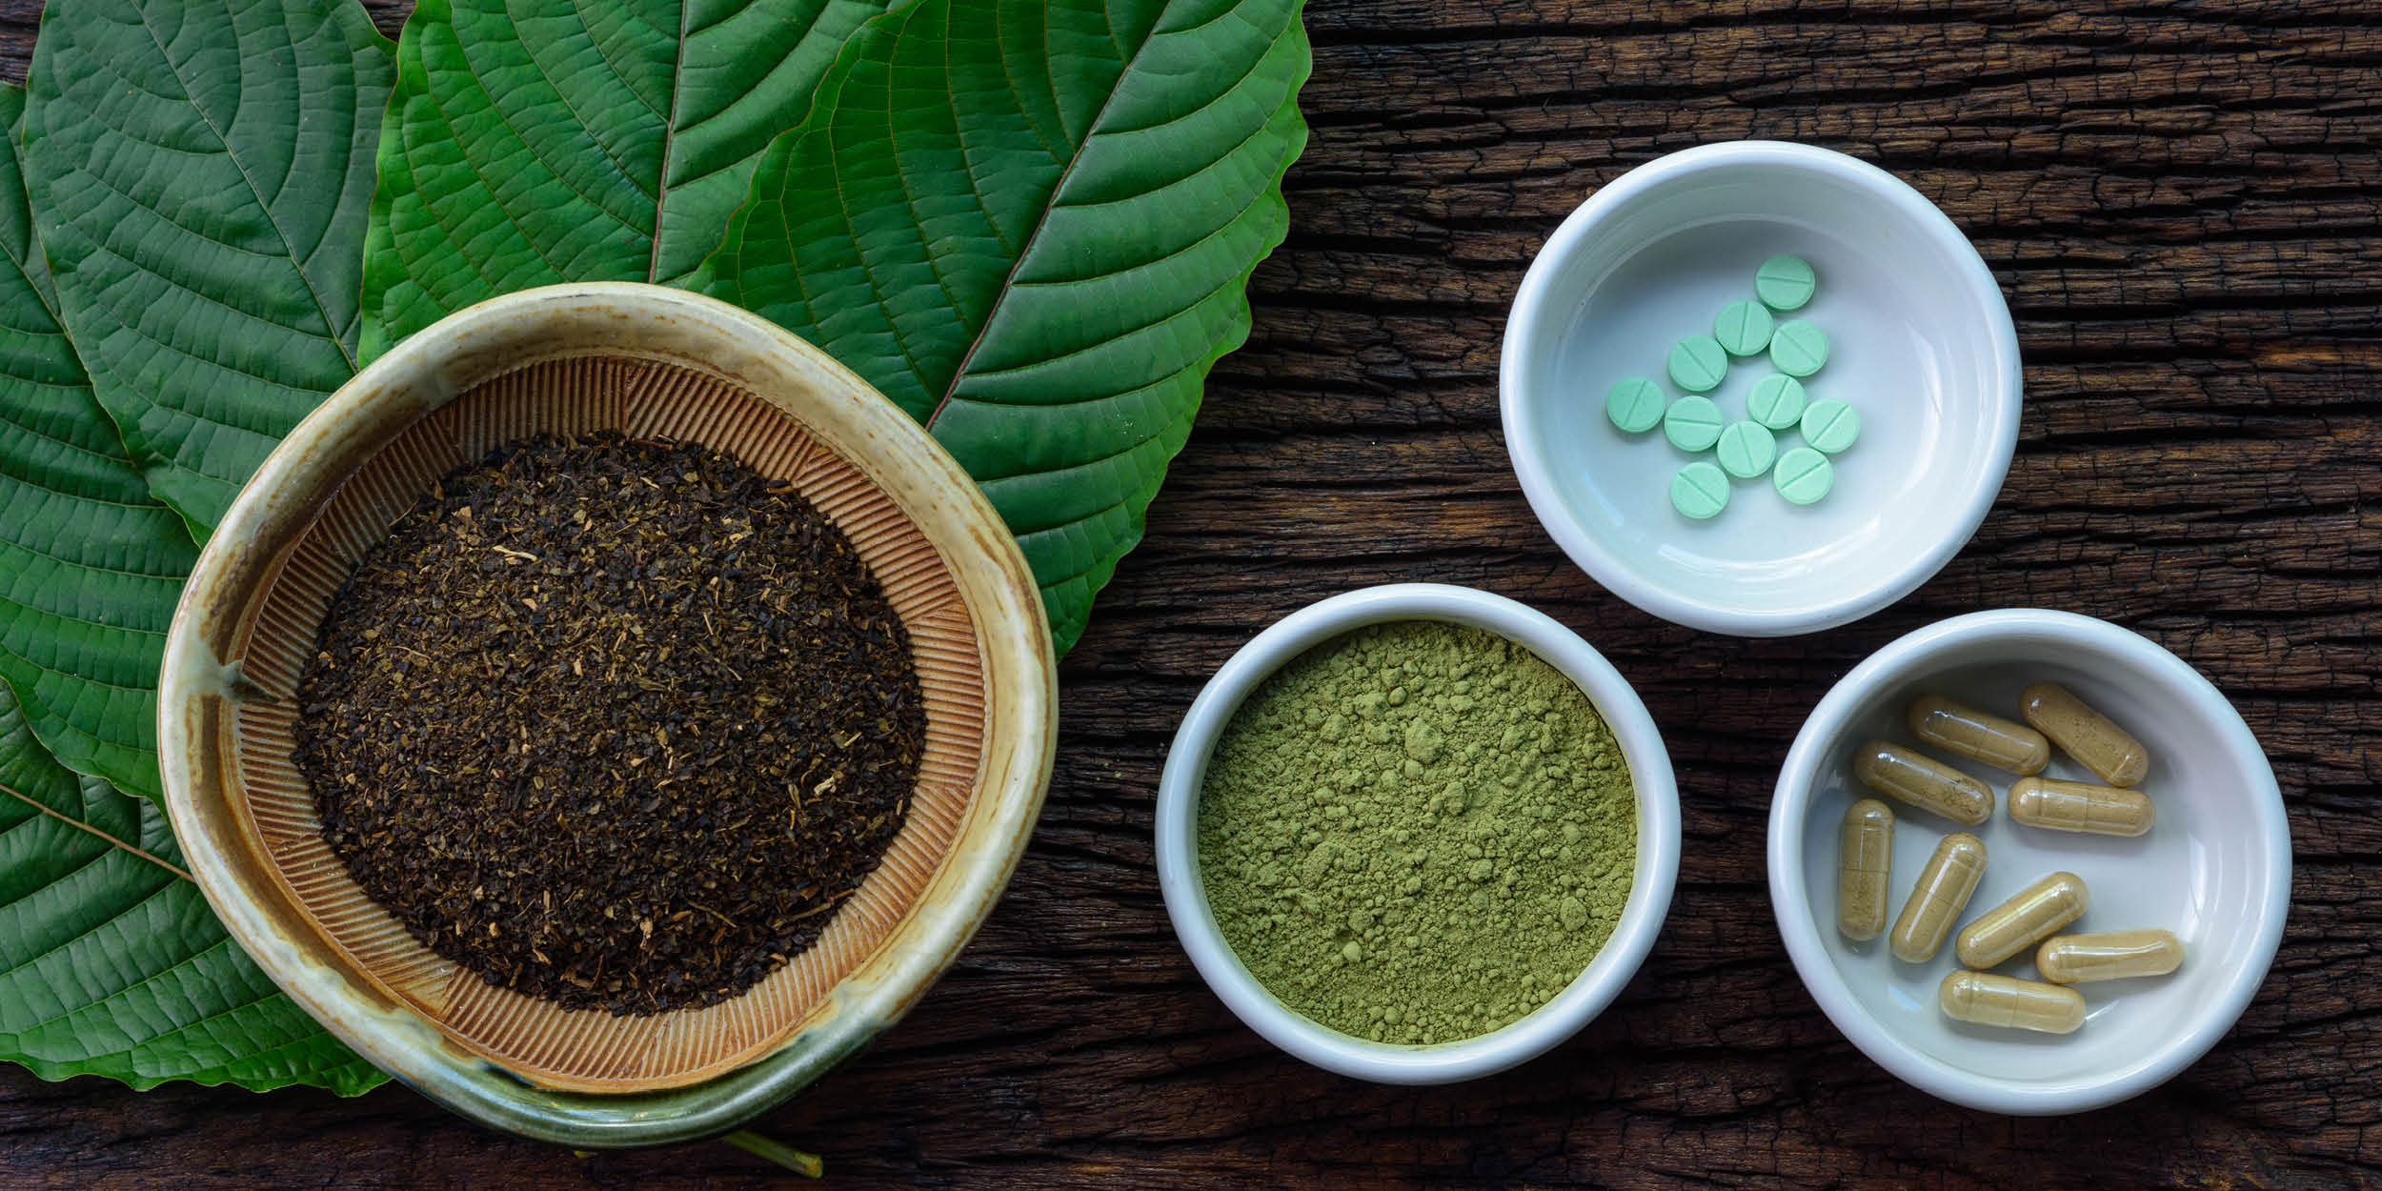
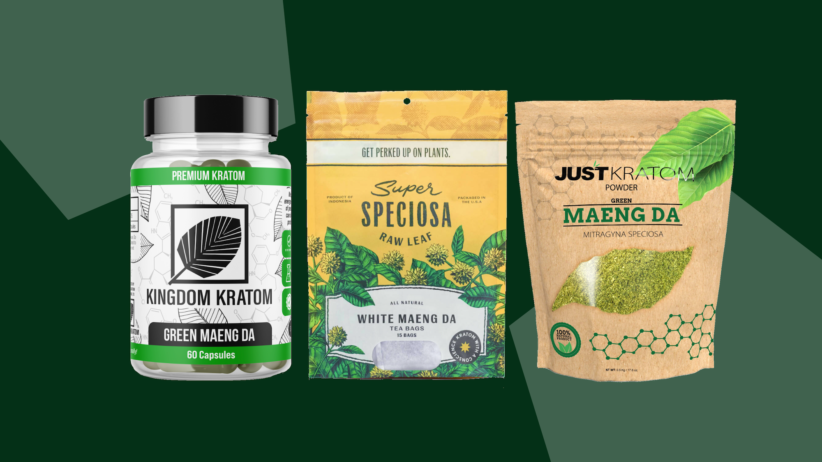
Kratom (Thang, Thom)
Kratom
Mixed effects:
Low doses – Stimulant effect
High doses – Sedative effect
Plant has 2 major psychoactive ingredients
Consumed – Crushed and smoked, made into tea or placed in oral gel capsules
Kratom, Native to Southeast Asia.

Slide 30
Stimulant overdose
Too much of a bad thing
Stimulants are easily overdosed, causing life-threatening signs and symptoms in both adults and children. Some of the more common ones are listed below:
Stimulant Overdose Signs and Symptoms
Tachycardia (rapid heart rate) and hypertension (high blood pressure)
Tachypnea (rapid respiratory rate) and labored breathing
Hyperthermia (high body temperature), excessive sweating, flushed skin
Dilated pupils, dry mucous membranes
Seizures, confusion, paranoia, agitation, and/or hallucinations
Hemorrhage stroke: Cerebral blood flow can increase up to 30% with amphetamine abuse¹
Acute myocardial infarction (“heart attack”) from coronary artery spasms
Vasan S, Olango GJ. Amphetamine Toxicity. [Updated 2021 Jul 10]. In: StatPearls [Internet]. Treasure Island (FL): StatPearls Publishing; 2022 Jan-. Available from: https://www.ncbi.nlm.nih.gov/books/NBK470276/. Accessed May 14, 2022.

Slide 31
Big H, Carfentanil, Fentanyl, Heroin, Horse, Junk, OC, Oxy, Purple Drank, Smack…
Opioids

Slide 32
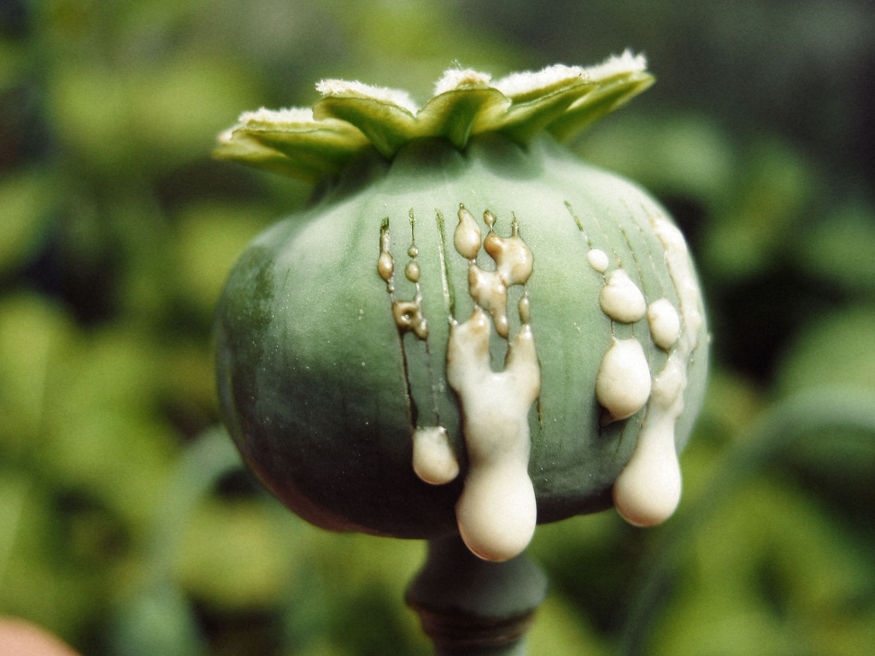
What is an opioid?
Definitions
Opioids include naturally-occurring drugs like morphine and synthetic or semi-synthetic drugs such as fentanyl and hydrocodone.
When used correctly in a medical setting, they relieve severe pain. Contrary to rumors, initial doses in the ambulance or hospital will not lead to dependance in most people.
The opioid-ladened liquid latex of the opium poppy.

Slide 33

The problem with abusing opioids
Hypoxia is deadly
Stimulants are “uppers”. In comparison, opioids are “sleepers”. The biggest problem with these drugs is the effect on the person’s respiratory drive: Opioids depress it.
Overdose? The person stops breathing.
A sleepy puppy is good. An opioid OD is not.

Slide 34
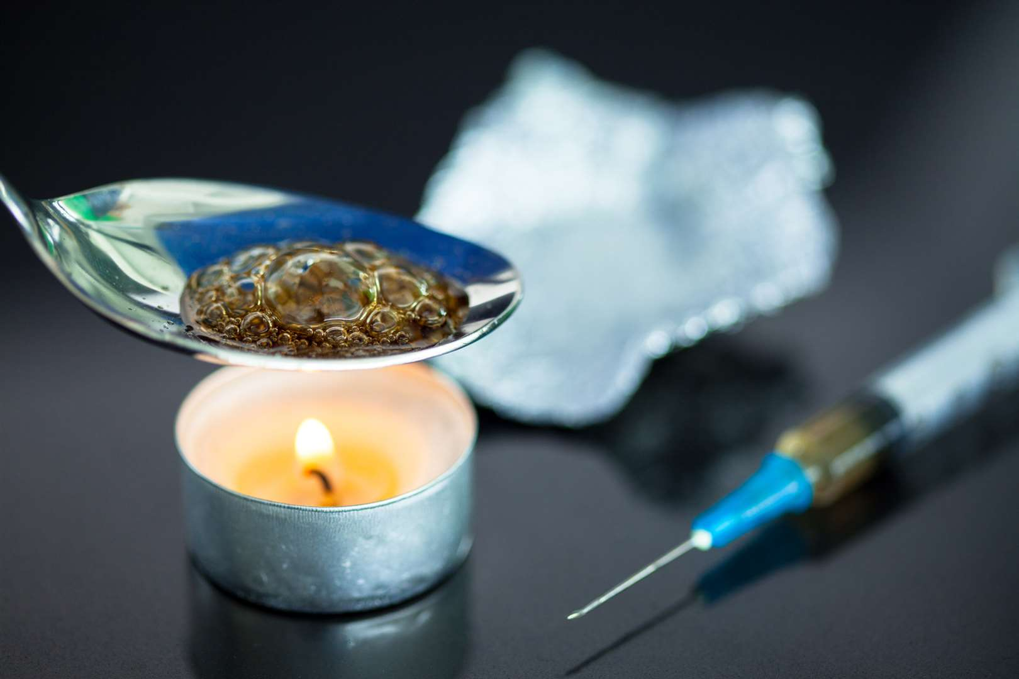
What’s on the street?
Different opioids out there
Carfentanil is “elephant fentanyl” used in veterinary medicine. Fentanyl and morphine are used in human medicine to treat pain.
Heroin has no medical benefit. However, it is extremely addictive… all it takes is one dose and you’re hooked.
Heroin melted for IV injection

Slide 35

Fake oxycodone (Percocet® and OxyContin®)
Fake oxycodone
We’re also seeing deaths from fake oxycodone (fake Percocet® and OxyContin®). Oxycodone is a milder opioid people take for chronic pain or for others, after a weekend of hard partying.
But the crackdown on its availability as a prescription or street drug opened up a new market: Fake oxycodone.

Slide 36
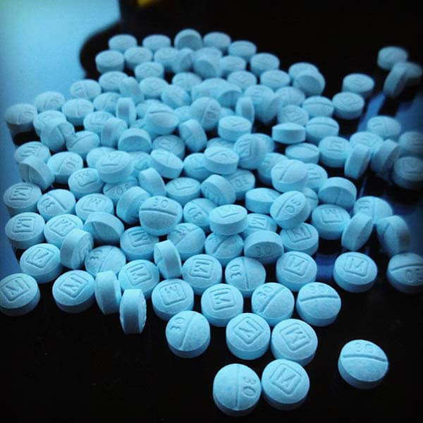
Fake oxycodone (Percocet® and OxyContin®)
Fake and deadly
Fake oxycodone is called “M-30” or “Blues”. The M-30 comes from the real oxycodone’s stamp on the pill.
The “M-30”s on the street are usually smuggled in from cartel-controlled labs in Mexico and may be made with cheap fentanyl… with poor dosing control.
It’s difficult to tell the difference between a real oxycodone pill and a fake M-30.

Slide 37
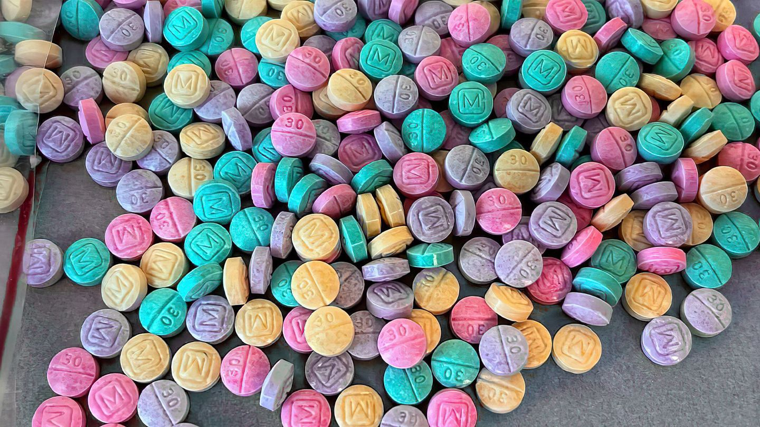
Fake oxycodone (Percocet® and OxyContin®)
Fake and deadly

Slide 38

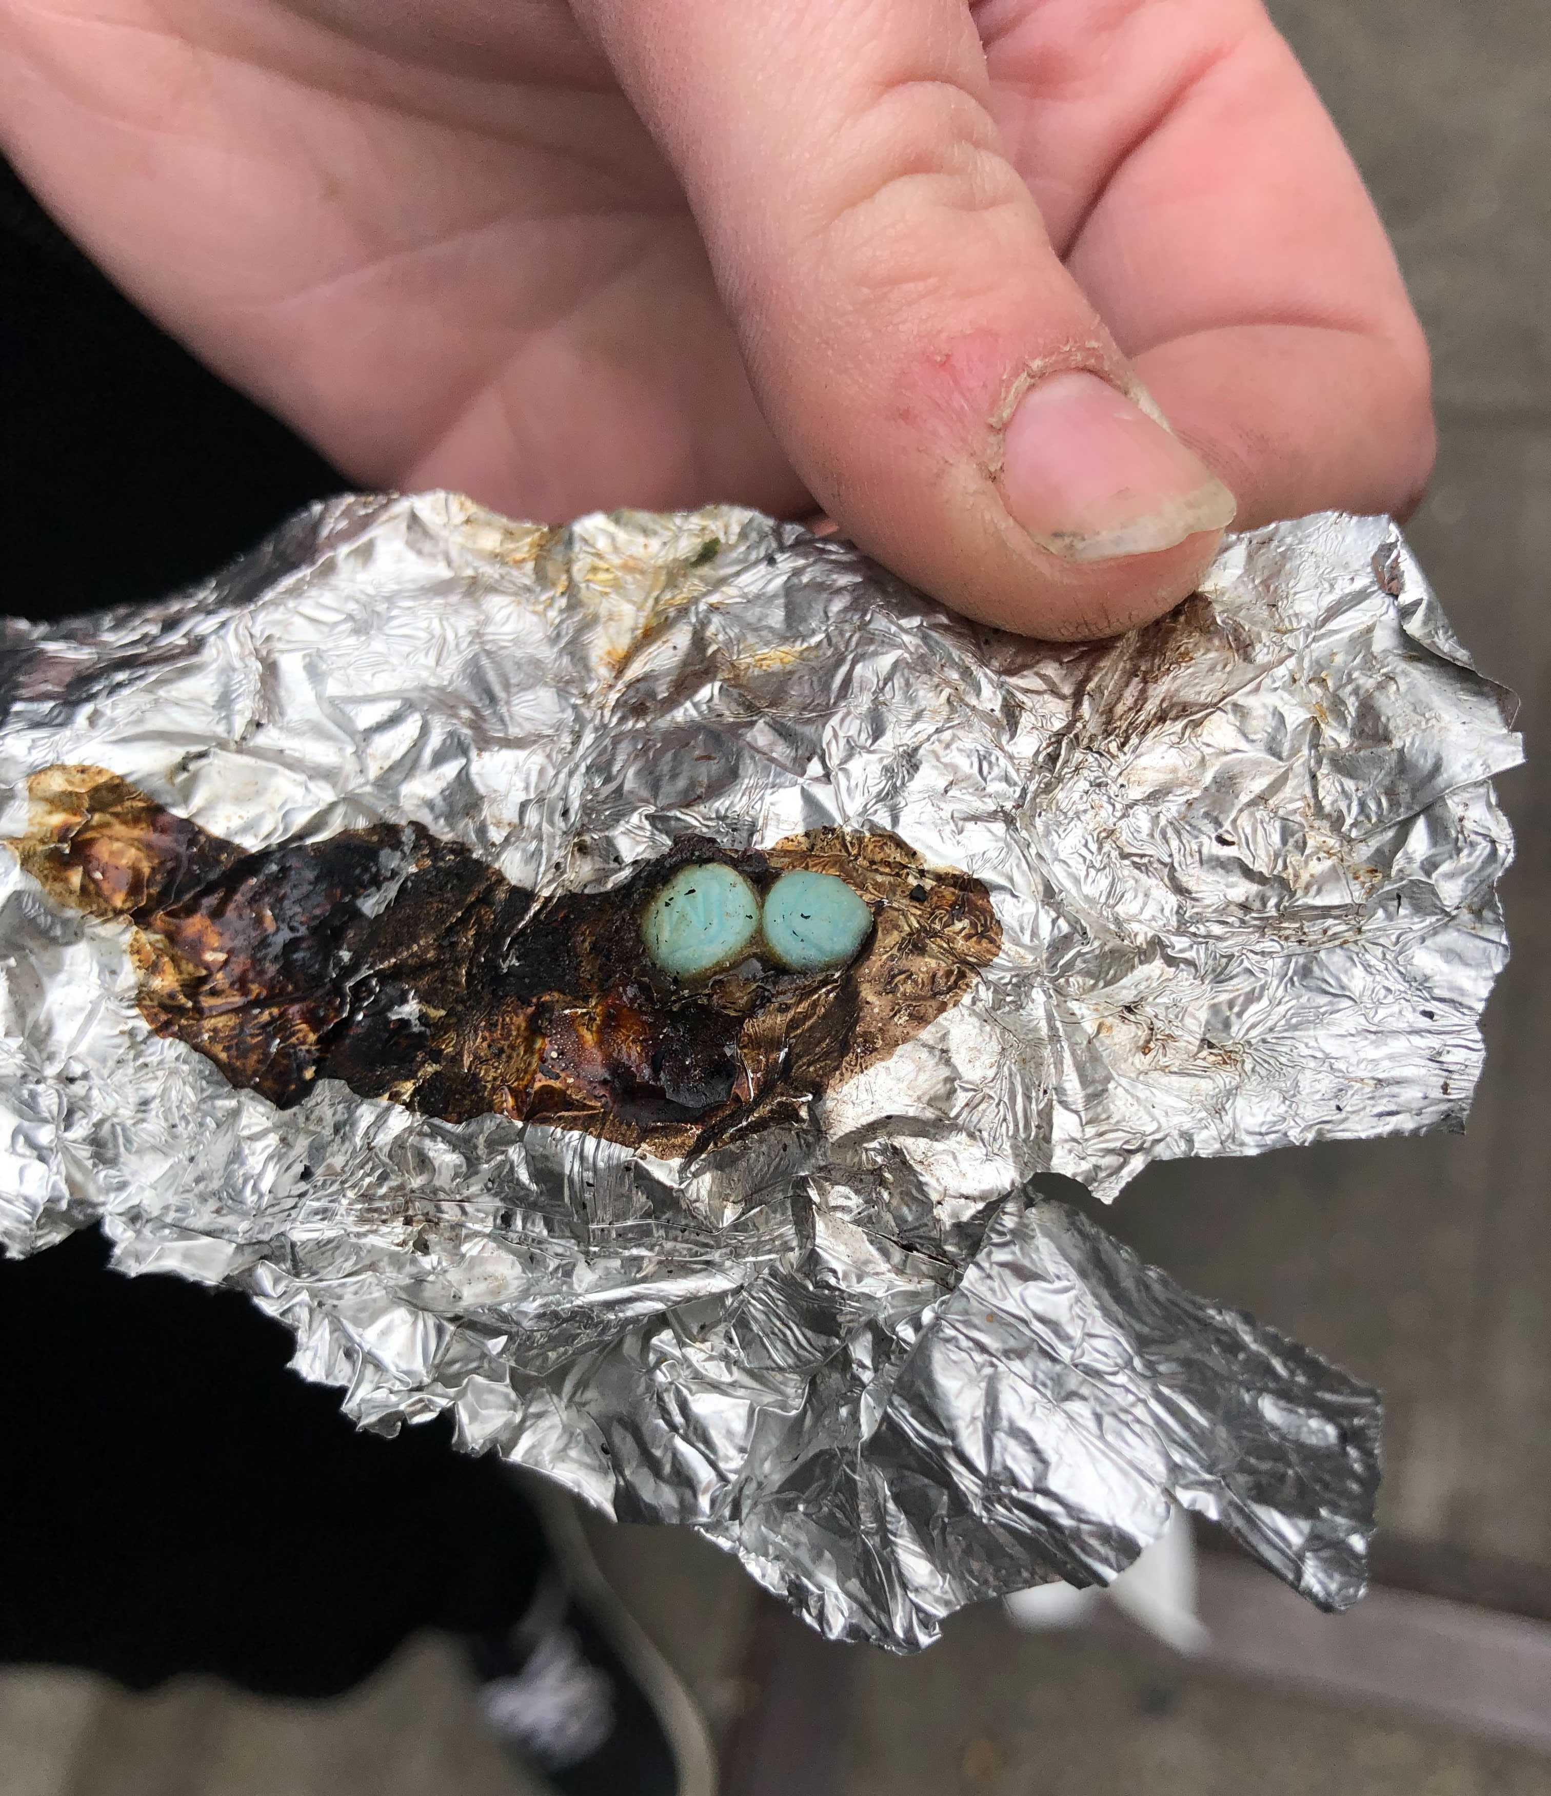
M-30s
It’s local and multipurpose
The M-30s can be taken as pills or melted.
In the melted form, they are licked, vaped, or injected into a vein. The vaped method may include a mix with other compounds such as THC.
An M-30 obtained from Lubbock this year.
Photo courtesy of Lubbock Police Department.

Slide 39
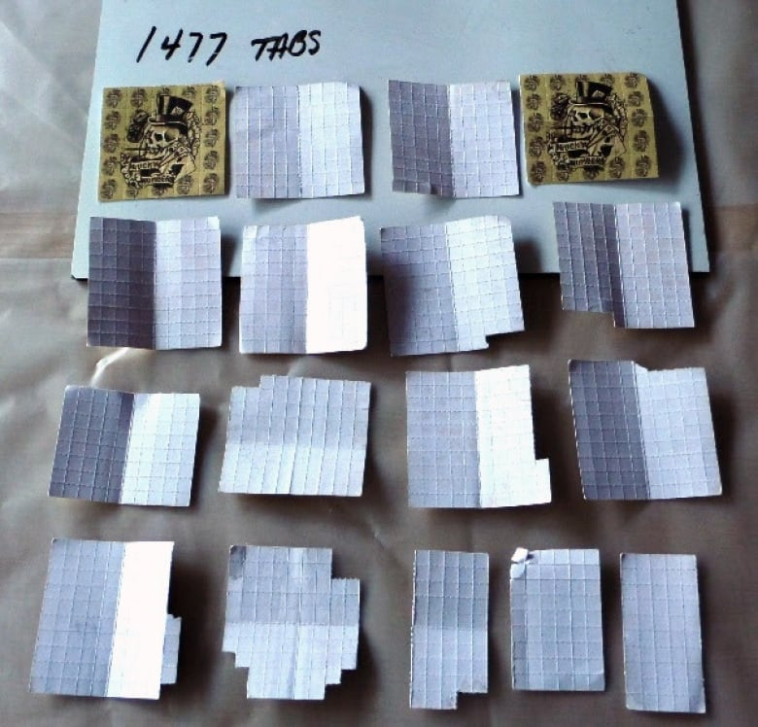
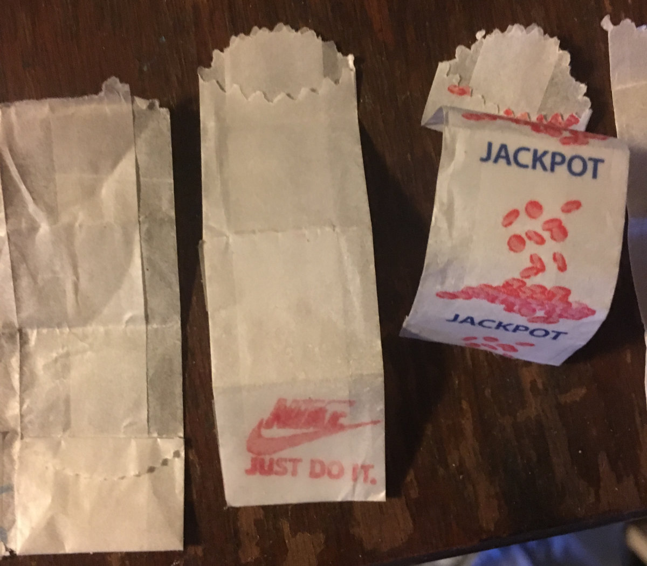
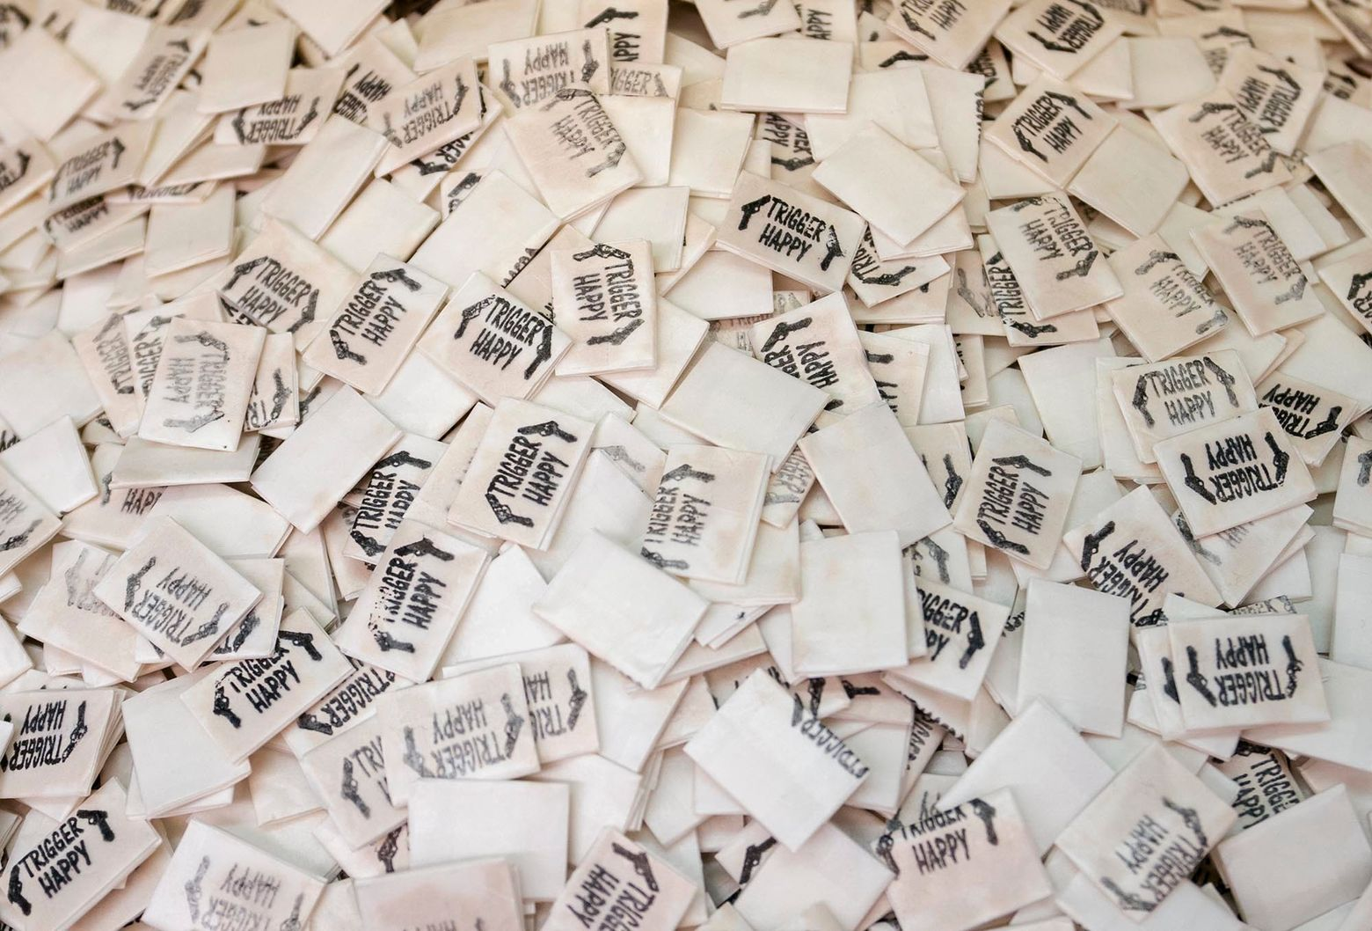
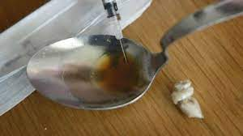
Liquid Fentanyl
Liquid Fentanyl

Slide 40
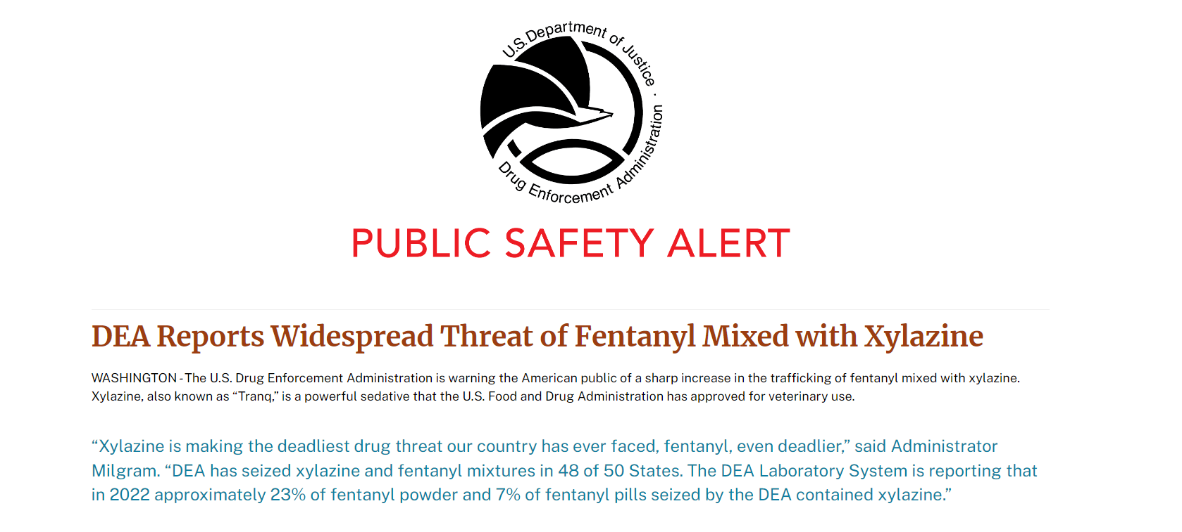
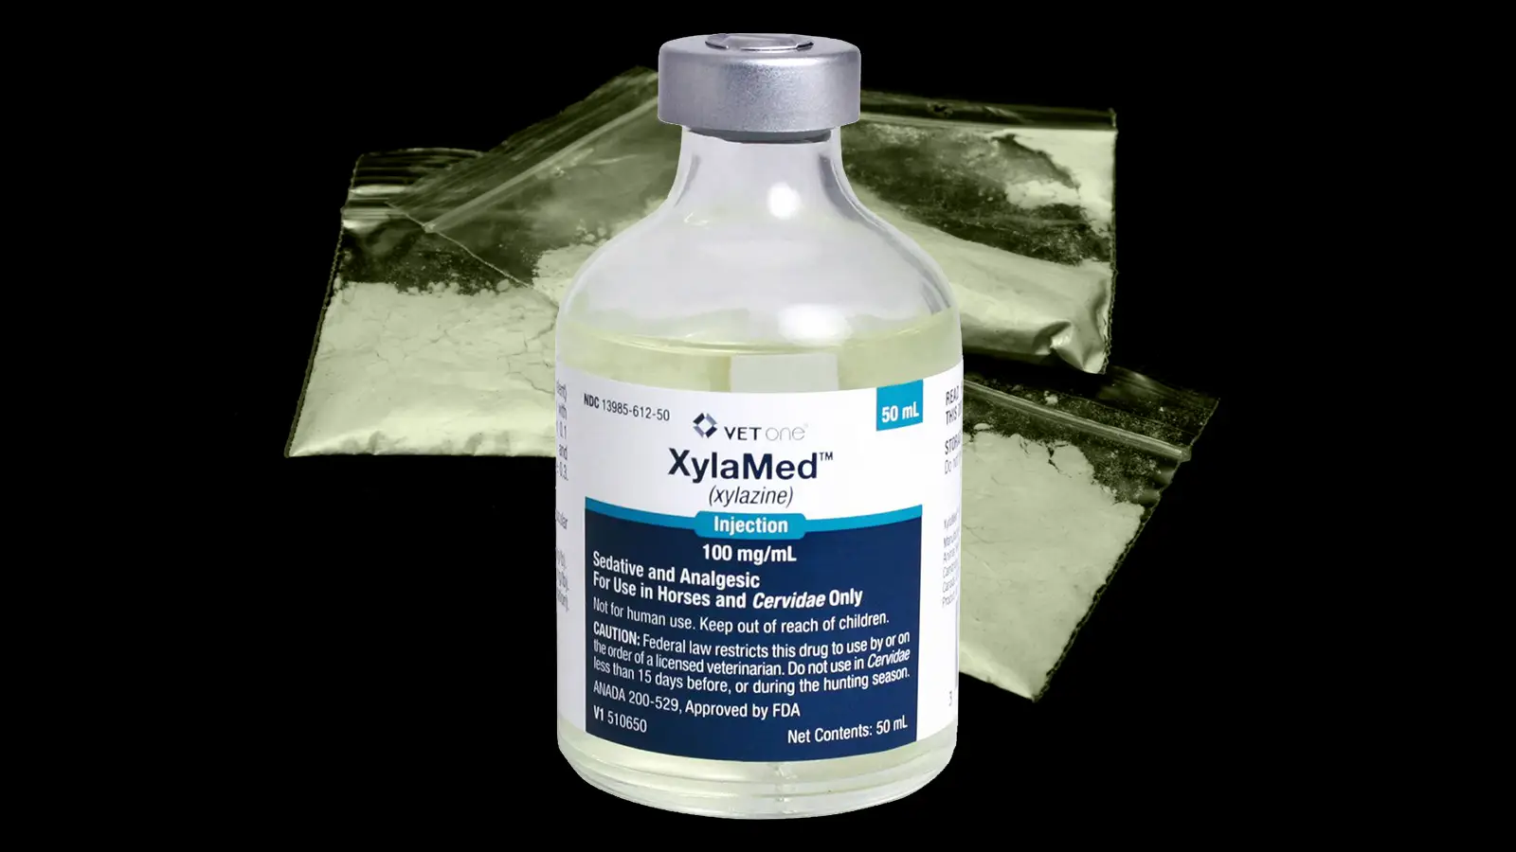
Xylazine (TranQ)
Xylazine
A non-opioid veterinary tranquilizer that is not approved for human use.
Effects can last for up to 8 hours depending on the dose
Typically mixed with crushed Fentanyl and re-pressed OR added to liquid Fentanyl
Narcan is ineffective
Xylazine was involved in 19% of all overdoses in Maryland last year
https://nida.nih.gov/research-topics/xylazine

Slide 41
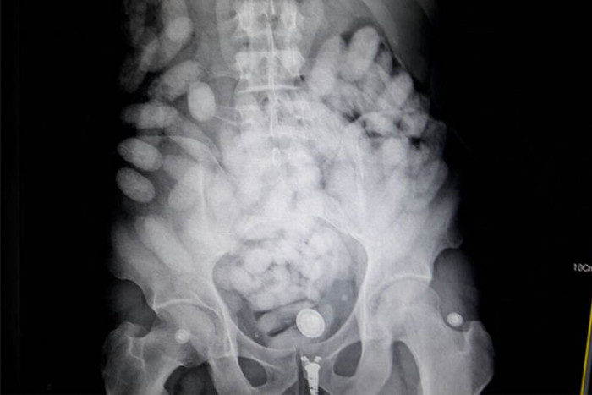
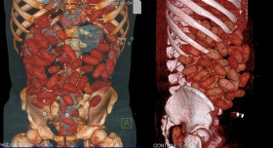
Liquid Fentanyl
Liquid Fentanyl
1.3 kg of liquid Fentanyl
https://www.bangkokpost.com/thailand/general/1321895/brazilian-who-swallowed-1-3kg-fentanyl-arrested-at-airport

Slide 42
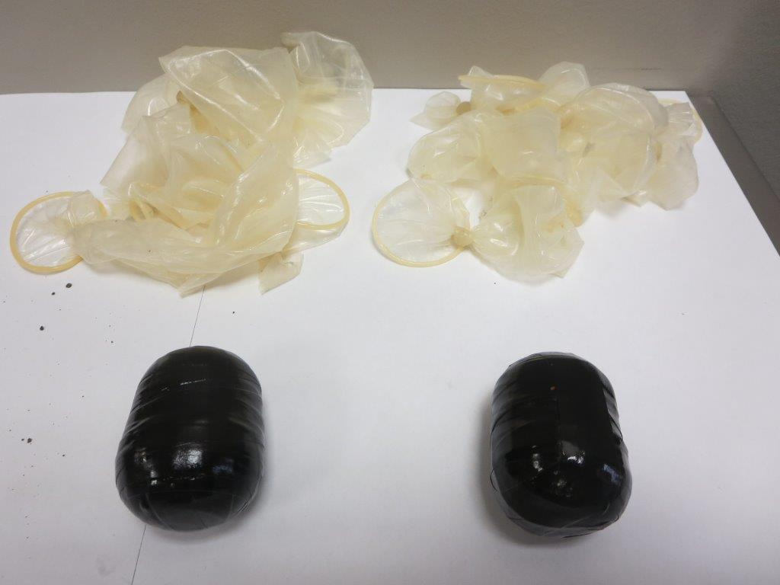
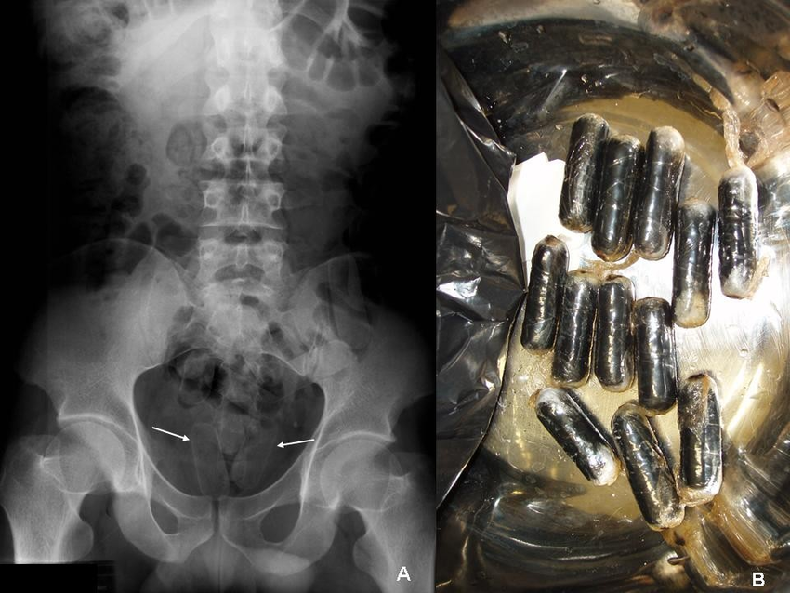
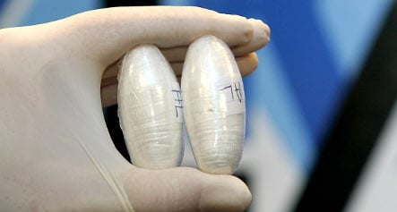
A Danger in itself
A danger in itself
Marijuana
Cocaine

Slide 43

A Danger in itself
A danger in itself

Slide 44

A Danger in itself
A danger in itself
Post-mortem bowel from smuggler

Slide 45

A Danger in itself
A danger in itself

Slide 46

What’s on the street?
Mortality
It doesn’t take much carfentanil to kill an adult… less than a granule (0.02 mg or 20 mcg)¹.
The image to the right shows why we’re seeing “heroin overdoses” that really are not from heroin. Instead, most of these drugs really contain fentanyl, which is far more potent.
The amount of drug needed to cause death, compared by relative volume. Fentanyl is deadly at 2 mg (2000 mcg), and carfentanil at 1/100 of that (0.02 mg).¹
Carfentanil: A Dangerous New Factor in the U.S. Opioid Crisis. July 2018. Drug Enforcement Administration. Available from https://www.dea.gov/sites/default/files/2018-07/hq092216_attach.pdf. Accessed on May 15, 2022.

Slide 47


Weird opioid ways
Over-the-counter fix
What do you do when you don’t want someone to recognize you from a street deal or you’re trying to quietly fix withdrawal symptoms at home?
Just load up on Imodium® and Tagamet®.

Slide 48

The dirty OTC fix
Over-the-counter fix
Loperamide HCl (Imodium®) slows peristaltic movements of the GI tract by targeting the mu opioid receptors. Normal doses of this medication don’t affect the CNS.
But, consume about 60 pills at once to bolus the opioid agonist effect and add cimetidine (Tagamet®) to help it across the blood-brain barrier, and now you have a cheap, dirty opioid drug.¹
White CM. Loperamide: A Readily Available but Dangerous Opioid Substitute. J Clin Pharmacol. 2019;59(9):1165-1169. doi:10.1002/jcph.1449

Slide 49
Opioid overdose
Too much of a bad thing
Opioids are easily overdosed, causing life-threatening signs and symptoms in both adults and children. Some of the more common ones are listed below:
Opioid Overdose Signs and Symptoms
Opioid Triad
-Very slow respiratory effort or apnea
-Unconsciousness
-Pinpoint pupils
Seizures and confusion
Vasan S, Olango GJ. Amphetamine Toxicity. [Updated 2021 Jul 10]. In: StatPearls [Internet]. Treasure Island (FL): StatPearls Publishing; 2022 Jan-. Available from: https://www.ncbi.nlm.nih.gov/books/NBK470276/. Accessed May 14, 2022.

Slide 50

Naloxone (Narcan)
To the rescue!
The opioid antidote naloxone (Narcan®) is an opioid receptor competitive antagonist. It blocks the receptors that would normally be bound by the opioids in heroin, fentanyl, morphine, etc.
It can restore respiratory drive, but in cases of fentanyl or carfentanil overdose, expect to administer repeat doses every 2 to 3 minutes to maintain effect.¹
Carfentanil: A Dangerous New Factor in the U.S. Opioid Crisis. July 2018. Drug Enforcement Administration. Available from https://www.dea.gov/sites/default/files/2018-07/hq092216_attach.pdf. Accessed on May 15, 2022.

Slide 51
Naloxone (Narcan) – Administration
To the rescue!
The opioid antidote naloxone (Narcan®) via nasally atomized (MAD device – Intranasal (IN)
Must push with constant and steady pressure
Goal: to restore respiratory drive only. Narcan is not designed to restore consciousness.
Full 2 mg must give Infor effectiveness
Carfentanil: A Dangerous New Factor in the U.S. Opioid Crisis. July 2018. Drug Enforcement Administration. Available from https://www.dea.gov/sites/default/files/2018-07/hq092216_attach.pdf. Accessed on May 15, 2022.

Slide 52
Questions?
Thank you for all you do!

