Slide 1
Goals of Care Conversation in the Trauma Patient
Stephen Gates, MD
Associate Professor, Texas Tech University health science Center
Director of palliative care consult service
University Medical Center

Slide 2
Speaking of goals…
Here are mine for this presentation
Be able to explain the “surprise question”.
Understand how the surprise question might be useful in identifying patients appropriate for a goals of care discussion.
Have an approach for discussing serious news in a trauma patient
Have an approach to having a goals of care conversation in a trauma patient.

Slide 3

"Providing palliative care alongside trauma care decreases length of stay, cost, and the intensity of nonbeneficial care at the end of life without a change in mortality rate.“
"The delivery of high-quality palliative care... reduces the utilization of long-term care beds and/or facilities for patients with poor functional outcomes.“
"Effective communication and support around prognosis, treatment options, and shared decision making is the cornerstone of palliative care in trauma."

Slide 4
Key Objectives
Palliative Care Screening
Breaking Bad News
Goals of Care Discussion

Slide 5
Who to Consider:
Trauma Patient
Pre-exiting Frailty
Weight loss > 10% in past 6 months
Frequent falls
Frequent recent hospitalizations
Decline in functional status, either acutely or chronically

Slide 6
Pre-transfer Goals of Care
Trauma Patient
Resides in long-term care facility
Advanced Age
cognitively impaired
metastatic or locally advanced incurable Cancer
Chronic home oxygen use

Slide 7
Who Else…
Trauma Patient
Organ failure/dysfunction
COPD on Home O2
Advanced Peripheral/Coronary Vascular disease
Dialysis-especially if its not going well
End stage liver disease
Advanced cancer

Slide 8
The “Surprise Question”
Would I be surprised if this patient died in the next 12 months?
Would I be surprised if the patient died during this hospitalization?
Would I be surprised if the patient LIVED through this hospitalization?

Slide 9
Questions:
Is the patient at significant risk for death or serious prolonged disability even if he/she is transferred to a higher level of care?
Would the transfer be consistent with the patient's goals?

Slide 10
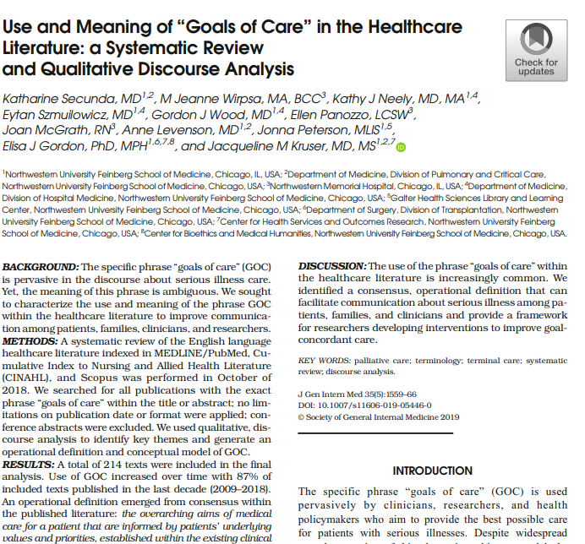
“Despite widespread use, the meaning of this phrase is ambiguous and lacks consensus or operational definition”

Slide 11
Goals of Care Definition
GOC are operationally defined as the overarching aims of medical care
for a patient that are informed by patient’s underlying values and priorities,
established within the existing clinical context, and used to guide decisions about the use of or limitation of specific medical interventions.

Slide 12
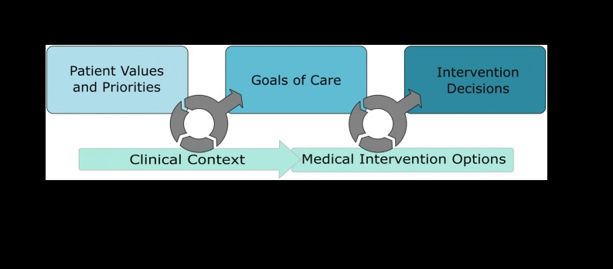

Slide 13
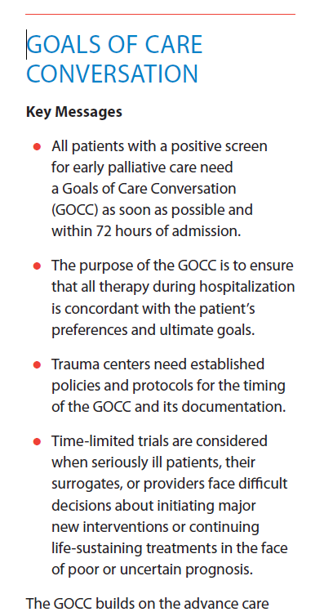
Goals of Care Conversation
Cardiopulmonary resuscitation
Mechanical ventilation
Artificial nutrition and hydration
Hemodialysis
Transfer to higher level of care?

Slide 14

NEWS
Notes:
Bad news is defined as any information which adversely or seriously affects in individuals view of his future. It is in the eye of the be holder. How many of you have some personal experience doing this?. How many of you have received any training in doing this?

Slide 15
SPIKES Protocol
Baile, Buckman et al The Oncologist 2000; 5:302-205
500 Oncologists at American Society of Clinical Oncology meeting
20% had received any formal training on delivering bad news
26% had a consistent plan or strategy for delivering bad news
66% were either not very comfortable or uncomfortable dealing with emotions
95% indicated that the SPIKES protocol was practical and useful in clinical practice

Slide 16
What is the most difficult aspect of discussing bad news?
Being honest without taking away patients hope
Dealing with the patient's emotions
Spending the right amount of time
Involving friends and family of the patient
Involving patient or family in the decision-making

Slide 17
SPIKES Protocol
Set Up
Perception
Invitation
Knowledge
Emotions
Summary

Slide 18
SPIKES Protocol-MD Anderson Cancer Center, Toronto-Sunnybrook Regional Cancer Centre
SUPER-Duke
REMAP-Dana Farber, Univ of Pittsburg, Univ of Washington
Serious Illness Conversation Guide-Ariadne Laboratories and Dana-Farber

Slide 19
Set Up
Privacy
Who would you like to be present?
SIT DOWN
Make a connection with the patient
Make sure you allot sufficient time
REMEMBER THE TISSUES!

Slide 20
Perception
“What have you been told about your medical situation so far?“
"What is your understanding of the reasons that we did the MRI?"

Slide 21
Invitation
"How would you like me to give you the information about the test results? "
"Would you like for me to give you all of the information, or just a summary? "

Slide 22
Knowledge
Warning shot
"Unfortunately I have got some serious news to tell you"
"I am sorry to have to tell you that…"

Slide 23
Knowledge
Start with the level of comprehension and vocabulary of the patient
Nontechnical language
Avoid excessive bluntness
Give information in small chunks
Periodically check the patient's understanding

Slide 24
Emotions
Observe
Identify
Confirm the reason for the emotion
Give the patient time to express his or her feelings
Do not be afraid of silence

Slide 25
Strategy-Summary
Check patient's understanding and expectations.
“Are you ready to discuss the next steps?“
Establish “Goals of Care”
Frame hope in terms of what is possible to accomplish

Slide 26
Goals of care-pathways
Transfer to a higher level of care
Focus on repair and prolonging life

Slide 27
Goals of care-pathway
Medical interventions
Surgery
Artificial life-sustaining measures
Prognosticate-likely outcomes (Return home versus facility)

Slide 28
Goals of care pathway
Focus on relief from symptoms/comfort
Allows patient to be at or near their home
Anticipate life expectancy would be shorter

Slide 29
Basic Principles of Communication
Patient's want to know the truth about prognosis
You will not harm the patient by talking about end-of-life issues
Anxiety is normal for the patient and the clinician during these discussions
Patients have goals and priorities besides living longer
Learning the patient's goals and priorities allows you to provide better care

Slide 30
Communication tips
Do:
Give a direct honest prognosis
Provide prognosis as a range and acknowledge uncertainty
Allow silence
Acknowledge and explore emotions
Focus on patient's quality of life, goals, fears, and concerns

Slide 31
Communication tips
Don’t
Avoid responding to patient's request about prognosis
Avoid being vague or overly specific
Talk more than half the time
Provide factual information and response to strong emotions
Focus on medical procedures

Slide 32
Things NOT to say:
"You have a very bad cancer, and unless we you get treatment immediately you are going to die. "
"There is nothing more we can do. "
"You have to...“
"Withdraw care"
"This not good. You die soon. "

Slide 33
AVOID
Quoting statistics
Being overly verbose
“Do you want us to do everything?”
“Breaking Bad News”

Slide 34
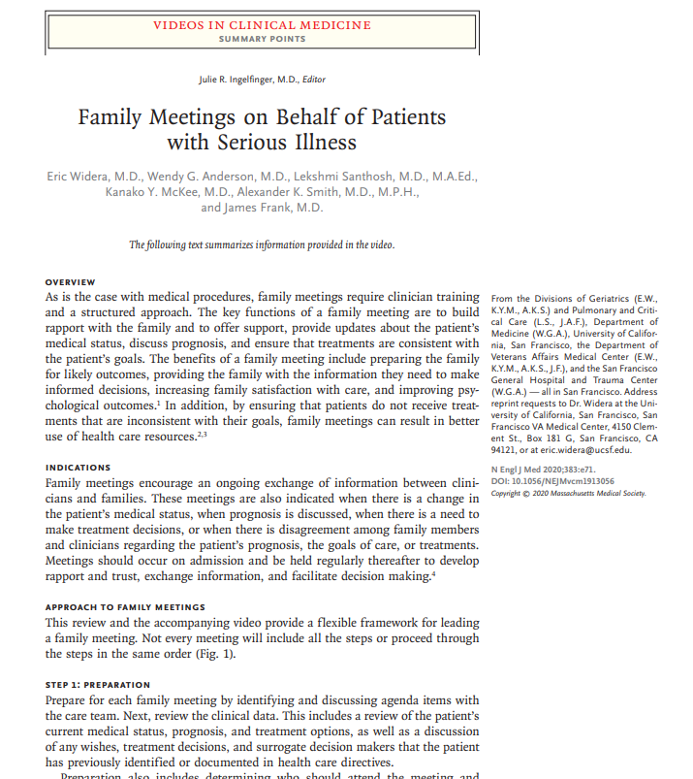
https://www.nejm.org/doi/full/10.1056/NEJMvcm1913056

Slide 35
Family Meetings on Behalf of Patients with Serious Illness
Video link:
https://www.nejm.org/doi/do_file/10.1056/NEJMdo005819/NEJMdo005819_download.mp4?area=&pubDoi=10.1056%2FNEJMvcm1913056

Slide 36
References
Serious Conversations. © 2015 Ariadne Labs: A Joint Center for Health Systems Innovation (www.ariadnelabs.org) and Dana-Farber Cancer Institute. Revised Feb 2016. Licensed under the Creative Commons Attribution Non Commercial-ShareAlike 4.0 International License, http://creativecommons.org/licenses/by-nc-sa/4.0/ http://www.instituteforhumancaring.org/documents/Providers/Serious-Illness-Guide-old.pdf
Pilot Study to Improve Goals of Care Conversations Among Hospitalists Kathryn I. Pollak, PhD, Xiaomei Gao, MA, Jessica Beliveau, MPH, Brian Griffith, MD, Danielle Kennedy, MPH, and David Casarett, MD https://doi.org/10.1016/j.jpainsymman.2019.06.007
SPIKES-A Six-Step Protocol for Delivering Bad News: Application to the Patient with Cancer Walter F. Baile, Robert Buckman, Renalto Lenzi, Gary Glober, Estela Beale, Andrzej, P. Kudelka https://doi.org/10.1634/theoncologist.5-4-302
REMAP: A Framework for Goals of Care Conversations Julie W. Childers, Anthony L. Back, James A. Tulsky, and Robert M. Arnold https://doi: 10.1200/JOP.2016.018796. Epub 2017 Apr 26

