Slide 1

Catastrophic Head Injury
Erin Burton, MD PGY4
TTUHSC Department of Surgery
Trauma Symposium
10/07/2023

Slide 2

Objectives/Disclosures
Identify catastrophic head injuries
Describe Treatments/Procedures that can be done prior to transfer of a higher level of care
Discuss management in the level 1 trauma center
No Disclosures

Slide 3
What is a catastrophic head injury?
Traumatic brain injury (TBI) – disruption or alteration of brain structure or function caused by external mechanical forces
Can be variable in severity, can be transient or permanent
What can cause a TBI? Rapid acceleration or deceleration, direct compression, penetration and physical disruption of brain tissue, blast injuries, etc
What type of trauma will these patients typically present with? MVC, pedestrian impact, falls, and assault
Epidemiology: approximately 1.4 million people per year in US; 1.1 million treated and released from hospital, 240,000 are hospitalized, and 50,000 die

Slide 4
TBI Population
TBI patient population – bimodal, greatest risks in 0-4yrs age and 15 to 19 yrs age
Falls in extremes of ages, MVCs in teenagers and young adults
1.5x more in males than females

Slide 5
How do we classify injury?
Primary vs secondary
-primary: result directly from the forces imparted at the time of the trauma and can include both focal disruptions of tissue and diffusely distributed damage
-secondary: occurring subsequent to the initial impact. Ex: hypoxemia, seizures, ischemia, fever, hypoglycemia that can directly impact the brain’s ability to respond to the primary insult
Brain injury is a dynamic process and will evolve over time. We cannot prevent the primary injury so our goal as providers is to prevent secondary injury.

Slide 6
Types of Injuries:
Closed vs penetrating injury
Diffuse axonal injury
Blast injury
Concussion
Abusive head trauma
Skull fractures
Epidural hematoma
Subdural hematoma
Intracerebral hematoma and contusion
Subarachnoid hemorrhage
Vascular injury

Slide 7
Closed vs Penetrating Injuries
Closed injuries – overlying scalp remains intact
Penetrating injuries – nonmissile (knives, arrows, darts, ice picks) – if patient still has object embedded, stabilize it and do not remove it (only remove in the operating room); missile (usually divided into high (750-1000m/s, hunting rifles, military weapons) and low velocity (200-500 m/s, handguns))
Try to not label wounds as entry and exit until workup is done/all information is obtained, if still unsure do not label
Scalp can bleed profusely – stop the bleed! Sutures, staples, compressive dressings
Consider CTA in addition to plain non con CT to further evaluate vasculature but do not delay care in obtaining this study
Secondary injuries can include edema, blossoming of contusions, DIC, hemorrhage from vessel disruption, ischemia, infarction, herniation

Slide 8
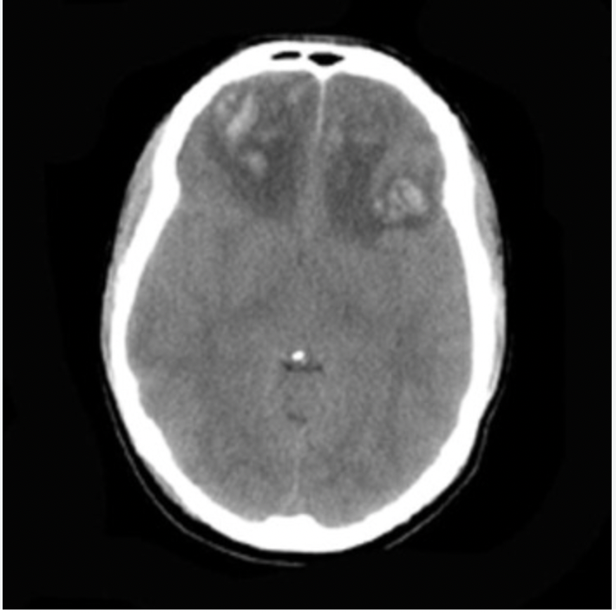
Diffuse Axonal Injury (DAI)
Axonal injury caused largely by rotational forces, do not have to have direct impact to the head to occur, can result from rapid acceleration or deceleration
Usually occurs over 6-12 hours post injury
Better evaluated by MRI than CT – lesions at gray/white matter interface
Prognosis worsens with the amount of lesions, or as depth goes towards the brainstem

Slide 9
Blast Injury
Primary blast injury – due to overpressure, occurs in air filled organs (lungs, bowel, middle ear)
Secondary blast injury – penetration of objects that are from an explosion
Tertiary blast injury – results from patient being thrown and striking the ground/object
Quaternary blast injury – includes additional factors such as heat, toxic fumes, inhalational injury, hypoxia

Slide 10
Concussion
Mildest form of TBI
Defined as transient alteration of neurological function caused by nonpenetrating injury with normal imaging studies
Symptoms: confusion, headache, irritability, amnesia, nausea, vomiting, balance issues, vertigo
Usually no LOC or very brief LOC
Do not let patient return to any type of contact activity until symptoms have completely cleared

Slide 11
Abusive Head Trauma/ Non accidental Trauma
NAT – deliberately inflicted injury to child or infant
“Shaken baby syndrome” – triad of long bone metaphyseal fractures, subdural hematomas, retinal hemorrhages; primary case of brain injury death in children under 2 yrs
Requires high index of suspicion
Commonly provided stories – fall from short height/counter/changing table or else will initially deny any trauma at all
Patient can present with lethargy, apnea, unresponsiveness, seizures, irritability, abnormal movements
Imaging usually shows more severe injuries than the story told should result in
Imaging patterns to raise suspicion – multiple fx, compound fx, midline fx, nonparietal fx, fx cross suture lines, intersphincteric SDH

Slide 12
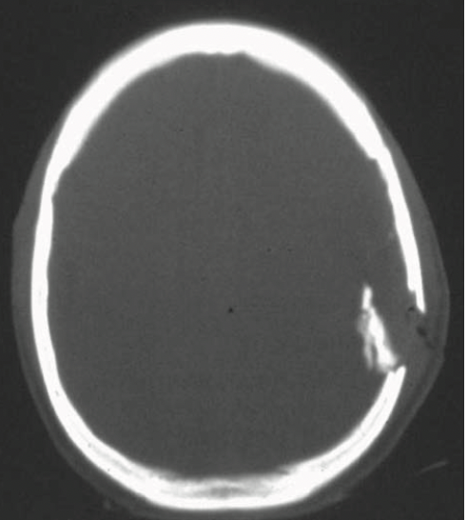
Skull Fractures
Classification – state of scalp (open or closed), number of bone fragments (simple or compound), relationship of bone fragments to each other (displaced/depressed or not), widening into existing cranial suture (diastatic), and involvement of the skull base
Clinical signs – gross deformity, palpable step off, basilar skull fracture (postauricular or periorbital ecchymosis), hemotympanum, CSF rhinorrhea or otorrhea
When to intervene? Closed usually don’t require treatment, open may need debridement, those with dural laceration or CSF leak require surgical repair to reduce risk of meningitis and herniation through a dural defect, depressed skull fracture with more than 8-10mm depression or more than the thickness of the adjacent skull

Slide 13
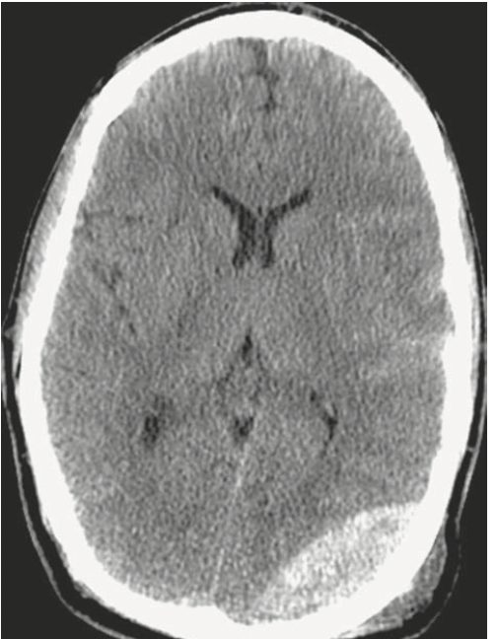
Epidural Hematoma
Occurs when blood collects in the potential space between the dura and inner table of the skull
Classically due to arterial bleeding from disruption of the middle meningeal artery
Patient has brief loss of conscious, followed by a lucid interval, then collapses (obtunded, contralateral hemiparesis, ipsilateral pupillary dilation)
CT: hyperintense, biconvex (lenticular) mass
Can rapidly increase in size
Mortality rate of 5-12%
Surgical guidelines: EDH > 10-15mm of thickness and >5mm shift or if neurologic symptoms present or GCS </- 8

Slide 14
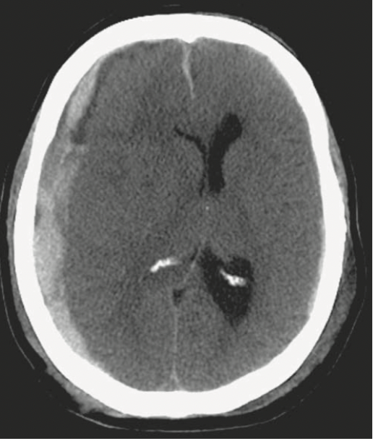
Subdural Hematoma
Occurs when blood collects between the arachnoid matter and inner layers of the meninges
Due to traumatic stretching and tearing of cortical bridging veins that cross the subdural space and drain into the dura or dural sinus
CT: crescent shaped, can cross suture lines, and layer around the falx or tentorium
Worse outcomes compared to EDH – as venous and not arterial take more time to grow and become symptomatic, usually require higher impact to result in
OR: evacuate if > 1 cm in thickness or a midline shift of >5 mm or if GCS decreases by 2, fixed or asymmetric pupil, or if ICP >20 mm Hg

Slide 15
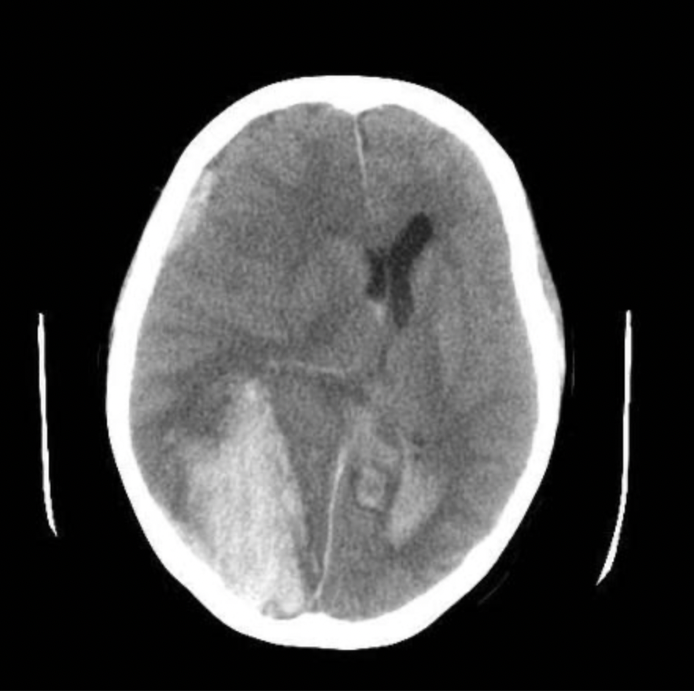
Intraparenchymal Hemorrhage
IPH and contusions can expand rapidly and result in significant mass effect with neurological deterioration
Operative guidelines are usually based off of volume of bleed (> 50 mm3 or >20 mm3 and shift of at least 5mm in GCS 6-8 patient)

Slide 16
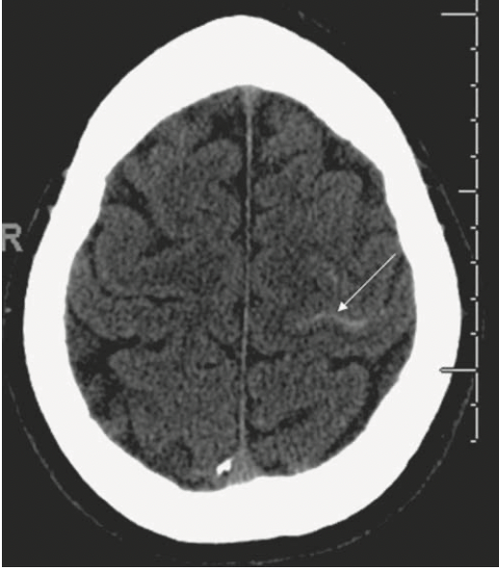
Subarachnoid Hemorrhage
Occurs when blood collects between the arachnoid and pial membranes
Results from venous tears in the subarachnoid space
CT: thin, diffuse hyperdensity over the sulci and gyri of the cerebral convexity
Can have post bleed vasospasm which can lead to ischemia or infarction 3-14 days after injury

Slide 17
Vascular Injury
Post traumatic stroke can result from injuries to the internal carotid artery, common carotid artery, or vertebral artery
Can be due to direct penetrating trauma vs traumatic dissection
Traumatic dissection can lead to a pseudoaneurysm if blood collects between the adventitia and media layers of the vessel or luminal stenosis if blood collects between the intima and media layers of the vessel
Presentation: headache, neck pain, TIA or stroke, carotid bruits
Treatment: anticoagulation as able based off of other injuries

Slide 18
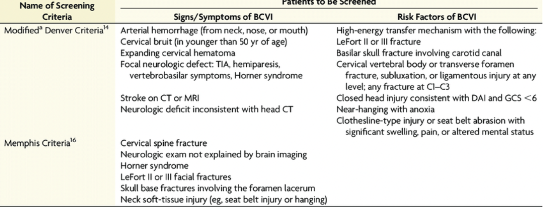
Vascular Injury – who to CTA?

Slide 19
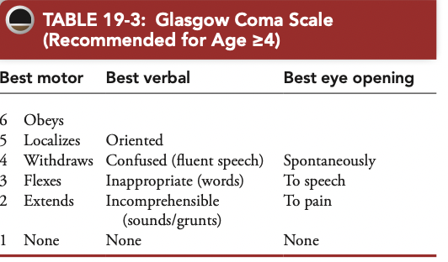
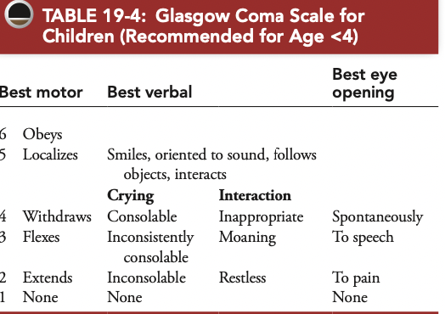
Clinical Assessment
GCS score – helps classify severity of brain injury:
GCS 13-15: mild TBI
GCS 9-12: moderate TBI
GCS <8: severe TBI
GCS score for children
Pupillary Exam – size and reactivity (ex: fixed dilated pupil sign of uncal herniation)
Neurologic Exam
Systemic evaluation – evaluating for other injuries, obtaining medical history, neurologic baseline, presence of substance use

Slide 20
Imaging
CT scan
MRI
Angiography

Slide 21
Management – General Principles
MAJOR GOAL – PREVENT SECONDARY BRAIN INJURY
Blood pressure and oxygenation
Nutrition
Prophylaxis – seizures, infections, hemorrhage, DVT
Intracranial pressure and how to measure and manage
  -analgesics and sedatives
  -hyperosmolar therapy
  -hyperventilation
  -barbiturate therapy
  -hypothermia
  -steroids
  -decompressive craniectomy

Slide 22
When patient arrives:
Head of bed > 30*
Neck midline
Check C collar to ensure not causing jugular compression
Euvolemia - Avoid dextrose containing fluids (worsens cerebral edema)
Normotheria
Frequent neurologic assessments

Slide 23
Blood pressure and oxygenation
The two key components to preventing secondary brain injury
Occurrence of a single episode of hypoxemia or hypotension is an independent predictor of worse outcomes after TBI
Blood pressure: use crystalloid, blood products, vasopressors as needed
Oxygenation: start empiric oxygen, consider intubation as needed

Slide 24
Nutrition
TBI patients have increased basal energy expenditure to 120-130% of baseline
Mortality is reduced in patients who receive full caloric replacement by one week post injury
15% of calories should be protein
Enteral > Parenteral nutrition

Slide 25
Prophylaxis
Post traumatic seizures: can lead to increased ICP and elevated meatabolic demand that may exacerbate the effects of the ischemia. Anticonvulsants have been shown to reduce the risk of post traumatic seizures in the first 8 days of injury but not after (7 day course of Keppra at our institution – loading dose followed by BID)
Stress Gastric ulcers (Cushing’s) – famotidine or protonix
Hemorrhage – TBI patients have supranormal activity of antithrombin activity which leads to increased rates of coagulopathy which can lead to DIC as well as expansion of existing head bleeds
DVT – mechanical and chemical

Slide 26
Intracranial Pressure
Monroe-Kellie Doctrine: Assumes that the skull is inelastic, the ventricular space is confluent and that pressures are equally and readily transmitted throughout the intracranial space
Balance between the brain, intravascular blood, and CSF contained in the intracranial space – increases in one compartment require compensatory decreases in the others to maintain constant ICP
Significant increases in pressure can result in transtentorial herniation, that can cause compression at the level of the brainstem, direct tissue to the midbrain, occlusion of the arteries, infarction, and death
Normal ICP varies by age: adults 10- 15 mm Hg, children 3-7 mm Hg, and 1.5-6 mm Hg in infants
Recommended monitoring in severe TBI and abnormal CT in a mild TBI or in a severe TBI with a normal head CT scan with selective criteria (age > 40, SBP > 90m Hg, unilateral or bilateral abnormal motor posturing)

Slide 27
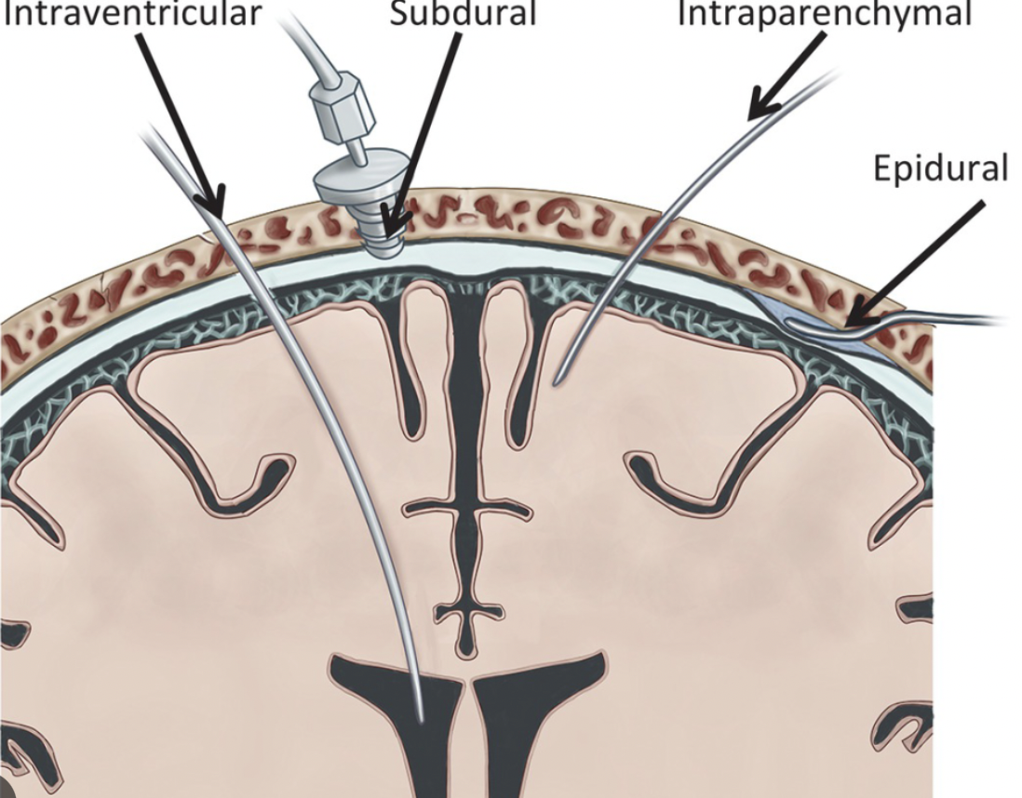
How to Monitor ICP
EVD – ventriculostomy catheter; have advantage of being able to drain CSF
Parenchymal ICP monitors- do not penetrate as much tissue and do not require localization of the ventricle
For neural tissue to function normally, must have adequate cerebral blood flow that can meet the metabolic demand. Cerebral Perfusion Pressure (CPP): MAP- ICP ; goal of 50-60 mmHg

Slide 28
What we can do when patient presents with TBI – Analgesia and Sedatives
TBI patients have increased levels of stress, agitation, and discomfort which cause increased sympathetic tone, temperature, and blood pressure and increased ICP, metabolic demand, and resistance to controlled ventilation
Medication selection – need to avoid masking neurologic exam and hypotension and rebound ICP elevation after discontinuation
Consider ICP monitors in patients that are heavily sedated/unable to obtain neurologic examination
Short acting agents - Propofol and fentanyl

Slide 29
What we can do when patient presents with TBI – Hyperosmolar Therapy
Mannitol – osmotic diuretic – initial bolus of 1g/kg followed by 0/25-0/5 g/kg every 6 hours. Caution in patients with renal failure as can result in ATN
Hypertonic saline – lowers ICP through oncotic pressure gradient; bolus vs continue flow at small rate (ex: 30 ml/hr). Target serum sodium goal of 145-160 mEq/L; monitor frequently to avoid central pontine myelinolysis. Be careful in patient’s with underlying cardiac or pulmonary deficits as can worsen pulmonary edema

Slide 30
What we can do when patient presents with TBI – Hyperventilation
Hyperventilation induces vasoconstriction, reduction in cerebral blood volume, and reduction in ICP
Have to be careful because do not want to lower cerebral blood flow as up to 50% of patients will have cerebral ischemia from the injury itself in the first 24 hours
Use in brief periods
Goal pCO2 of 30-35 mm Hg

Slide 31
What we can do when patient presents with TBI – Barbiturate Therapy
Benefit TBI patients by decreasing the cerebral metabolic rate of oxygen, decreasing formation of free radicals and intracellular calcium influx, and lowering ICP
Side effects – immunosuppression, hypotension, mild myocardial depression, infectious and respiratory complications
No role for prophylactic barbiturate therapy as it increases hypotension without significantly improving outcomes, therefore use as a last resort medical therapy
Pentobarbital – 10mg/kg loading dose over 30 min, followed by 5mg/kg/h infusion for 3 hours, followed by maintenance dose of 1 mg/kg/h

Slide 32
What we can do when patient presents with TBI –Hypothermia
Induced hypothermia may result in decreasd cerebral metabolism, ICP, inflammation, lipid peroxidation, excitotoxicity, cell death, and seizures
Adverse effects include cardiac function, thrombocytopenia, elevated creatinine clearance, pancreatitis, and shivering with associated elevations in ICP
Clinical trials have not shown significant improvement in outcomes
If going to do, do for at least 48hrs and then rewarm at a rate of 1*C every 4-6hrs

Slide 33
What we can do when patient presents with TBI –Steroids?
Steroids are NOT recommended for treatment of TBI
Lead to increased mortality

Slide 34
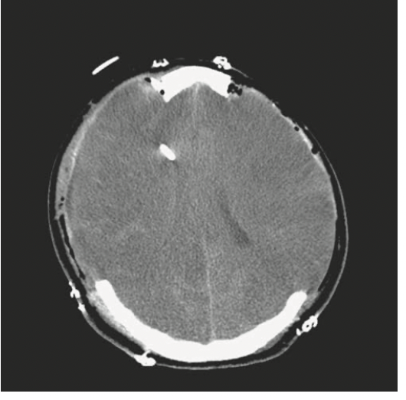
What we can do when patient presents with TBI –Decompressive craniectomy
Do in patients with medically refractory IC-HTN
Remove bone, evacuate lesion, dura closed, bone +/- replaced
Usually a unilateral hemispheric decompression however can do bifrontal and bilateral hemispheric craniectomies

Slide 35
At Level 1 Trauma Center
Information to communicate with transferring facility – Patient age, mechanism and time of injury, respiratory and cardiovascular status, neurologic exam – GCS (esp motor), pupil size & reactivity, presence of focal neurological deficits, associated injuries, imaging results if available (do not delay transfer to obtain imaging), use of anticoagulants, and any treatments you have done
Who to operate on? Most patients with GCS 3-4 have poor outcomes regardless of imaging, GCS 5 indeterminate, GCS 6 or > case for aggressive management pending other injuries and clinical picture
Poor prognostic factors – self inflicted injuries, bilateral fixed and dilated pupils, development of coagulopathy, bullet passing through midline, through ventricles, or across more than one lobe
The biggest determinant of outcome is based on the care patients receive in the days to weeks after their injury in the ICU

Slide 36
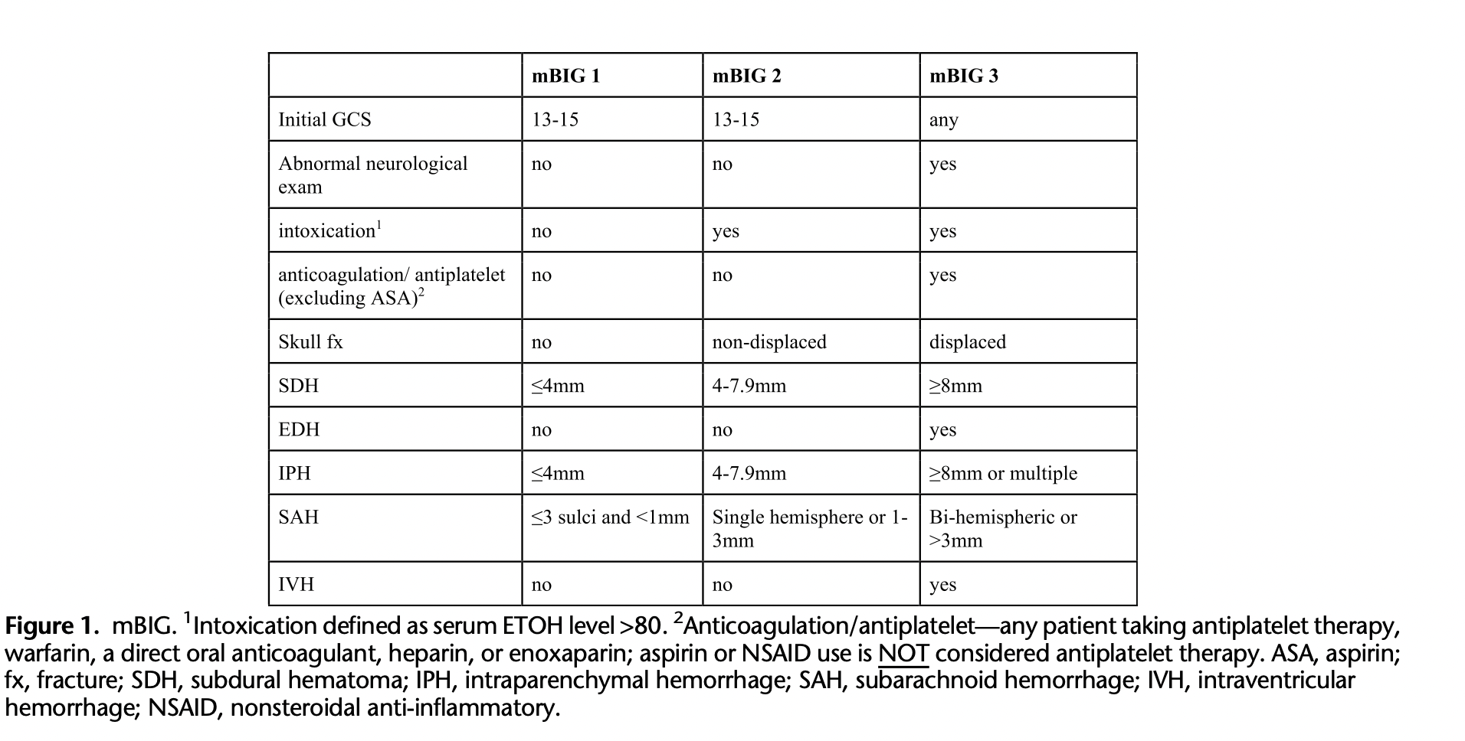
BIG Criteria – Where to admit and how to manage
mBIG 1 – no repeat head CT or NSG consult, observe for 6 hours and GCS 15 can discharge without hospital admission
mBIG 2 – no repeat head CT or NSG consult, admitted for 24 hrs obs, GCS 15 can be discharged
mBIG 3 – receive repeated head CTs, NSG consult, and hospital admission (ICU)

Slide 37
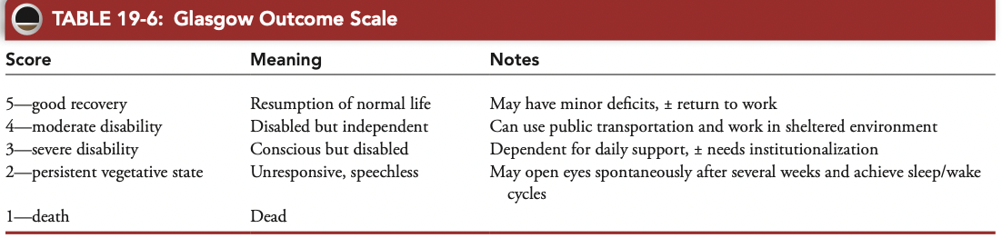
Outcomes
Prognostic data – Glasgow Outcome Scale
Brain death – irreversible absence of any brain function; nonreactive pupils, no corneal, oculocephalic, oculovestibular, gag, cough reflex. Other testing: absence of intracranial blood flow, apnea testing
Transfer to neuro rehab

Slide 38
More information
Brain Trauma Guidelines for the Management of Severe Traumatic Brain Injury
- prehospital, pediatric, surgical management, penetrating, combat related
https://braintrauma.org
Major sources used:
Trauma 8th edition textbook
Brain Injury Guidelines
EAST and AAST evaluation articles of Brain Injury Guidelines

