Slide 1


Exploring Mammogram Adherence Disparities in Hispanic Subgroups: Socioeconomic Factors Unveiled in NHIS Data (2010-2018)
Stephen Contreras, RN, MS2
Mariela Lane, M.D.
Jessica Calderón-Mora, DrPH
Alok Kumar Dwivedi, Ph.D.
Guowei Li, Ph.D
Amadeus Ramirez, RN, MS2
John Guardiola, RN, MS2
2nd ANNUAL
WEST TEXAS HEALTH DISPARITIES
RESEARCH SYMPOSIUM
Notes:
What are the disparities in adherence to mammogram screenings as per The United States Preventive Services Task Force (USPSTF) Guidelines among different Hispanic subgroups and how do socioeconomic variables contribute to these disparities? A comparative analysis using National Health Interview Survey (NHIS) Public data from 2010, 2013, 2015, 2018.

Slide 2
2nd ANNUAL
WEST TEXAS HEALTH DISPARITIES
RESEARCH SYMPOSIUM
Disclosure
Nothing to Disclose

Slide 3
2nd ANNUAL
WEST TEXAS HEALTH DISPARITIES
RESEARCH SYMPOSIUM
Background
Breast cancer is the leading cause of cancer death among Latina women, with rising incidence in other ethnic groups.
  Early detection, especially through methods like mammography, is crucial for improving survival rates and treatment outcomes.
  Social Determinants of Health as contributing factors
As of 2020, Hispanics comprised 19.1% of the United States population, representing 19 different subgroups.
  Lack of research in this population is a challenge
Notes:
Current studies emphasize sociodemographic factors in mammogram screening adherence, often overlooking specific subgroups within the Hispanic population and aggregate them as one.

Slide 4
2nd ANNUAL
WEST TEXAS HEALTH DISPARITIES
RESEARCH SYMPOSIUM
Purpose
  Our objective was to comprehensively analyze mammogram adherence rates within specific Hispanic subgroups.
  Identify possible barriers to health in not only Hispanics but in different Hispanic Subgroups overall.

Slide 5
2nd ANNUAL
WEST TEXAS HEALTH DISPARITIES
RESEARCH SYMPOSIUM
Study Design & Methods
Collecting Data
Inclusion
Subjects
Key Variables
Analysis
Health insurance status
Education level
Recent contact with MD
Marital status
Income
Work history
Years in the U.S.
Adherence to USPSTF mammogram screening guidelines
Publicly available de-identified NHIS datasets spanning the years 2010, 2013, 2015, and 2018.
Inclusion criteria: self-identified as aged 50-75, and of Hispanic female or another relevant subgroup.
Exclusion Criteria: Self-identified as non-hispanic female, not aged
3,120 subjects identified.
Subcategories: Puerto Rican, Mexican, Mexican American Cuban/Cuban American, Dominican, and Central or South American
The prevalence of up-to-date screening across subgroups was calculated, and prevalence ratios (PR), confidence intervals (CI), and P-values were compared across key variables.

Slide 6
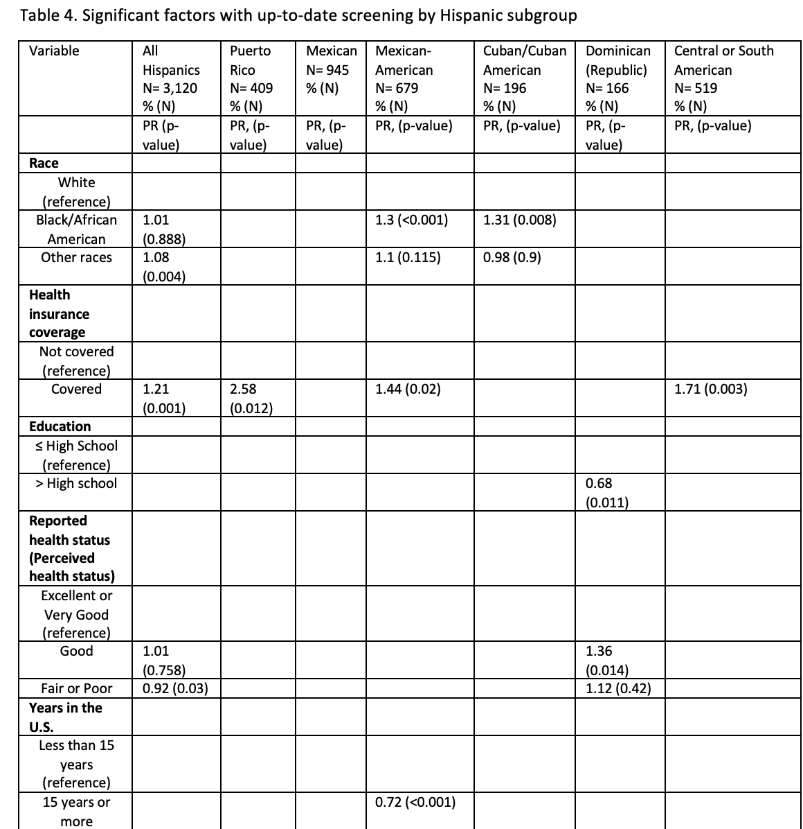
2nd ANNUAL
WEST TEXAS HEALTH DISPARITIES
RESEARCH SYMPOSIUM
Results
Health Insurance Coverage:
-All Insured Hispanics: More likely to be up-to-date vs. non-insured (PR 1.21, p<0.001). Puerto Ricans (PR 2.58, p=0.012), Central/South Americans (PR 1.71, p=0.003), Mexican Americans (PR 1.44, p=0.02).
Perceived Health Status
-Dominican Hispanics: More likely to be up-to-date if health perceived as "good" and "fair/poor" vs. "excellent/very good" (PR 1.36, p=0.014).
Education
-Dominican Hispanics: Less likely to be up-to-date on screening with education beyond high school (PR 0.68, p=0.011).
Length of Residency in United States
-Mexican-Americans: Less likely to be up-to-date if in the U.S. for 15+ years vs. less than 15 years (PR = 0.72, p < 0.001).
Employment Status:
-Puerto Ricans were more likely to be up-to-date on screenings than those who were not (PR 1.23, p<0.001).
Notes:
All Hispanics with insured individuals were significantly more likely to be up-to-date compared to those without coverage (PR 1.21, p-value 0.001), particularly evident in the Puerto Rican (PR 2.58, p-value 0.012), Central/South American (PR 1.71, p-value 0.003), and Mexican American (PR 1.44, p-value 0.02) subgroups.
In the Dominican subgroup, Hispanics were significantly more likely to be up-to-date with screening if they reported their health status as “good” compared to “excellent or very good” or “fair or poor” (PR 1.36, p-value 0.014).
Conversely, Hispanics in the Dominican subgroup were significantly less likely to be up-to-date on screening if they had an education level higher than high school (PR 0.68, p-value 0.011).
Hispanics in the Mexican-American subgroup with 15 years or more in the U.S. were significantly less likely to be up-to-date compared to those with less than 15 years (PR = 0.72, p < 0.001).

Slide 7
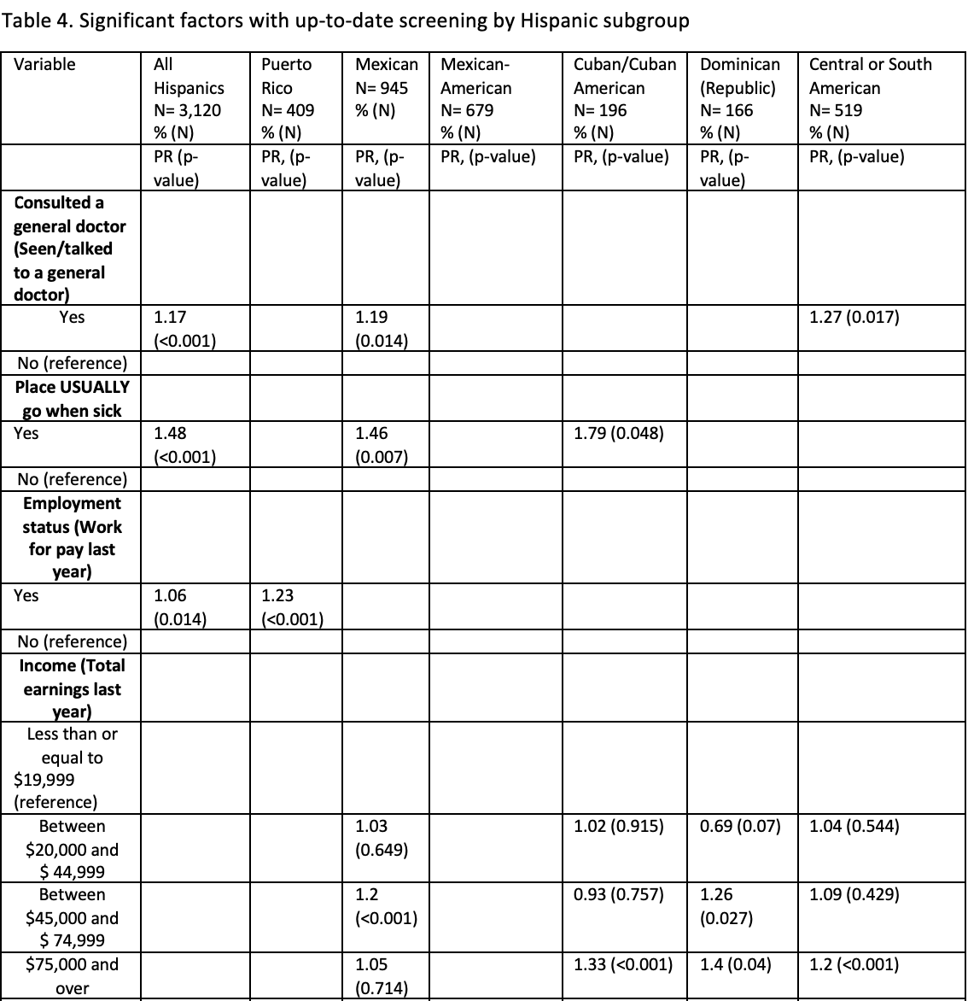
2nd ANNUAL
WEST TEXAS HEALTH DISPARITIES
RESEARCH SYMPOSIUM
Results
Consultation with General Doctor
-All Hispanics were more likely to be up-to-date: Overall (PR 1.17, p<0.001), Mexicans (PR 1.19, p=0.014), Central/South Americans (PR 1.27, p=0.017).
Usual place for Medical Care
-All Hispanics were more likely to be up-to-date: Overall (PR 1.48, p<0.001), Mexicans (PR 1.46, p=0.007), Cuban Americans (PR 1.79, p=0.048).
Income:
-Mexican and Dominicans were more likely to be up to date if they earned between 45,000-$74,999 annually (Mexican PR 1.2, p<0.001; Dominican PR 1.25, p=0.027).
-Cuban, Dominican, and Central/South American subgroups: more likely to be up to date if they earned over $75,000 annually (Cuban PR 1.33, Dominican PR 1.4, Central/South American PR 1.2; all p<0.05).
Notes:
All Hispanics who had consulted a general doctor within the past 12 months were significantly more likely to be up-to-date than those who had not (PR 1.17, p-value <0.001), especially evident in the Mexican (PR 1.19, p-value 0.014) and Central/South American (PR 1.27, p-value 0.017) subgroups.
All Hispanics who reported having a designated "place they usually go to when sick" were significantly more likely to be up-to-date compared to those who did not (PR 1.48, p <0.001), notably in the Mexican (PR 1.46, p-value 0.007) and Cuban/Cuban American (PR 1.79, p-value 0.048) subgroups.
In the Puerto Rican subgroup, individuals who worked for pay in the previous year were significantly more likely to be up-to-date with screening than those who did not (PR 1.23, p-value <0.001).
Within the Mexican and Dominican subgroups, earnings between $45,000 and $74,999 were associated with a significantly higher likelihood of being up-to-date with screenings (PR 1.2, p-value <0.001) and (PR 1.25, p-value 0.027), respectively.
In the Cuban, Dominican, and Central/South American subgroups, earnings of $75,000 and over were significantly associated with a higher likelihood of being up-to-date with screenings (PR 1.33, p-value <0.001), (PR 1.4, p-value 0.04), and (PR 1.2, p-value <0.001), respectively.

Slide 8
Conclusion
2nd ANNUAL
WEST TEXAS HEALTH DISPARITIES
RESEARCH SYMPOSIUM
Health Insurance Coverage is Crucial:
Insured individuals, across all Hispanic subgroups, are significantly more likely to be up-to-date with mammogram screenings.
Unexpected Education Impact
Higher education levels are associated with lower screening rates in the Dominican subgroup.
Cultural preferences could influence screenings
Understanding and respecting cultural preferences in healthcare-seeking behaviors are crucial for effective interventions.
Acculturation and Years in the U.S.
Indicates potential acculturation effects, emphasizing the need for targeted outreach to long-term residents.
Variable Complexity
Educational Impact
Notes:
Talking Points:
Health Insurance Coverage is Crucial:
Insured individuals, across all Hispanic subgroups, are significantly more likely to be up-to-date with mammogram screenings.
Emphasizes the need to improve and ensure access to health insurance for promoting preventive healthcare behaviors.
Unexpected Education Impact:
Higher education levels are associated with lower screening rates in Hispanics in the Mexican subgroup.
Suggests factors beyond education may influence screening behaviors, warranting further investigation into health literacy and awareness.
Cultural Preferences Matter:
In Puerto Rico, individuals with a specific place they usually go when sick are more likely to be up-to-date with screenings.
Understanding and respecting cultural preferences in healthcare-seeking behaviors are crucial for effective interventions.
Acculturation and Years in the U.S.:
In the Mexican-American subgroup, individuals with 15 years or more in the U.S. are less likely to be up-to-date with screenings.
Indicates potential acculturation effects, emphasizing the need for targeted outreach to long-term residents.
Variable Complexity:
Certain variables, like health insurance coverage, have consistent impacts across subgroups, while others exhibit different effects.
Highlights the multifaceted nature of healthcare disparities, emphasizing the need for comprehensive and culturally sensitive strategies.

Slide 9

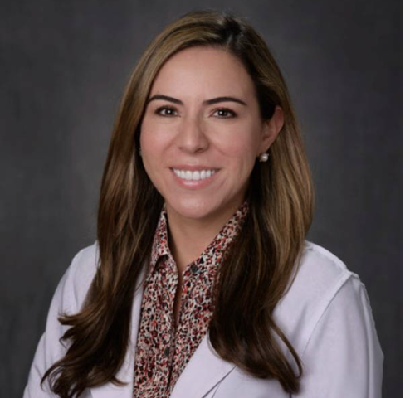
2nd ANNUAL
WEST TEXAS HEALTH DISPARITIES
RESEARCH SYMPOSIUM
Acknowledgments
Gratitude to the Guiding Lights: Mentors Extraordinaire
Dr. Jessica Calderon-Mora, DrPH
Dr. Mariela Lane, MD

Slide 10


2nd ANNUAL
WEST TEXAS HEALTH DISPARITIES
RESEARCH SYMPOSIUM
Acknowledgments
Vital Forces Behind the Research Triumph
Alok Dwivedi, Ph.D.
Li Guowei, Ph.D.

Slide 11
2nd ANNUAL
WEST TEXAS HEALTH DISPARITIES
RESEARCH SYMPOSIUM
Questions?

Slide 12
2nd ANNUAL
WEST TEXAS HEALTH DISPARITIES
RESEARCH SYMPOSIUM
Sources
1. United States Census Bureau. Annual Estimates of the Resident Population for the United States, States, Counties, and Puerto Rico Commonwealth and Municipios: April 1, 2010, to July 1, 2019. Census Bureau; 2020.
2. Miller KD, et al. Cancer statistics for the US Hispanic/Latino population, 2021. CA: A Cancer Journal for Clinicians. 2021;71:466-487.
3. Flores EJ, López D, Miles RC, et al. Impact of primary care physician interaction on longitudinal adherence to screening mammography across different racial/ethnic groups. *Journal of the American College of Radiology*. 2019;16(7):908-914. doi:10.1016/j.jacr.2018.12.020
4. Nahleh Z, Botrus G, Dwivedi A, et al. Clinico-pathologic disparities of breast cancer in Hispanic/Latina women. Breast Disease. 2018;37(3):147-154. doi:10.3233/bd-170309
5. Shoemaker ML, White MC. Breast and cervical cancer screening among Hispanic subgroups in the USA: Estimates from the National Health Interview Survey 2008, 2010, and 2013. *Cancer Causes & Control*. 2016;27(3):453-457. doi:10.1007/s10552-016-0718-5
6. Spak DA, Foxhall L, Rieber A, Hess K, Helvie M, Whitman GJ. Retrospective review of a mobile mammography screening program in an underserved population within a large metropolitan area. *Academic Radiology*. 2022;29. doi:10.1016/j.acra.2020.07.012
7. U.S. Cancer Statistics Working Group. Based on 2022 submission data (1999-2020), U.S. Cancer Statistics Data Visualizations Tool: U.S. Department of Health and Human Services, Centers for Disease Control and Prevention and National Cancer Institute; (https://www.cdc.gov/cancer/dataviz). Published June 2023.
8. Guide to Clinical Preventive Services. Recommendations of the US Preventive Services Task Force. 2014. (http://www.ahrq.gov/professionals/clinicians-providers/guidelines-recommendations/guide/index.html)
9.Funk C, Lopez MH. A brief statistical portrait of U.S. Hispanics. Pew Research Center. https://www.pewresearch.org/science/2022/06/14/a-brief-statistical-portrait-of-u-s-hispanics/. Published June 14, 2022.
Notes:
https://www.pewresearch.org/science/2022/06/14/a-brief-statistical-portrait-of-u-s-hispanics/

