Slide 1



Prevalence of Anxiety and Depression in Women with Overactive Bladder in an Underserved Area
Kaylyn Lazuka, M. Ed.; Angela Jones, M.D.; Sheralyn Sanchez, Ph.D., M.P.H.; P. Antonio Maldonado, M.D.
Department of Obstetrics and Gynecology, Foster School of Medicine
Texas Tech University Health Sciences Center El Paso, El Paso, Texas
2nd ANNUAL
WEST TEXAS HEALTH DISPARITIES
RESEARCH SYMPOSIUM

Slide 2
2nd ANNUAL
WEST TEXAS HEALTH DISPARITIES
RESEARCH SYMPOSIUM
DISCLOSURES
Nothing to disclose

Slide 3
2nd ANNUAL
WEST TEXAS HEALTH DISPARITIES
RESEARCH SYMPOSIUM
BACKGROUND AND SIGNIFICANCE
Overactive bladder is a chronic condition involving urinary urgency, frequency, and nocturia with or without urgency urinary incontinence.
Prevalence in the general population is 16.9%
Associated with poor quality of life, poor sleep, depression and anxiety

Slide 4
2nd ANNUAL
WEST TEXAS HEALTH DISPARITIES
RESEARCH SYMPOSIUM
BACKGROUND AND SIGNIFICANCE
Current treatment methods fail to address the emotional burden that accompanies OAB
High prevalence of depression and anxiety especially in diverse and underserved communities

Slide 5
2nd ANNUAL
WEST TEXAS HEALTH DISPARITIES
RESEARCH SYMPOSIUM
HYPOTHESIS
Anxiety and depression will be very prevalent in a cohort of predominately Hispanic patients with OAB in an underserved area.

Slide 6
2nd ANNUAL
WEST TEXAS HEALTH DISPARITIES
RESEARCH SYMPOSIUM
SPECIFIC AIMS
This study aims to estimate the prevalence of anxiety and depression in a cohort of predominately Hispanic patients with OAB in an underserved area.

Slide 7
2nd ANNUAL
WEST TEXAS HEALTH DISPARITIES
RESEARCH SYMPOSIUM
RESEARCH DESIGN/METHODS
Retrospective cross-sectional study
Single institutional urogynecology clinic
Charts reviewed for patients presenting with OAB from 2016-2020
Charts were identified using ICD-10 codes

Slide 8
2nd ANNUAL
WEST TEXAS HEALTH DISPARITIES
RESEARCH SYMPOSIUM
RESEARCH DESIGN/METHODS
Inclusion criteria:
  Women over 18 with OAB symptoms per ICD 10 codes
  Subjects may carry additional diagnoses of pelvic floor disorders or recurrent UTI
Exclusion criteria:
  Pregnant or postpartum patients
  Patients found to have a gynecologic or urologic malignancy

Slide 9
2nd ANNUAL
WEST TEXAS HEALTH DISPARITIES
RESEARCH SYMPOSIUM
RESEARCH DESIGN/METHODS
Chart Abstraction
  Demographic data
  Patient history and physical exam
  Main presenting symptoms on initial urogynecology visits
  Treatment plan at initial and subsequent visits

Slide 10
2nd ANNUAL
WEST TEXAS HEALTH DISPARITIES
RESEARCH SYMPOSIUM
STATISTICAL ANALYSIS
Data is reported using summary statistics
Chi square tests were used to assess associations between variables and diagnosis with anxiety/depression
Logistic regression analysis was used to identify factors associated with an increased prevalence of anxiety/depression

Slide 11
2nd ANNUAL
WEST TEXAS HEALTH DISPARITIES
RESEARCH SYMPOSIUM
RESULTS
671 patient charts included in final analysis
217 (32.3%) of OAB patients had history of anxiety and/or depression
  21.2% anxiety only
  42.9% depression only
  35.9% both symptoms
1.4% (3 patients) were referred to psychiatry

Slide 12
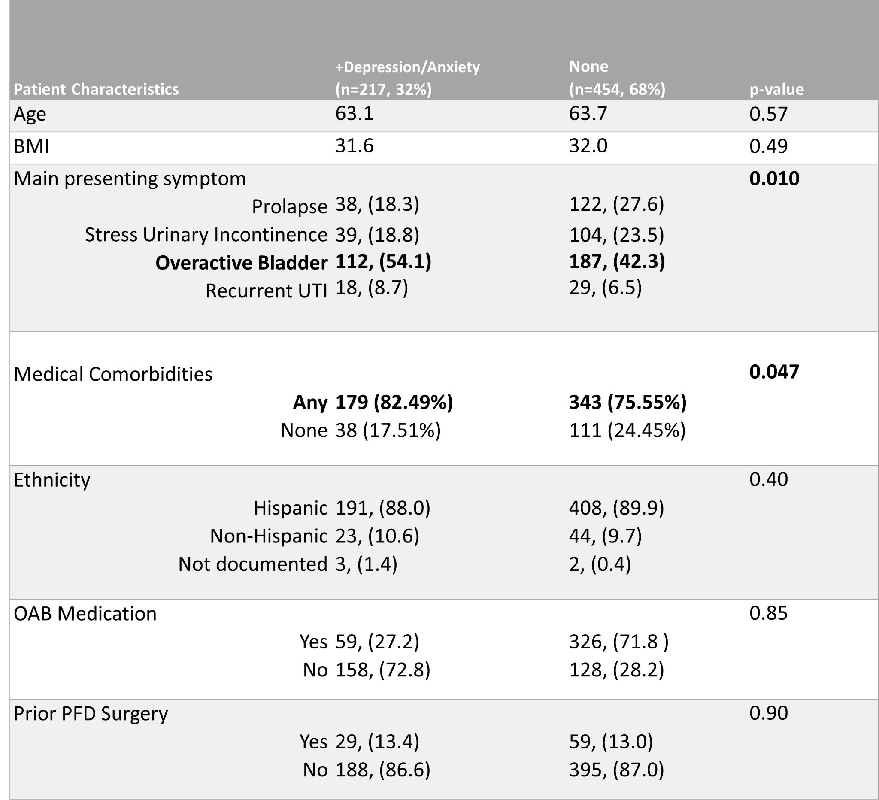
2nd ANNUAL
WEST TEXAS HEALTH DISPARITIES
RESEARCH SYMPOSIUM
RESULTS
Table 1: Characteristics of OAB patients with and without the diagnosis of anxiety and/or depression

Slide 13
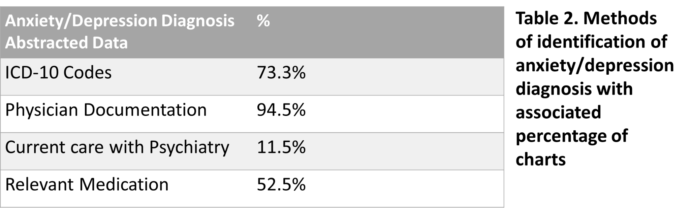
2nd ANNUAL
WEST TEXAS HEALTH DISPARITIES
RESEARCH SYMPOSIUM
RESULTS

Slide 14
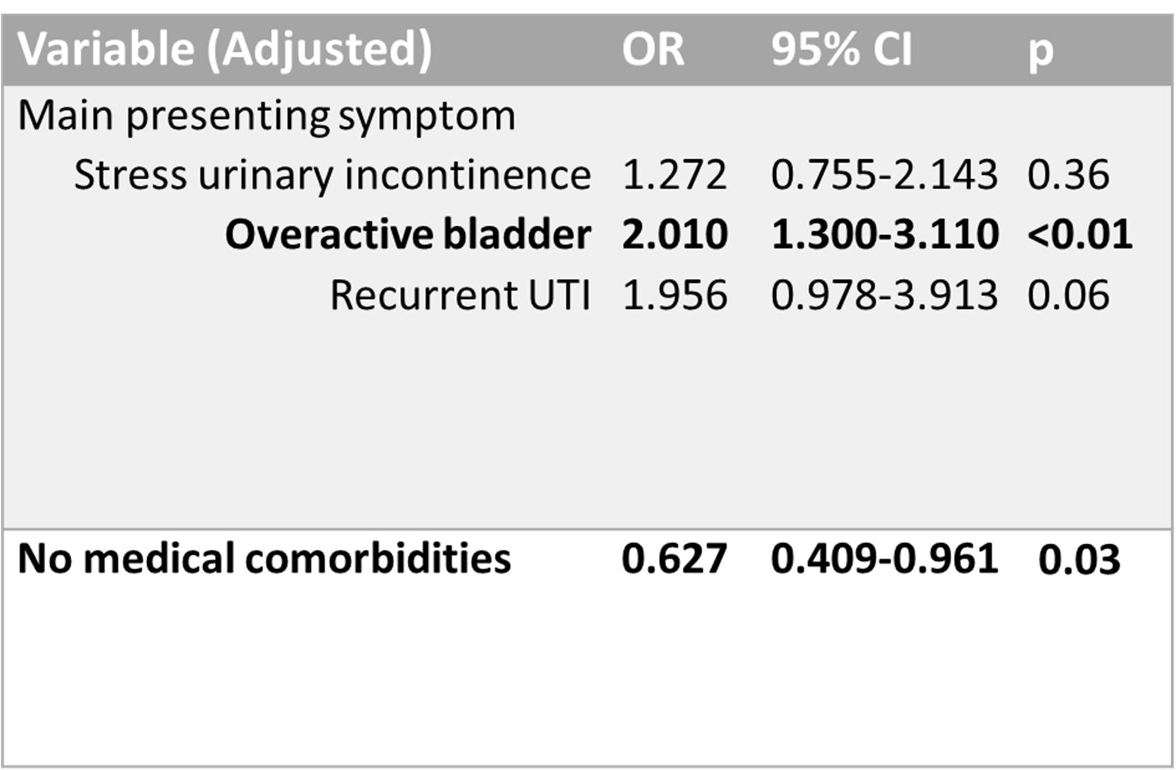
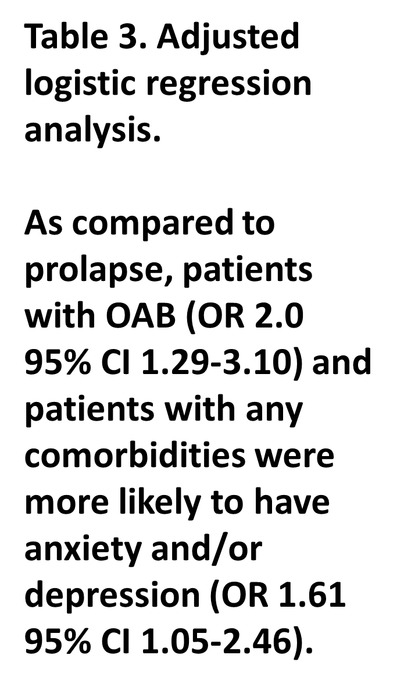
2nd ANNUAL
WEST TEXAS HEALTH DISPARITIES
RESEARCH SYMPOSIUM
RESULTS

Slide 15
2nd ANNUAL
WEST TEXAS HEALTH DISPARITIES
RESEARCH SYMPOSIUM
CONCLUSIONS
671 patient charts included in final analysis
217 (32.3%) of OAB patients had history of anxiety and/or depression
  21.2% anxiety only
  42.9% depression only
  35.9% both symptoms
1.4% (3 patients) were referred to psychiatry

Slide 16
2nd ANNUAL
WEST TEXAS HEALTH DISPARITIES
RESEARCH SYMPOSIUM
FUTURE PLANS
Our study does suggest that there may be benefit in screening patients with OAB for anxiety/depression and considering a multidisciplinary approach to treatment.
Future work will examine therapies for mental health and their effect in treatment of OAB.

Slide 17
2nd ANNUAL
WEST TEXAS HEALTH DISPARITIES
RESEARCH SYMPOSIUM
ACKNOWLEDGEMENTS
Dr. P. Antonio Maldonado, Dr. Sheralyn Sanchez
Madison Bencomo, Kate Olivas-Cardiel

Slide 18
2nd ANNUAL
WEST TEXAS HEALTH DISPARITIES
RESEARCH SYMPOSIUM
QUESTIONS

