Slide 1



Exploring Rural and Border Health Disparities through Student-Led Medical Missions in West Texas
Jayanand Mijagiri, MS3
2nd ANNUAL
WEST TEXAS HEALTH DISPARITIES
RESEARCH SYMPOSIUM
Notes:
Name
UTMB
Project title

Slide 2
2nd ANNUAL
WEST TEXAS HEALTH DISPARITIES
RESEARCH SYMPOSIUM
DISCLOSURES
NOTHING TO DISCLOSE

Slide 3

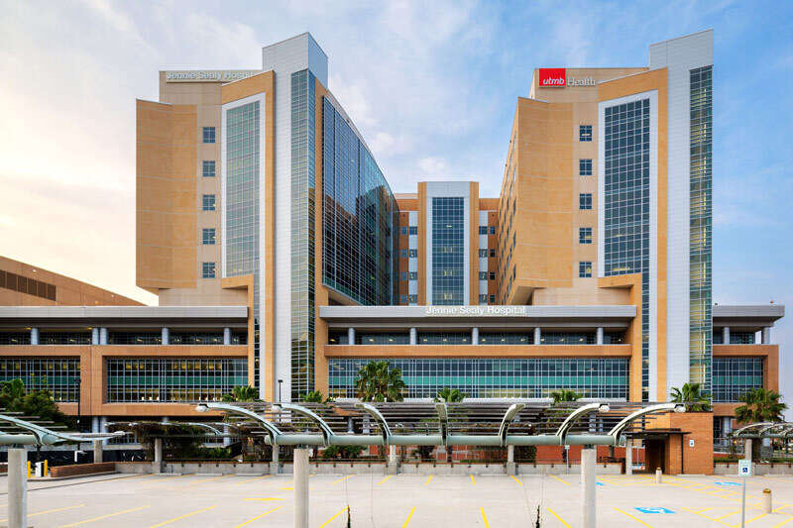

2nd ANNUAL
WEST TEXAS HEALTH DISPARITIES
RESEARCH SYMPOSIUM
Who We Are
Notes:
UTMB = University of Texas Medical Branch
First, and thereby oldest medical school in Texas
Galveston, Texas
Serve primarily the Galveston and Brazoria counties in East Texas
FdS, the organization I represent

Slide 4
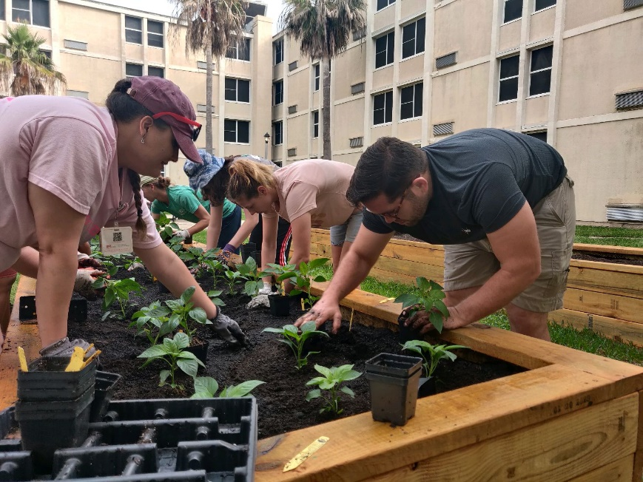
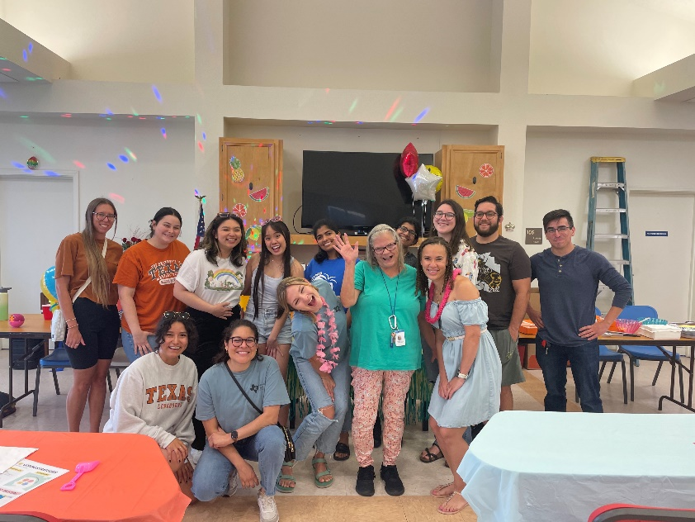
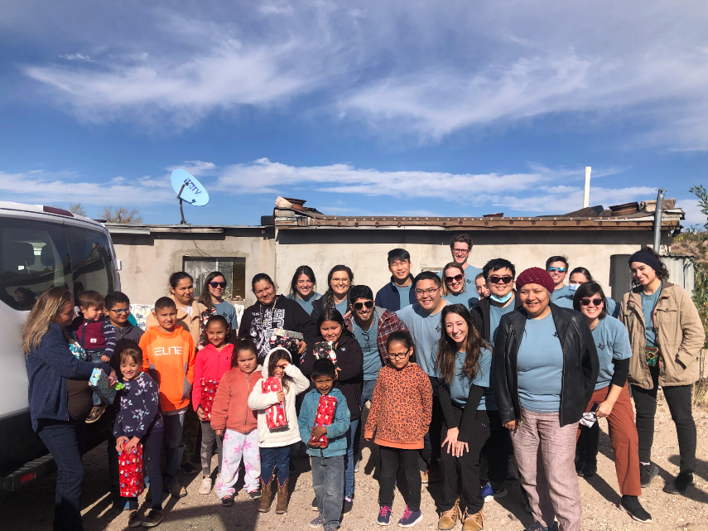
2nd ANNUAL
WEST TEXAS HEALTH DISPARITIES
RESEARCH SYMPOSIUM
Frontera de Salud
Interprofessionalism
Service
Border Health
Notes:
We are FdS: An interprofessional organization, one of the most active orgs on campus focusing on community and border health

Slide 5
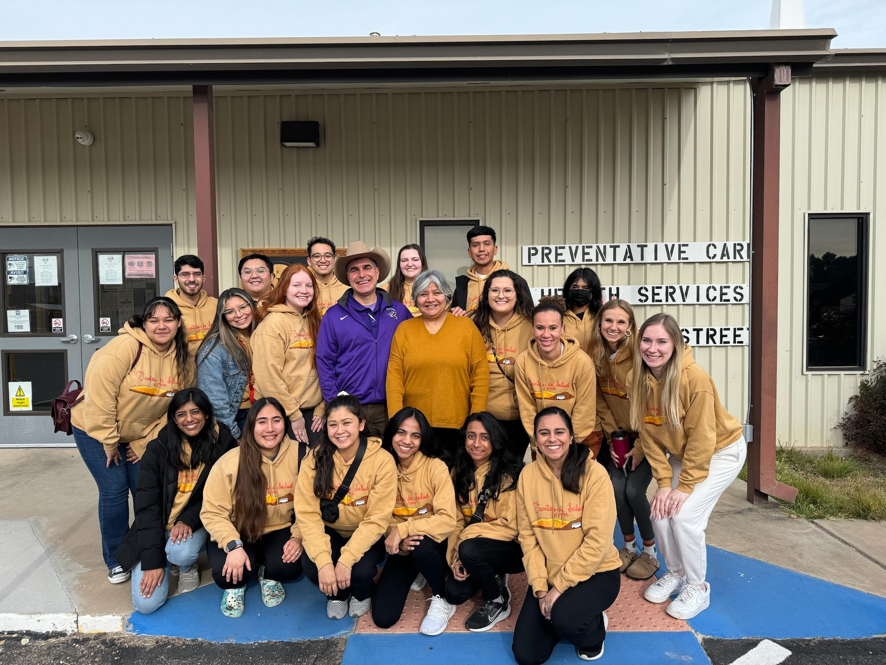
2nd ANNUAL
WEST TEXAS HEALTH DISPARITIES
RESEARCH SYMPOSIUM
Introduction
2023 FdS Annual Mission Trip
Notes:
Our annual Mission trip to West Texas, designed to address inequities in care and expose students to rural healthcare

Slide 6
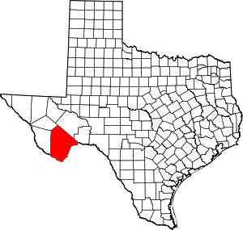
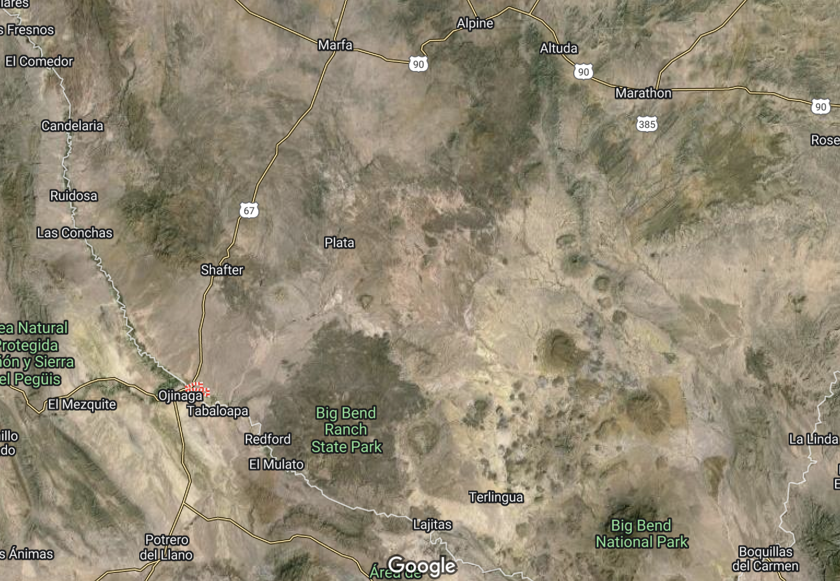
2nd ANNUAL
WEST TEXAS HEALTH DISPARITIES
RESEARCH SYMPOSIUM
Introduction
Notes:
The cities we visited over the last 2 trips
Arrows indicate Needs assessment locations

Slide 7
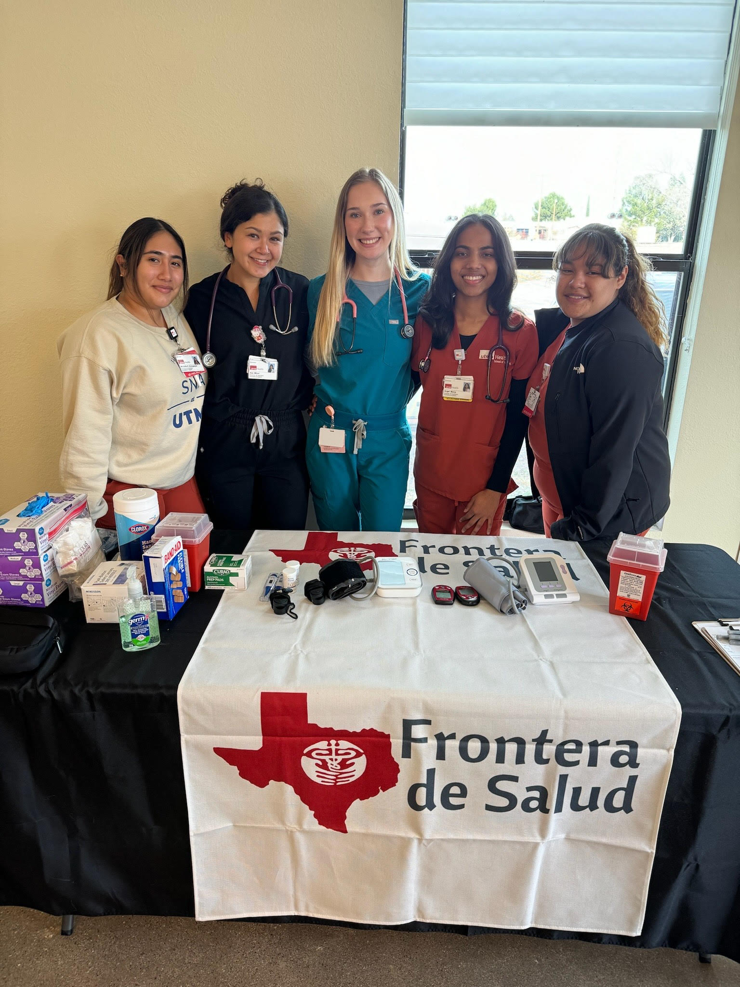
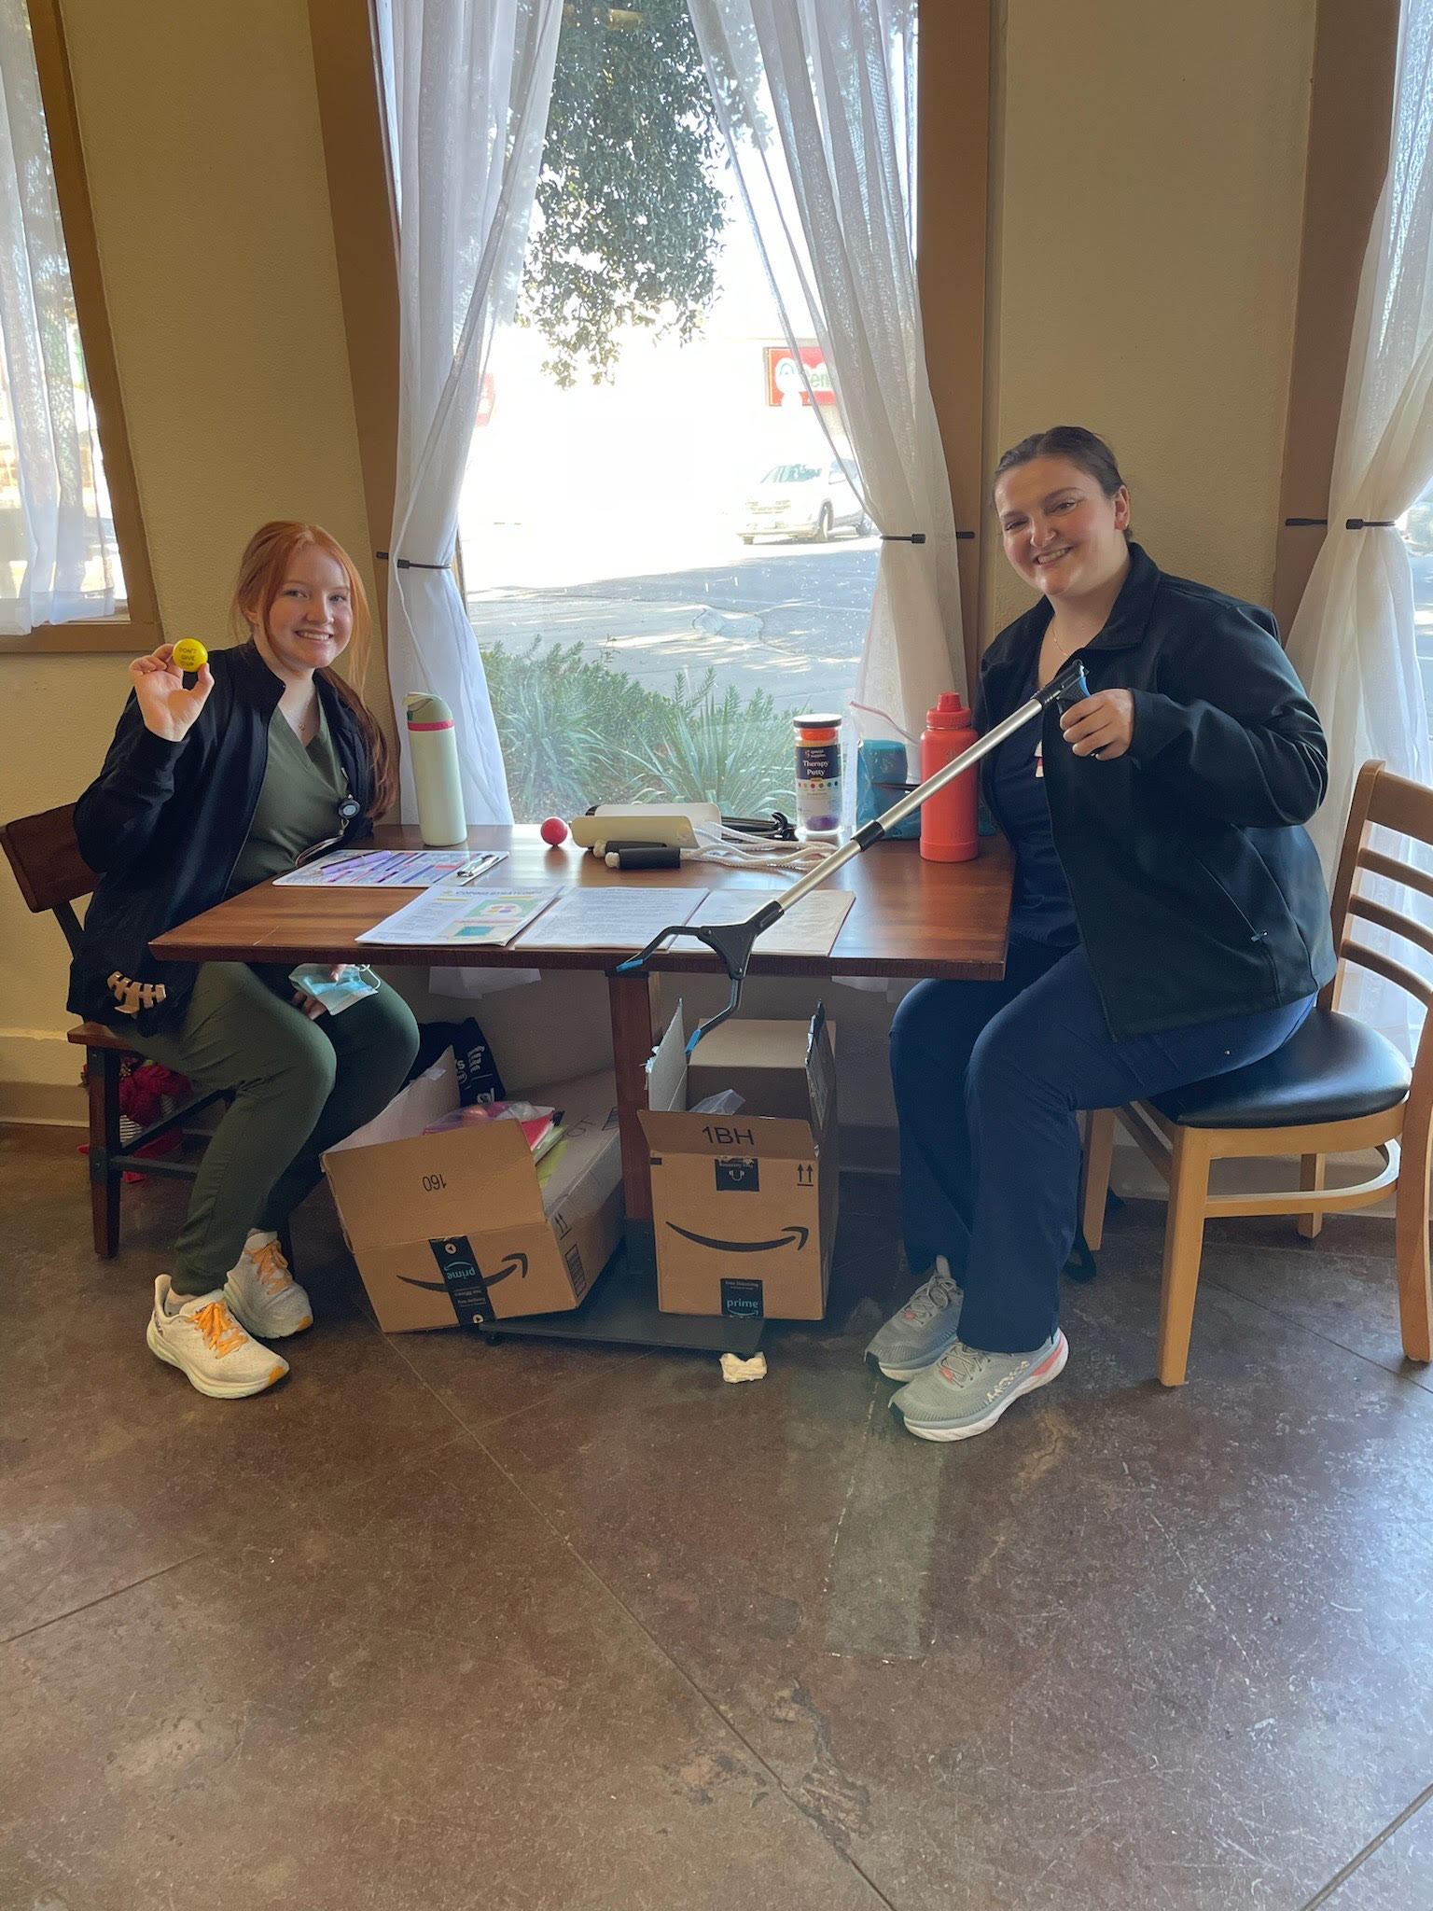
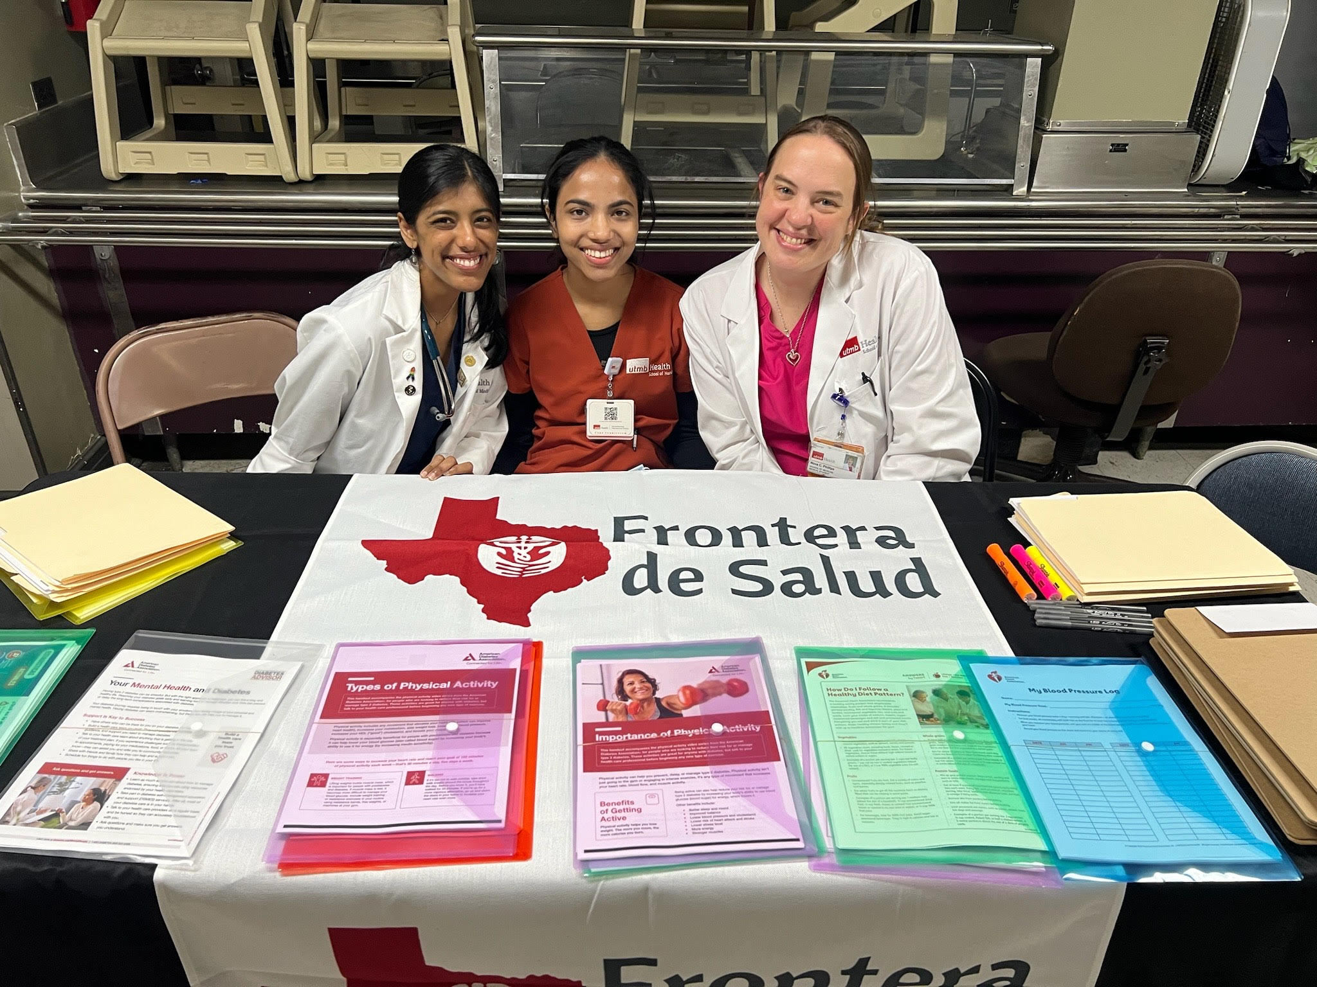
2nd ANNUAL
WEST TEXAS HEALTH DISPARITIES
RESEARCH SYMPOSIUM
Introduction
Health Care Pop-up Clinics
Notes:
First our nursing student would obtain vital signs, measure blood glucose, and ask them if they had any current concerns
Next our junior medical students would do a brief medical interview, complete a heart and lung exam and any other indicated exams
Then our upperclassman would work with our NP and family medicine residents to provide counseling and provide educational resources. We would also refer them to OT
OT would counsel patients on exercises and techniques to help them function more independently in their ADL

Slide 8
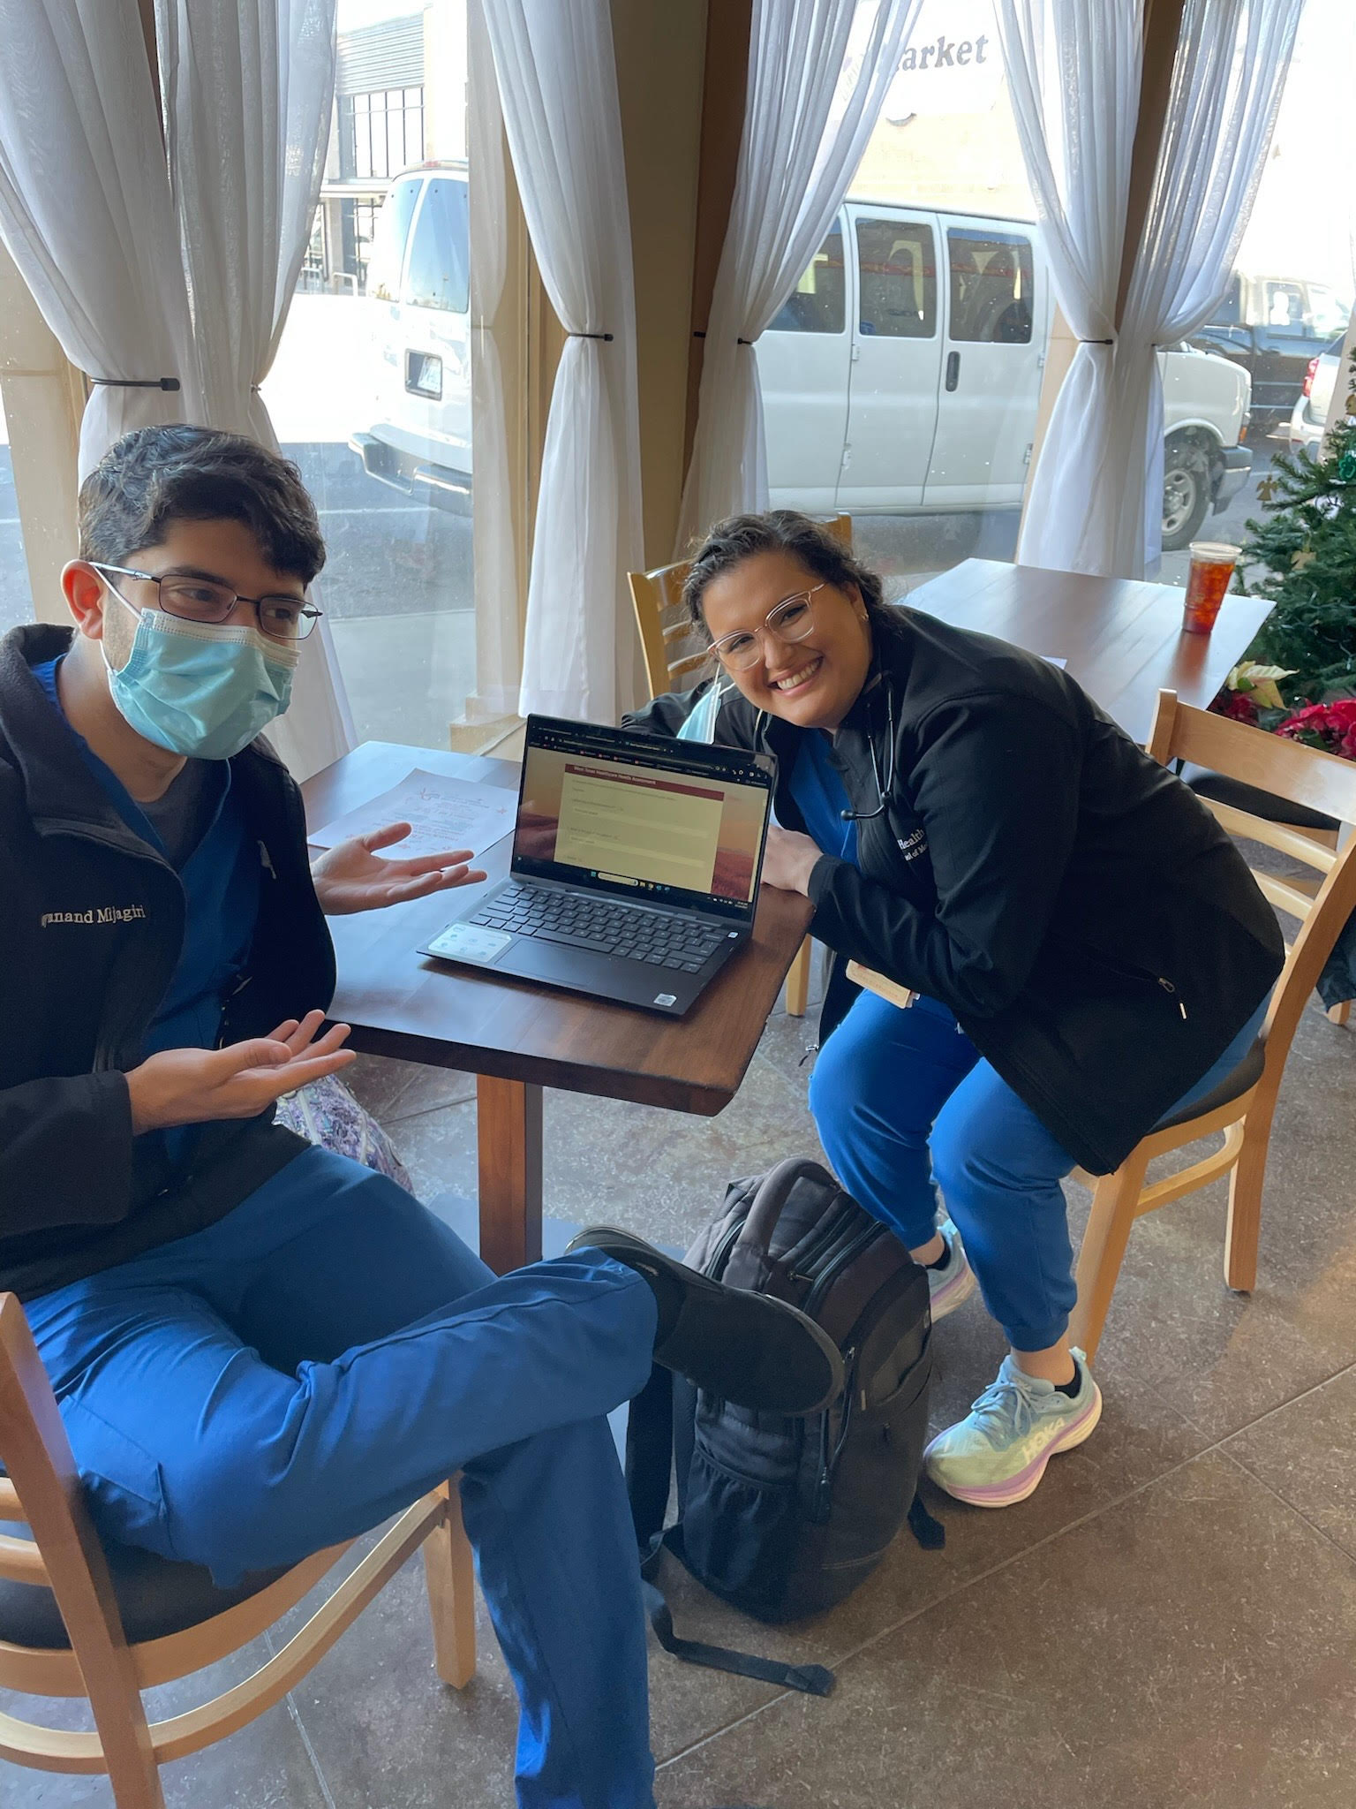
2nd ANNUAL
WEST TEXAS HEALTH DISPARITIES
RESEARCH SYMPOSIUM
Methods
Needs Assessment:
Informed consent was obtained
Objective data
  Demographics
  Healthcare access
  Tele-health
Subjective data
  Barriers to care
  Changes they would like to see
Notes:
At the end of the screening, we would ask if they were interested in completing a survey for our new needs assessment
Methodology and questions

Slide 9
2nd ANNUAL
WEST TEXAS HEALTH DISPARITIES
RESEARCH SYMPOSIUM
Demographics
N = 16
Average Age: 66 years
Notes:
Those who live in rural communities tend to be older (with an average age of 51 years, versus 46 in urban communities)[1]

Slide 10
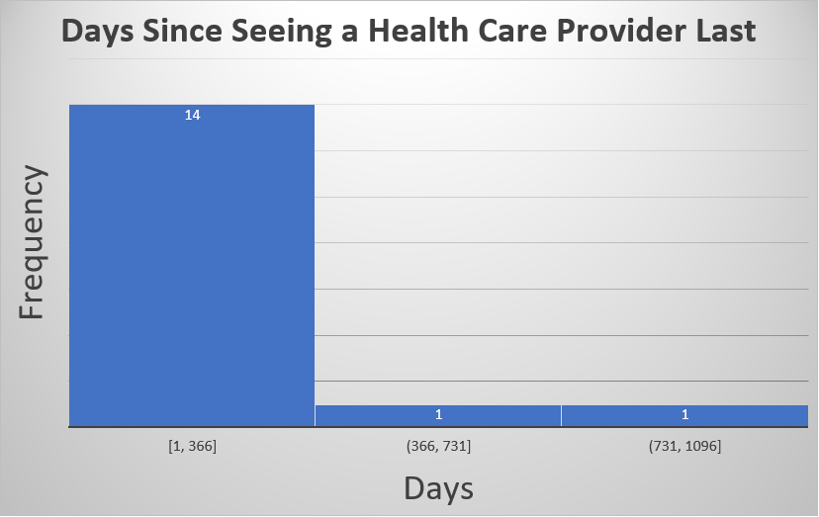
2nd ANNUAL
WEST TEXAS HEALTH DISPARITIES
RESEARCH SYMPOSIUM
Healthcare Access Data
Average:
203.5 days
Median:
76 days
Notes:
From the day we surveyed

Slide 11
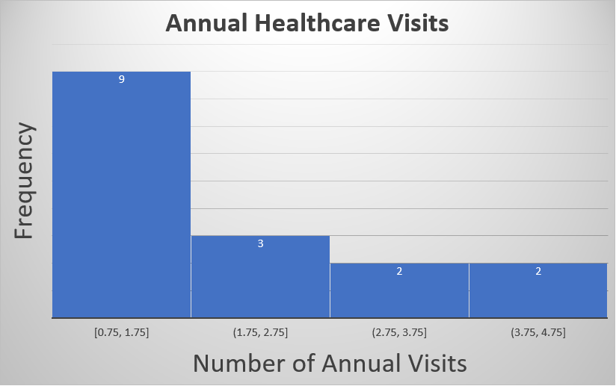
2nd ANNUAL
WEST TEXAS HEALTH DISPARITIES
RESEARCH SYMPOSIUM
Healthcare Access Data
Average:
1.86 visits annually
Median:
1 visit annually
National Average:
4 visits annually [2]
Notes:
USA average is 4 visits annually according to USA census data

Slide 12
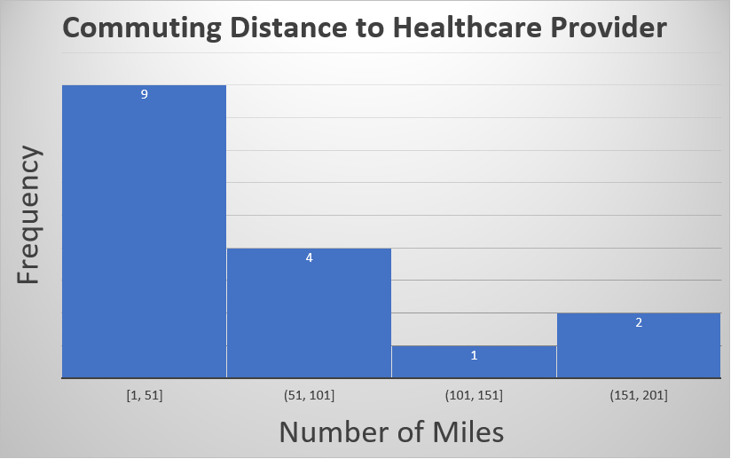
2nd ANNUAL
WEST TEXAS HEALTH DISPARITIES
RESEARCH SYMPOSIUM
Healthcare Access Data
Average:
51.53 miles
Median:
30 miles
National Average:
Rural: 10.5 miles
Urban: 4.4 Miles [3]
Notes:
Rural Americans live an average of 10.5 miles from the nearest hospital, compared with 5.6 miles for people in suburban areas and 4.4 for those in urban areas, according to a new PEW Center analysis.

Slide 13
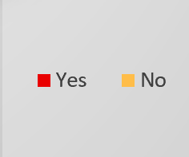
2nd ANNUAL
WEST TEXAS HEALTH DISPARITIES
RESEARCH SYMPOSIUM
Tele-Health Data
Interest in Tele-health Use
Notes:
Most did not use telehealth, but 50% of those who did not were interested

Slide 14
2nd ANNUAL
WEST TEXAS HEALTH DISPARITIES
RESEARCH SYMPOSIUM
Subjective Data
Notes:
Subjective data

Slide 15
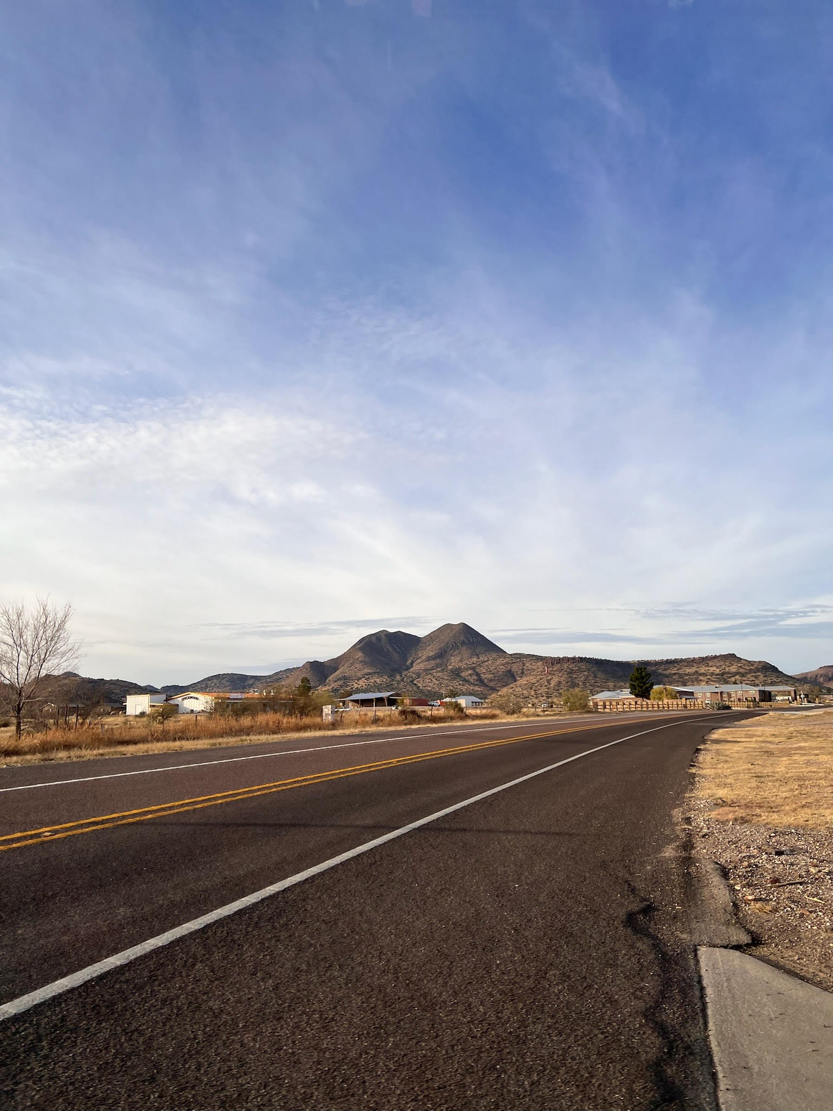
2nd ANNUAL
WEST TEXAS HEALTH DISPARITIES
RESEARCH SYMPOSIUM
Conclusions
Highlighted inequity in medical access in West Texas
There is potential for Tele-health to help bridge inequity
Most frequently cited barriers:
  Provider availability
  Financial
  Transportation.
Notes:
Even compared to other rural communities in USA
75% did not use telehealth, but 50 of those that did not were interested.
Systemic changes for Financial, but we provided free health care screens
Transportation, we came to them, however linited by the geography
Provider availability, we hope to inspire future health care providers to consider working in West texas

Slide 16
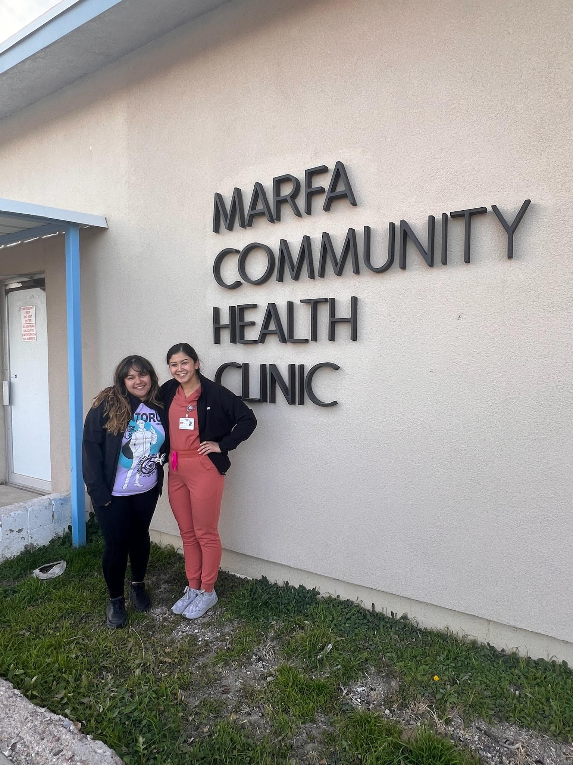
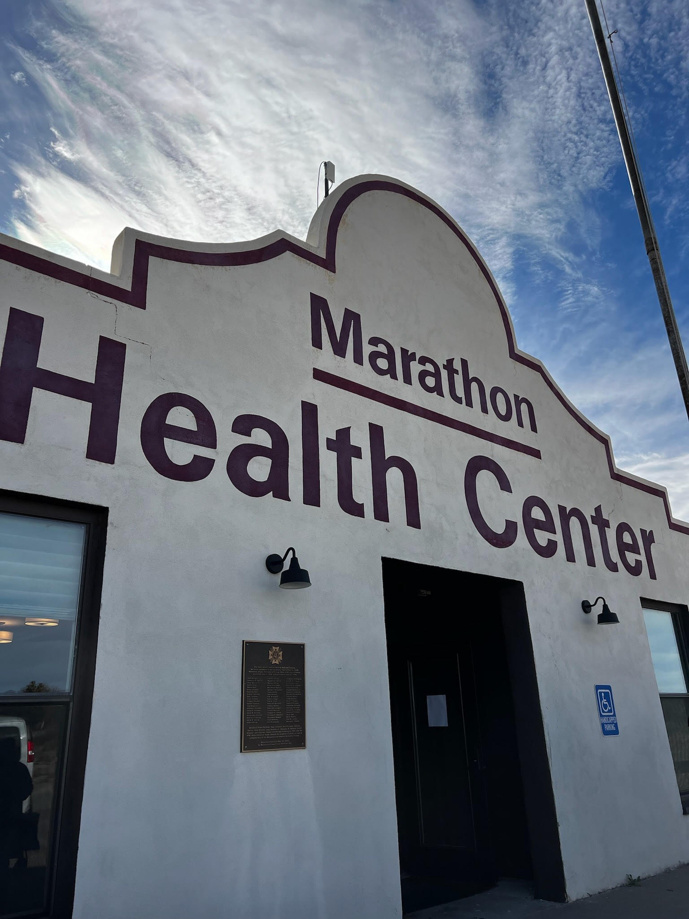
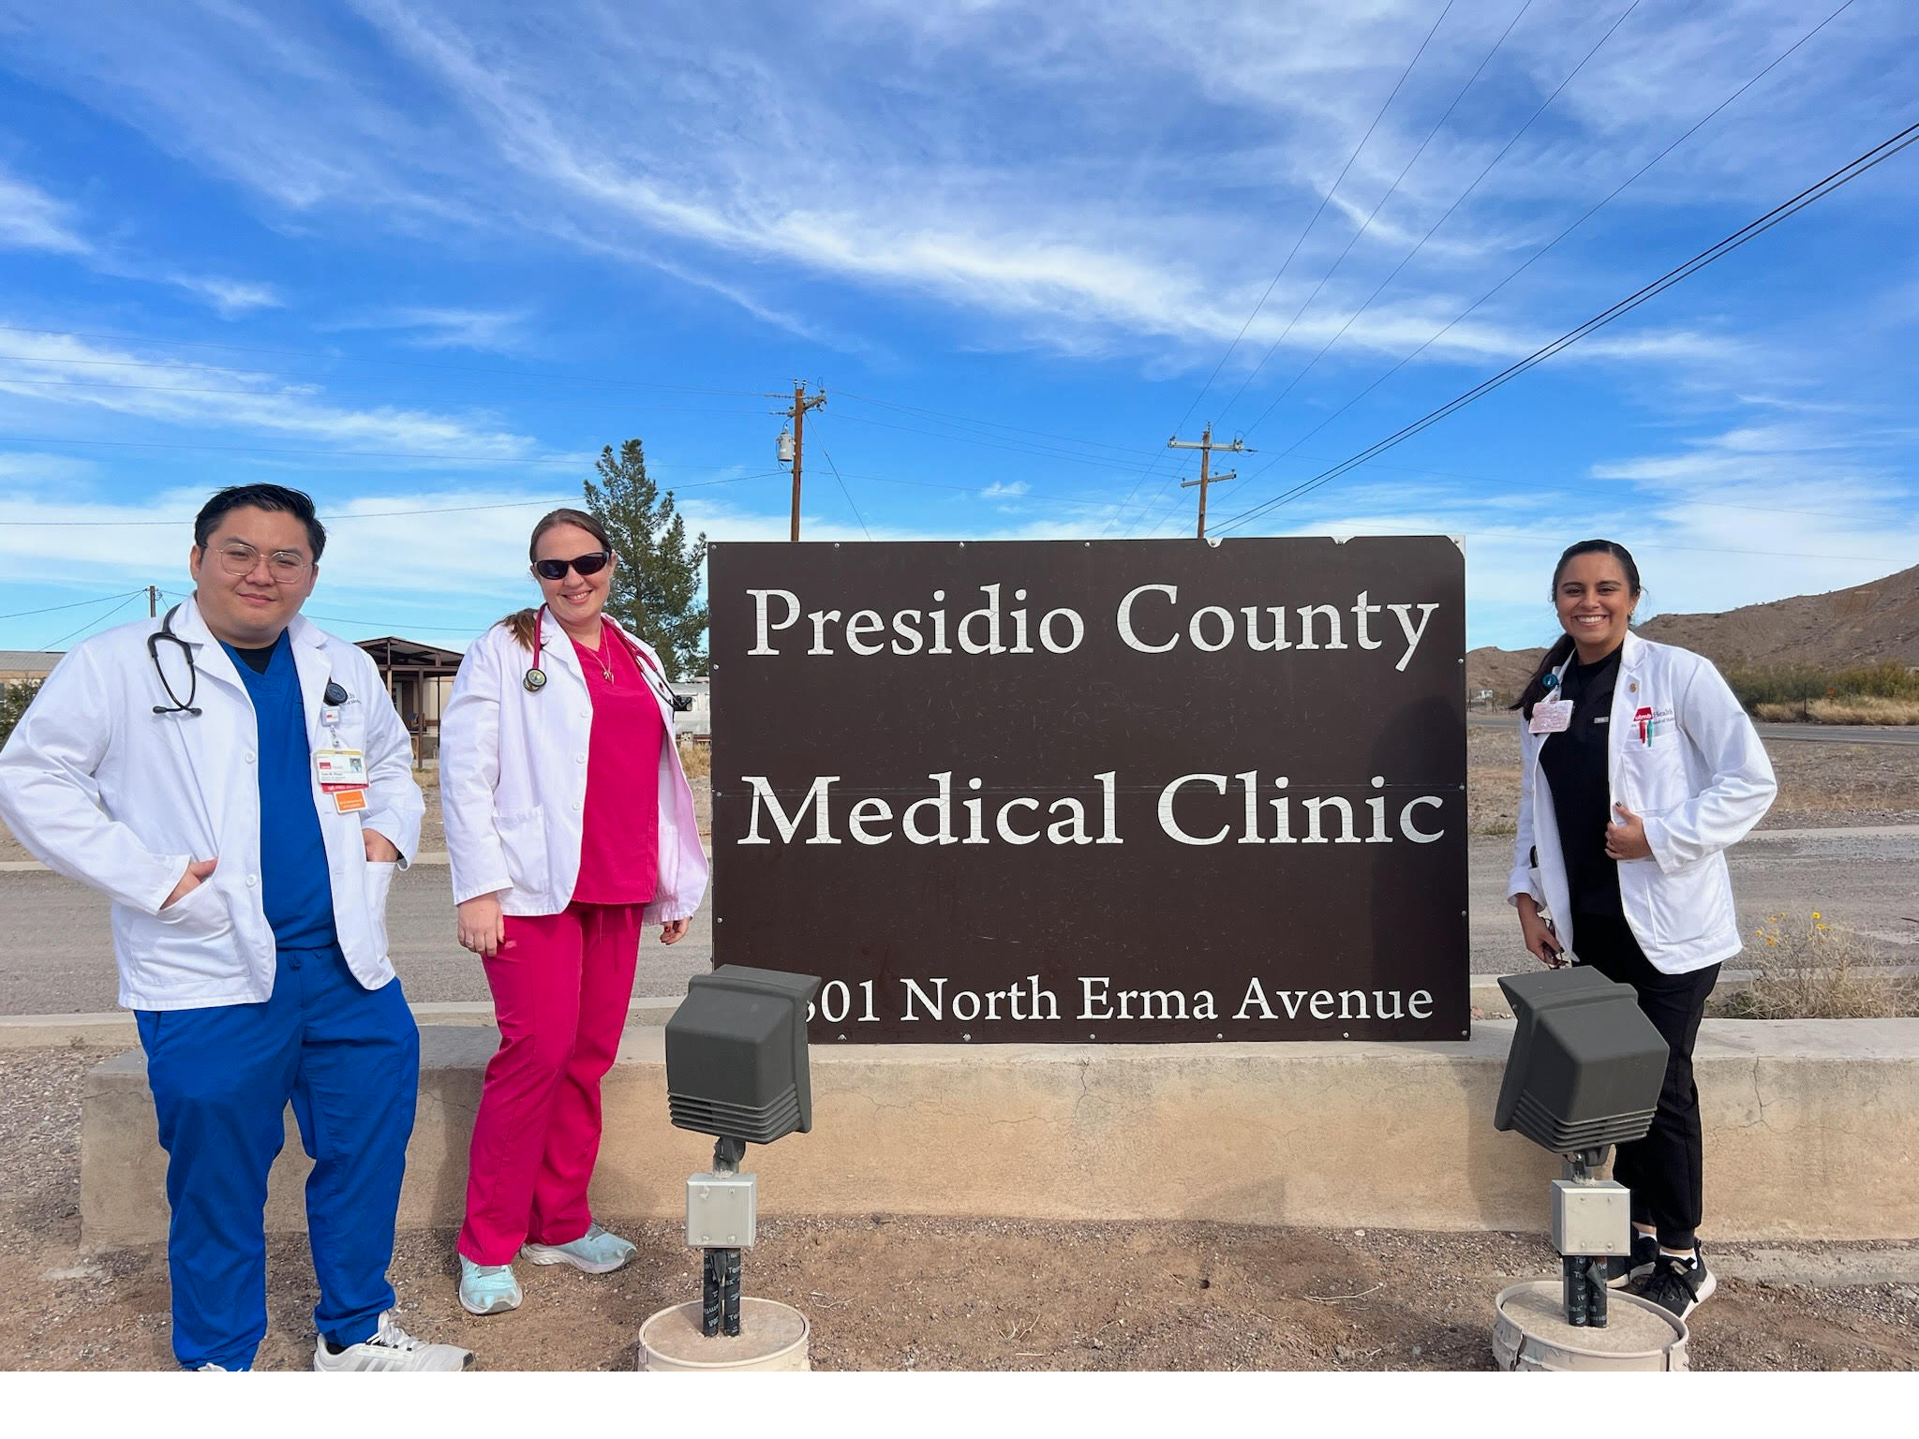
2nd ANNUAL
WEST TEXAS HEALTH DISPARITIES
RESEARCH SYMPOSIUM
Future Studies
Continue building upon our needs assessment and survey data
Tele-health quality metrics
Notes:
Need to get more surveys completed for a better sample size. Streamline Process to get more participants
How satisfied do tele-health patients feel with their care

Slide 17
2nd ANNUAL
WEST TEXAS HEALTH DISPARITIES
RESEARCH SYMPOSIUM
Acknowledgements
Authors: Jayanand Mijagiri, BS, 1, Elysse Reyes, MS, 1, Lydia A. Jepsen, BS, 1, Tuan Pham, BS, 1, Nova C. Phillips, MPH, 1, Alex Bustamante, MD, 2, Dylan Dean, MD, 2, Blake Billings, 3, Zane Billings, 4, Amber B. Armstead, DrPH, 1, Adrian Billings, MD, 4, Norma A. Pérez Raifaisen, MD, 1
University of Texas Medical Branch, Galveston, TX
TTUHSC Alpine Rural Family Medicine Residency Program, Alpine, Texas
University of Texas, Austin, TX,
Texas Tech University, Lubbock, TX

Slide 18
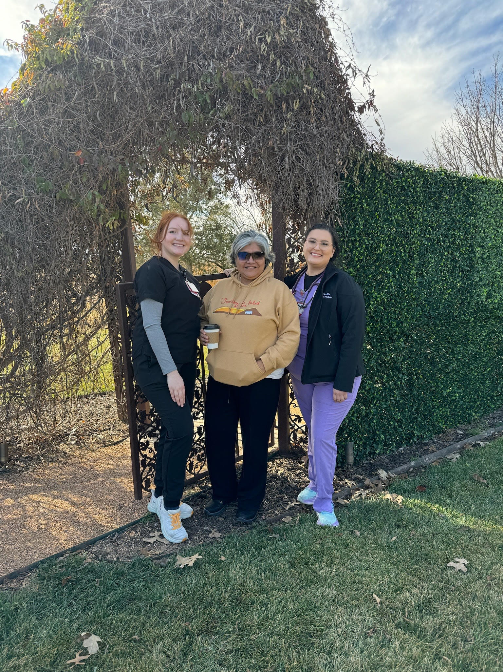
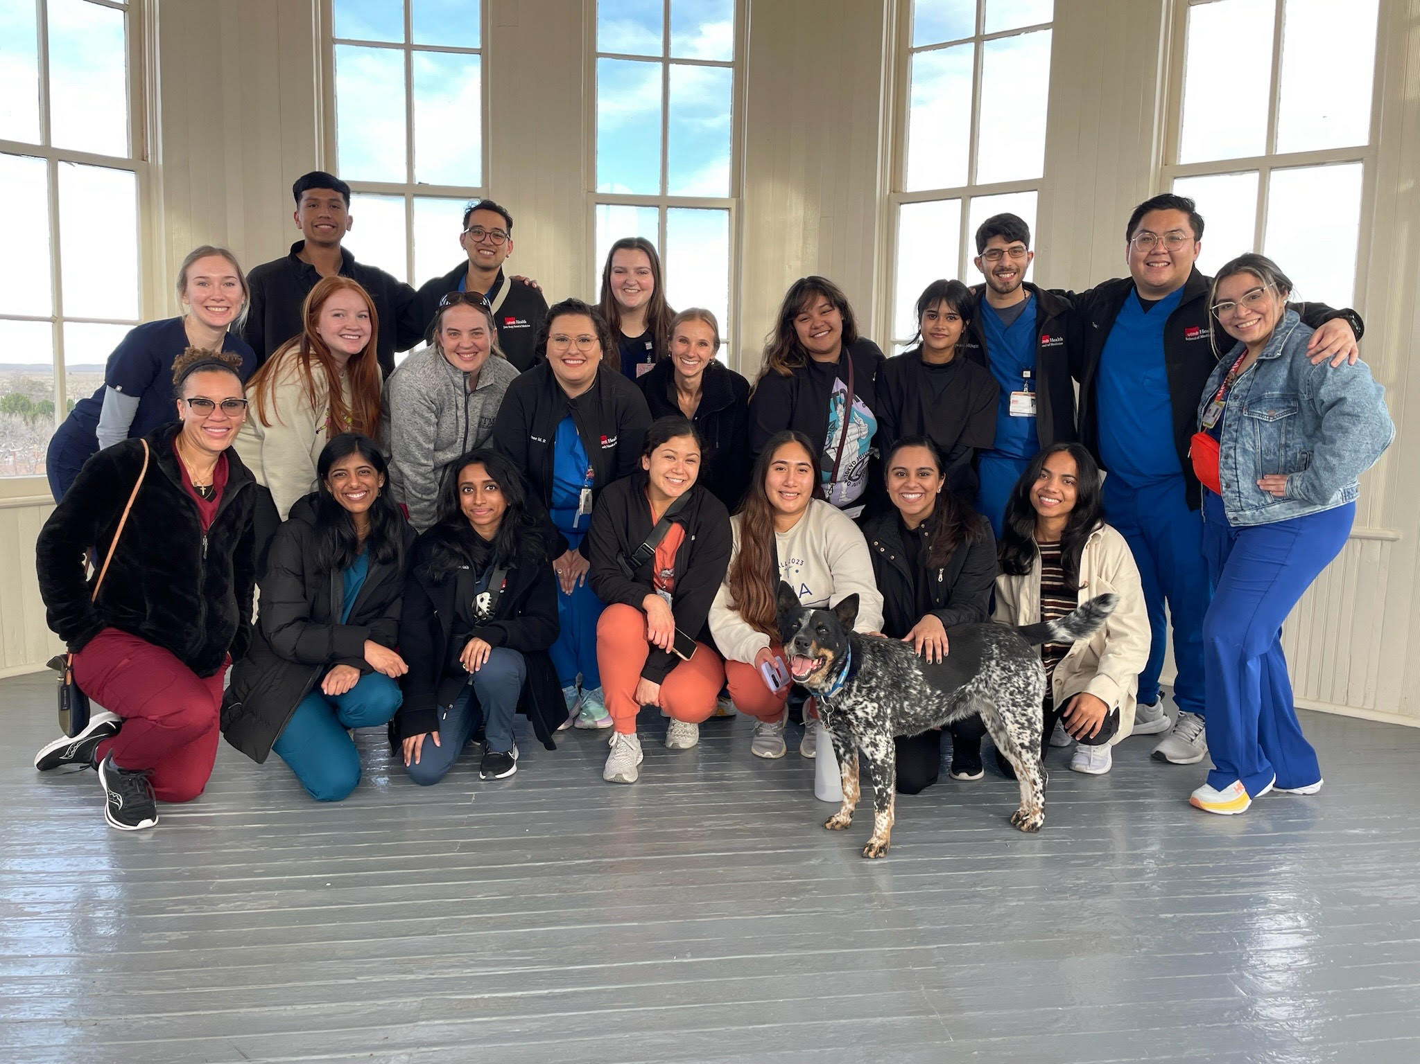
2nd ANNUAL
WEST TEXAS HEALTH DISPARITIES
RESEARCH SYMPOSIUM
Thank you!
Notes:
Questions?

Slide 19
2nd ANNUAL
WEST TEXAS HEALTH DISPARITIES
RESEARCH SYMPOSIUM
Works cited
Kim, R. (2020, October 13). Urban-rural by the numbers. National League of Cities. https://www.nlc.org/article/2018/09/27/urban-rural-by-the-numbers/#:~:text=Those%20who%20live%20in%20rural,29%20percent%20in%20urban%20communities).
Lam, O. (2018, December 12). How far americans live from the closest hospital differs by Community Type. Pew Research Center. https://www.pewresearch.org/short-reads/2018/12/12/how-far-americans-live-from-the-closest-hospital-differs-by-community-type/#:~:text=Rural%20Americans%20live%20an%20average,to%20a%20new%20Center%20analysis.
US Department of Commerce. (2016, May 19). Americans are visiting the doctor less frequently, Census Bureau reports - Health Care & insurance - newsroom - U.S. census bureau. United States Census Bureau. https://www.census.gov/newsroom/releases/archives/health_care_insurance/cb12-185.html

