Slide 1
A Review of Clinical Epidemiology, Study Design, and Statistical Inference for the Clinician
Robert P. Kauffman, M.D., MSCP
Professor
Department of Obstetrics & Gynecology
Assistant Dean for Research Education
Texas Tech University HSC School of Medicine
Amarillo, Texas

Slide 2
Outline
Definitions
Study Designs
Descriptive
Cohort
Case-control
Randomized clinical trial
Selecting a control group
Bias
Selection
Confounding
Ascertainment
Randomization
Chance
Other Terms
The Evidence Hierarchy

Slide 3
Bennet’s Classification for Reading the Medical Literature
Medical Student | Reads entire article but does not understand what it means
Resident | Would like to read article but eats dinner instead
Chief Resident | Skips article entirely and reads classifieds instead
Junior Attending | Reads and analyzes entire article to pimp medical students and residents
Private Attending | Doesn’t buy journals in the first place but keeps an eye open for medical articles that make it into the newspapers
Emeritus Attending | Reads entire article but does not understand what it means
Bennet H. JAMA 1992; 267(7): 920

Slide 4
Medicine Residents’ Understanding of the
Biostatistics and Results in Medical Literature
Windish DM, et al. JAMA 2007; 298: 1010-1022.
Notes:
You can be sure that those in private practice do worse. Journal club activities should be part of lifelong learning.

Slide 5
Definition Epidemiology
The study of the distribution, determinants, and prevention of health problems in a population
An investigation into the factors that determine the presence or absence of diseases and disorders
Epidemiological research helps us to understand how many people have a disease or disorder, if those numbers are changing, and how the disorder affects our society and our economy
Determines evidence-based diagnostics and treatment

Slide 6
Epidemiology
The basic science of clinical practice
The key to the new paradigm of evidence-based medicine
An intuitive, logical way of approaching patients and their problems
JAMA 1992;268:2420-4.

Slide 7
Statistics
Statistics is a mathematical science pertaining to the collection, analysis, interpretation or explanation, and presentation of data
Notes:
Stats are a mathematical expression of data much like physics is the application of mathematics to physical phenomena.

Slide 8
Approach to Population Analysis
Census Approach
Study everyone
Pro: no need for statistics or inference
Con: impractical
Sample Approach
Study a sample of the population
Pro: feasible
Con: need mathematical modeling (statistics) to infer into the broader population

Slide 9
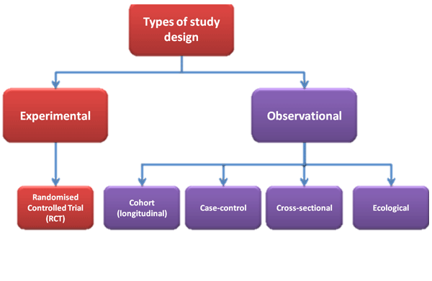
Study Design

Slide 10
Taxonomy of Research Studies
Case reports and case series
Observational
Descriptive
Cross-sectional studies
Analytic
Cohort study
Case-control study
Experimental
Randomized trials
Each method will be explored in this lecture
Notes:
Some set descriptive studies as its own category.

Slide 11
The Two Basic Research Types (Study Designs)
Case Report
Observational
Investigators merely watch what occurs in clinical situation or practice.
No manipulation of exposures
Passive involvement
Experimental
Investigators manipulate the exposures of interest
Active involvement

Slide 12
Approach to Study Design
No study is perfect, therefore it is important to understand the limits of each design
Serious problems or mistakes in the study design stage cannot be corrected in subsequent stages of the study
Notes:
Dr. Myles n&v study being undertaken by Dr. Johnson. This error was a serious mistake.

Slide 13
Case Reports and Case Series

Slide 14
Types of Case Reports/Series
 | Images in Medicine | Case Reports/Series | Clinical Problem Solving Case (CPS)
Description | ECG, photos, labs | Extensive fact finding Review other cases Implications for practice or research | Diagnostic approach to sequentially presented information Clinical reasoning integrated throughout report
Effort | Easy | Requires more work | Requires extensive work and use of an “expert”

Slide 15
Case Reports and Case Series
Case report
Detailed report of a patient’s medical encounter, symptoms, diagnosis, treatment, and follow up
3 or fewer patient
Goal: create new research questions that enhance knowledge base
Case series
Involve multiple patients
Qualitative research method
Gives greater in-depth analysis compared to single case reports
May describe a condition and associated relationships among patients

Slide 16
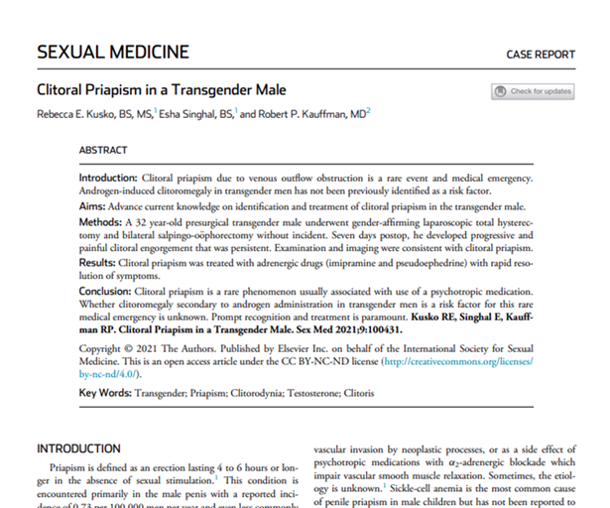
Case Report
Kauffman RP, et al. Sexual Med 2021; (: 100431

Slide 17
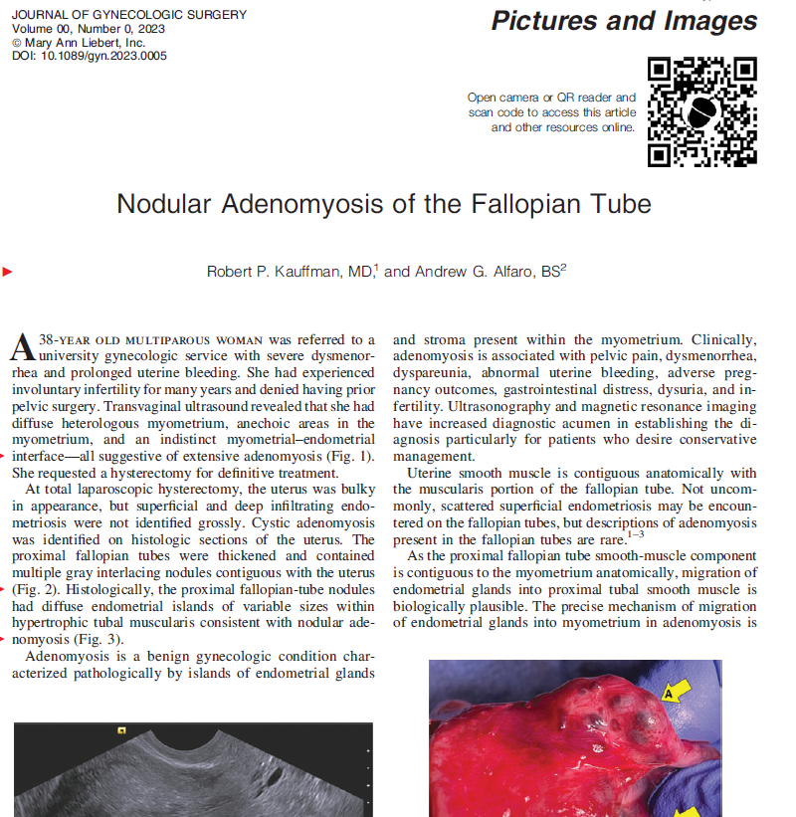
Medical Images
Kauffman RP, et al. J Gynecol Surg 2023

Slide 18
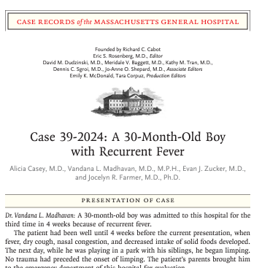
Clinical Problem Solving Case
Casey A, et al. N Engl J Med 2024; 392(23): 2245

Slide 19
Case Reports and Case Series Advantage and Disadvantages
Advantages | Disadvantages
One case needed to spur interest (report) | No controls
Provides stronger evidence with multiple cases (series) | Difficult to compare different cases (heterogeneity)
Adds to medical knowledge | Knowledge may not be generalizable
Easy to do | Selection bias
Identifies new diseases or rare manifestations of a disease

Slide 20
Descriptive Studies

Slide 21
Descriptive Study Cross-Sectional Study
Information about a new disease or condition is collected
Collection of data from a large case series
No manipulation (no exposure)
No comparison group
One time interaction or longitudinal approaches
Possible endpoints
Symptoms
Exposures
Outcomes
Next step in research protocol: observational study with control group

Slide 22
Descriptive Study Subtype of Observational Study
Population based survey
Assesses incidence or prevalence of a problem or an exposure
Measure exposure and outcomes simultaneously
Describes characteristics of those with the problem or the exposure
Develops clues about etiology that can ten be tested with more rigorous designs
Examples
Characterization of COVID-19 presentation (symptoms)
Assessment of populations with mild/severe COVID-19
Notes:
Descriptive study is usually conducted when little is known about the occurrence, natural history, or determinants of a health issue.

Slide 23
Descriptive Studies Data Sources
Vital records (birth and death certificates)
Hospital charts
Surveys/questionnaires
Lab reports
Morbidity/mortality reports

Slide 24
Descriptive Studies
The 6 W’s
Who? was involved
What? happened
Why? did it occur
When? did it take place
Where? did it happen
So What? What difference does it make?

Slide 25
Rationale for Descriptive Studies
Information derived from descriptive studies may suggest possible associations which require further study using analytic techniques

Slide 26
Descriptive Studies Advantages
Data may be already collected
Data may be easy to obtain
Ethical problems are minimal
Usually low cost

Slide 27
Cross-Sectional Descriptive Studies Limitations
Only one group is studied
No comparison group
No firm conclusions can be made about exposure and outcome
Notes:
Can get false associations.

Slide 28
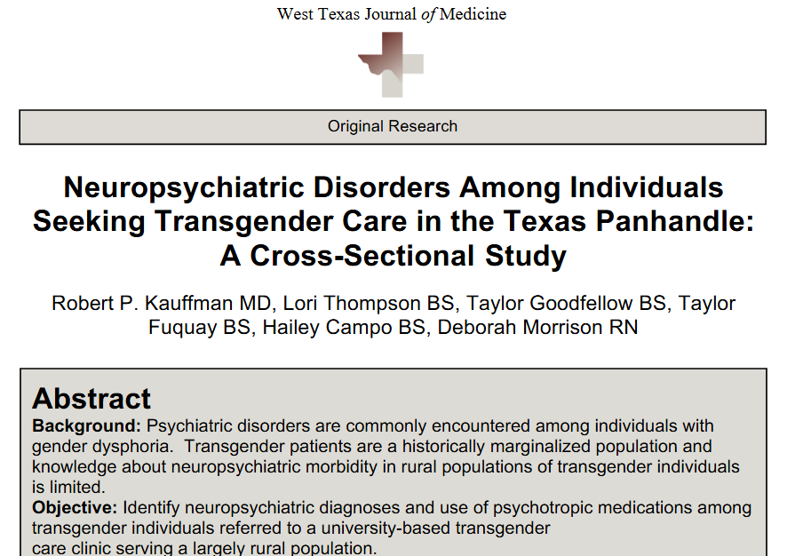
Cross-Sectional Study
Kauffman RP, et al. West Texas J Med 2024; 2(2): 1-9

Slide 29
Cross-Sectional Study
Female patients with PID
Reproductive Outcomes
Exposures
STI’s
SOCIOECONOMIC CHARACTERISTICS
Age, Marital Status

Slide 30
Cross-Sectional Study
Symptoms
Effect on Male/Female Fertility
COVID-19
Perinatal Outcomes
At Risk Categories
(Age, Comorbidities)
Long-term
Sequela

Slide 31
Data Presentation Descriptive Studies
Tables
Histograms
Line Graphs
Scatter Plots
Pie Charts
Pictograms

Slide 32
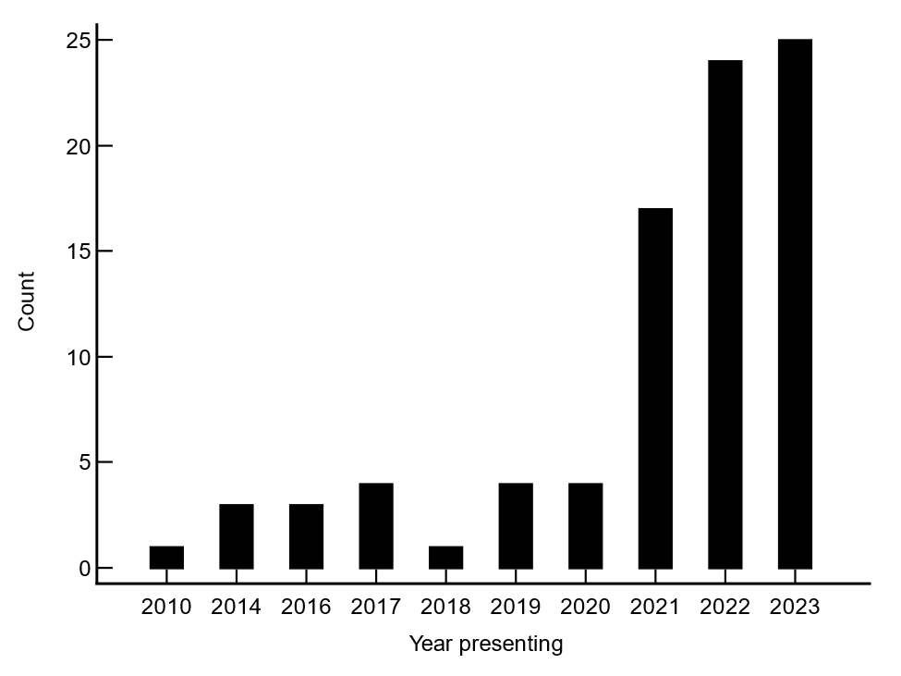
Histogram for a Descriptive Study
P < 0.0001
Number of new patients presenting for transgender care
Kauffman RP, et al. West Tex J Med 2024; 2(2): 1-8

Slide 33
Analytic Studies
Cohort
Case-control

Slide 34
Analytic Studies
At least 2 study groups present
One group of subjects with the outcome or exposure of interest and another group without the health problem or exposure
Association between exposure and outcome can be examined

Slide 35
Analytic Studies
COHORT
Cause or Exposure
Effect or Outcome
CASE-CONTROL

Slide 36
Cohort Study Example
Theoretical study of 200 mothers who volunteer to receive RSV vaccination in 3rd trimester. No randomization or placebo arm.
RSV Vaccinated in Utero (Exposure) RSV in Baby (Outcome)
Yes (n = 100) 5 (5%)
No (n=85) 17 (20%)
TIME
Notes:
Prospective.

Slide 37
Cohort Study Example
Hypertensive
EXPOSED
(Used OCP)
Not Hypertensive
Women using TTUHSC Clinics
Hypertensive
UNEXPOSED
(No OCP Use)
Not Hypertensive
Exposure Outcome
Notes:
Outcome data can be categorical (as above) or continuous.

Slide 38
Cohort Design Notes
At least 2 groups are studied
Entry into groups is not randomized
Both groups followed for a period of time to determine frequency of the outcome in each group
The risk of developing the problem for those exposed and those unexposed can be compared to see if there is a difference between groups (statistical analysis)

Slide 39
Cohort Study
Advantages
Relatively free of selection bias
Can observe spectrum of outcomes
Allows determination of incidence rates and relative risks (RR)
Disadvantages
Exposure information must be determined at onset of trial
Statistically inefficient for studying rare diseases since exposure information must be collected on a large number of subjects

Slide 40
Cohort Study Helpful Hints
Occurrence of outcome should be fairly frequent, eg, > 5% of the population
If outcome occurs rarely, then a case-control study may be better suited
Notes:
Cohort only useful when outcome is not rare.

Slide 41
Nonconcurrent vs. Concurrent Cohort Studies
Nonconcurrent Study
Concurrent Study
Look Back
+
+
-
-
Trace Forward
Follow Forward
2004
2014
2024

Slide 42
Relative Risk (RR)
A measure of association
A ratio of rates
Rate in exposed
Rate in unexposed
RR = 1.0 (no effect, ie, null hypothesis proven)
RR > 1.0 (increased risk)
RR < 1.0 (decreased risk)
RR’s have no units
= RR
Notes:
Null hypothesis—there is no difference between study groups.

Slide 43
Cohort Studies and Relative Risk
The traditional p-value tells us only about random chance
Relative risk (with 95% confidence limits) tells us about:
Strength of association
Direction of association
Random chance
Example
P<0.05 vs. RR=8.0 (95% confidence interval, 6.2-9.8)
Notes:
“p” value tells use that if the experiment is repeated several times, the chance of the outcome falling in the 95% CI is 95%.

Slide 44
Cohort Study Analysis
Exposure (Vaccine)
yes no
A | B
C | D
yes
Outcome
(RSV)
no
Theoretical study of 200 mothers who volunteer to receive RSV vaccination in 3rd trimester. No randomization or placebo arm.

Slide 45
Relative Risk (RR)
Numeric measure of association between exposure and outcome
Exposure
+ -
A | B
C | D
RR = [a/a+c] / [b/b+d]
+
Outcome
-
Notes:
Used in cohort studies only and not case-control studies.

Slide 46
Theoretical study of 200 mothers who volunteer to receive RSV vaccination in 3rd trimester. No randomization or placebo arm.
Exposure
+ -
5 | 17
95 | 68
+
Outcome
-
RR = 0.25
(95% CI 0.096-0.649)
p = 0.004
100 85
Notes:
Sample 200 Texas med school applicants who applied to medical school, and represents data from a single year. This data is made up. Tech is exposure, med school admission is outcome. 57 got into med school of the sample of 200 (a+b), and 143 did not get in (c+d). 32 of 57 Tech grads got in, but 68 Tech grad out of 143 surveyed did not get in. This sample may have come from people living in the Panhandle (selection bias).

Slide 47
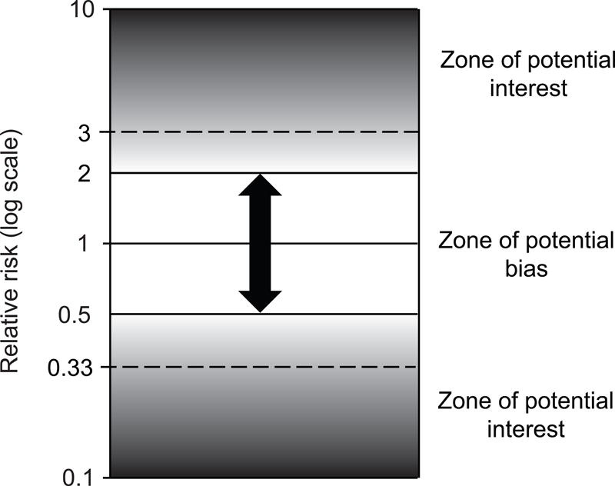
Zones of Potential Bias in Cohort Study
Grimes DA, et al. Obstet Gynecol 2012; 120(4): 920-7
Notes:
Zones of potential bias and potential interest in a cohort study. Threshold of potential interest starts at 2 or 3 (dashed line) for increased risk and 0.5 or 0.33 (dashed line) for decreased risk.

Slide 48
Confidence Intervals (CI)
Relative risks provide a point estimate of the true relative risk in the entire population
Confidence intervals tell us how precise are the point estimates of RR
Degree to which results would vary if measured multiple times
Hence, if study repeated multiple times, the range would contain the true effect 95% of the time.
A range of plausible results (“effect estimation”)
Narrow confidence intervals imply precision, and vice versa
By definition, if the 95% confidence interval does not overlap 1.0, the RR is significant at p<0.05

Slide 49
A larger study usually results in narrower CI (greater precision)
Exposure
+ -
RR = 0.25
(95% CI 0.096-0.649)
p = 0.004
5 | 17
95 | 68
+
Outcome
-
RR = 0.25
(95% CI 0.227-0.275)
p < 0.0001
500 | 1700
9500 | 6800
10000 8500
Notes:
Same proportion (RR) on bottom but with higher precision due to 100x pateints.

Slide 50
Analytic Studies II
COHORT
Cause or Exposure
Effect or Outcome
CASE-CONTROL

Slide 51
Case-Control Trial
Tests whether an association exists between an outcome and a previous exposure

Slide 52
Case-Control Design
2 (or more) groups studied
Cases—group(s) that experience(s) outcome studied
Controls—group that does not experience outcome
Entry into groups not influenced by investigator and therefore cannot be randomized
Cases are identified during a given period of time
Notes:
Randomization not possible as studying outcome back to exposure. Must use all cases in a specified time to avoid bias.

Slide 53
Case-Control Study Example 1
Exposed to Risk Factor (Infection)
IUFD
No Risk Factor Exposure
Hospital Deliveries
Exposed to Risk Factor (Infection)
No IUFD
No Risk Factor Exposure
OUTCOME
EXPOSURE
Notes:
Infection could be GBBS. Good study design because fetal demise is uncommon

Slide 54
Case-Control Study Example 2
Study Question: Is sexual activity a risk factor for UTI in teen girls?
Design: Retrospectively examine charts of 200 girls age 14-18

Slide 55
Case-Control Study Example 2
Sexual Activity (Exposure) UTI (Outcome)
n=18 or 22% Yes (n=82)
n=20 or 17% No (n=118)
Odds Ratio 1.23 (95% CI 0.60-2.53, p = 0.56)
Time
Notes:
Small study had large CI.

Slide 56
Case-Control Analysis
EXPOSURE
yes no
A | B
C | D
yes
OUTCOME
no

Slide 57
The Odds Ratio (OR)
Exp
Not Exp
Case
A
B
Control
C
D
odds a case is exposed
O.R. =
odds a control is exposed
A·D
B·C

Slide 58
The Odds Ratio (OR)
Exp
Not Exp
Case
18
64
Control
20
88
odds a case is exposed
O.R. =
odds a control is exposed
A·D
B·C

Slide 59
Advantages of Case-Control Studies
Good for rare outcomes
Best with diseases with long latency
Fewer subjects
Less expensive
Quicker to complete
Evaluate multiple exposures
Notes:
Rare outcomes = <5% occurrence.

Slide 60
Disadvantages of Case-Control Studies
Selection of an appropriate control group is difficult (Selection bias)
Retrospective collection of data from records or questionnaires (Recall bias)
Ascertainment bias
Incidence cannot be determined
Cannot observe temporality of association
Less intuitive
Notes:
Cases and controls are picked from 2 different populations making it difficult to ensure that the 2 populations are comparable with respect to extraneous exposures or other sources of distortion. Recall bias same as information bias. Less intuitive = inappropriate for determining other possible health effects of an exposure.

Slide 61
The Odds Ratio (OR) The Power of Numbers
Exp
Not Exp
Case
1800
6400
Control
2000
8800
odds a case is exposed
O.R. =
odds a control is exposed
A·D
B·C

Slide 62
Larger Samples Bring Greater Precision
Exp No Exp
Case
18
64
Odds Ratio 1.23
(95% CI 0.60-2.53, p = 0.56)
Control
20
88
Case
1800
6400
Odds Ratio 1.23
(95% CI 1.15-1.33, p < 0.0001)
Control
2000
8800

Slide 63
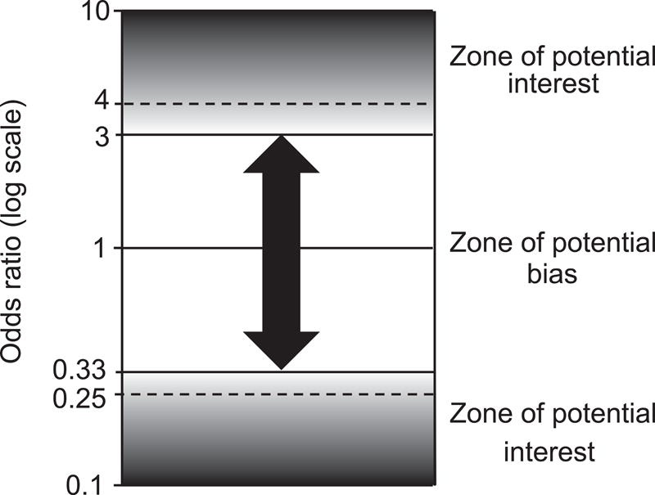
Zones of Potential Bias in Case-Control Study
Taubes G. Science 1995; 269: 164-9
Grimes DA, et al. Obstet Gynecol 2012; 120(4): 920-7
Notes:
Zones of potential bias and potential interest in a case-control study. Threshold of potential interest starts at 3 or 4 (dashed line) for increased risk and 0.33 or 0.25 (dashed line) for reduced risk. Others have gone further and stated that lower limits of 95% CI should be >5.

Slide 64
Although case-control studies are “easier to do”, they are more prone to biases, hence, careful thought and planning is critical

Slide 65
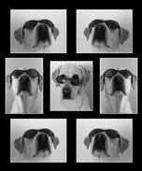
Experimental Design
The Randomized Clinical Trial

Slide 66
The Randomized Clinical Trial (RCT)
Purest scientific study, but not perfect
The basis of evidence-based medicine
Investigator randomly allocates subjects into study groups based on proposed exposure
Determines whether a significant difference in outcome is produced by exposing subjects having the same health problem to 2 (or more) different treatments (exposures)

Slide 67
Advantages of the RCT
Can discern subtle differences
Statistically efficient
Concurrent controls (placebo or older rx)
Larger sample sizes controls most extraneous external biases
Particularly selection bias
Limits ascertainment bias
Notes:
Allows most control over the study situation.

Slide 68
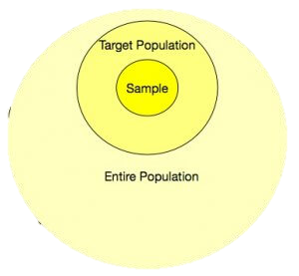
Disadvantages of the RCT
Challenging to conduct
Cost can be high
Study (sample) population may differ from target population
Not practical for rare events
Double blinding may not be ethical or feasible for nonpharmacologic exposures
Ex: surgery
Ethical issues of experimentation and randomization
Notes:
Requires scientific rigor.

Slide 69
Example of a Randomized Clinical Trial
Entry
Women with Chlamydia+
Randomization
Exposure (Antibiotic)
Outcome (Cure)
Drug A. Doxycycline
Drug B. Tetracycline
Drug C. Placebo*
90%
85%
5%
Time
*Question: Would this be ethical to include the placebo arm?

Slide 70
RCT Example
Intervention
Outcome
Improved
COC
Not improved
Randomization
Improved
PCOS with
Hirsutism
COC+
Spironolactone
Not improved
Randomization
Improved
Placebo
Not improved
Exposure Outcome
Notes:
Could also add placebo group. Blinded—all pills look the same. Each subject randomized. Data can be continuous or categorical.

Slide 71
Defining Interventions (Treatment Arms)
Whenever possible, choose only 2 arms (KISS)
Arms should be disparate
Note bene
The bigger the difference you seek, the greater will be your power
The more arms the study has = bigger headaches

Slide 72
Outcome Expression in RCT
Relative Risk (RR)
Same expression as in prospective cohort trial
Sometimes expressed as hazard ratio (HR) if harm occurs
Example: DVT or breast cancer in a trial of a new oral contraceptive
Notes:
Like a cohort study

Slide 73
Why is Blinding Important?
Some outcome are relatively subjective
Ex: Hot flashes or depression
Noncompliance/drop-outs related to knowledge of treatment arm
Diminishes compensatory actions by investigator (type of bias)
Notes:
Subjective outcome would be a treatment of hot flashes or depression where it is hard to measure to determine improvement. Blinding less important with objective outcomes like vaginal bleeding in a HT study like the WHI.

Slide 74
Blinding
Single: Patients or investigators
Double: Both patients and investigators
Triple: Evaluator is another person who is also unaware of treatments
☹
Quadruple: You have lost the randomization scheme and don’t know who got what

Slide 75
Dropout A Pitfall in Blinded Studies
1000 Women with Severe Dysmenorrhea
Randomization (1:1)
GnRHa
Placebo
60%
Completed 1 y
40%
Dropped out
90%
Completed 1 y
10%
Dropped out
Outcome: Dysmenorrhea Scores after 1 yr
Notes:
Blinded RCT, but pts on danazol had more sx and dropped out more, hence study becomes somewhat unblinded.

Slide 76
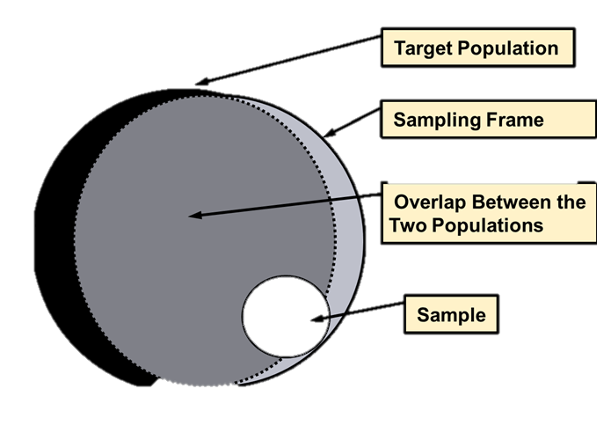
Common Problems with Randomized Trials
Enrollment exclusions before randomization: impact?
Population sampled may not be population of interest
Deviations from assigned treatment arm
Once randomized, always analyze
“Intent to treat” philosophy
“As treated” analysis may bias outcomes
Loss to follow-up
Notes:
Hot flash patients eliminated from WHI.

Slide 77
Crossover Design (RCT)
Randomization
WASHOUT
D O U B L E - B L I N D E D
Group 1
Fluoxetine 10 mg
Fluoxetine 10 mg
Women with
PMDD
WASHOUT
Group 2
Placebo
Placebo
Tung-Ping S, et al. Neuropsychopharmacol 1996; 16: 346-56
Notes:
Original PMDD study.

Slide 78
Selecting the Control Group

Slide 79
Choosing a Control Group
Key points
Controls should be comparable to groups of interest on factors that predict both exposure and disease
Randomization usually assures similar groups (study arms) and avoids selection bias

Slide 80
Choosing a Control Group
Use 1 control group
Treatment arm vs. controls need not be allocated to 1:1 ratio
Randomization scheme could make enrollee number unequal between groups
Greater power could be obtained by comparing 2:1 intervention:control
Notes:
Some state that 1-4 controls should be used per case, but if controls are fairly uniform, using more cases is acceptible.

Slide 81
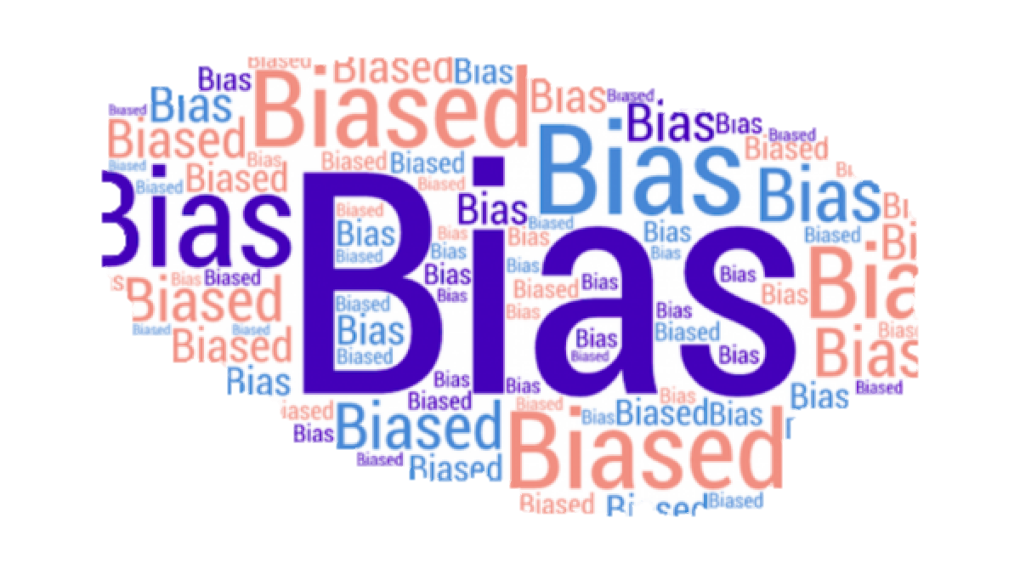

Slide 82
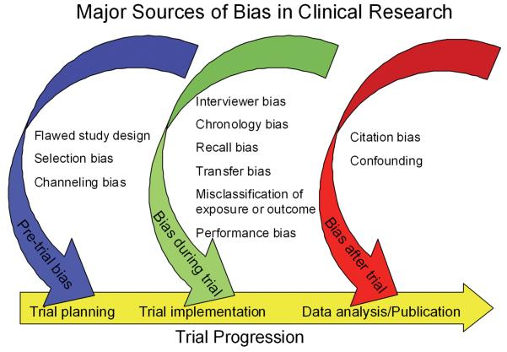
Bias
Systematic flaw in study design, data accumulation, or the analysis and interpretation of results
100s of biases have been defined
Research bias
Recall bias
Publication bias
Healthy user bias
Information bias
Regression to mean
Observer bias
Performance bias
Response bias
Etcetera
Delgado-Rodriguez M, et el. J Epidemiol Community Health 2004; 58(8): 635-41

Slide 83
Selection Bias
Bias introduced through the selection of one group that is different from the other group in some critical characteristic
Notes:
Ex. 1: if we pick cases and controls from specific populations, results may vary (unmarried v. married, indigent v. insured patients.) IUD users may have been more promiscuous.
Ex. 2: OC users may have more sexual partners than non users.
Ex. 3:

Slide 84
Ascertainment Bias (Measurement Bias)
Bias introduced through the collection of information in a way that is different for one group than the other, or in other words, measurement error or misclassification
Selective recall of exposure
Use of different data collection tools
Questionnaire vs. interview
Diagnosis of DM by OGTT vs HgbA1c

Slide 85
Confounding Bias
Distortion of the effect by extraneous (unaccounted for) variables related to both the exposure and outcome
Ex: smokers in a study of antihypertensive medications
Can be controlled for, unlike selection and ascertainment bias
Selection Process
Restriction
Matching
Analysis Process
Stratification
These serve to achieve homogeneous groups regarding the confounder thus wiping out its impact

Slide 86
Confounding Bias: Examples
EXPOSURE
OUTCOME
OC use
CA of Cervix
…
…
Cigarette smoking
Cigarette smoking
IUDs
PID
…
…
Multiple sex partners
Multiple sex partners
Estrogen
MI, stroke
…
…
Atherosclerosis
Atherosclerosis

Slide 87
Controlling Confounding Bias
Restriction
Cases and controls selected according to narrow range or single component
Ex: no smokers
Matching
Cases and controls matched on potential confounders. Matching is
maintained in analysis, and discordant pairs are analyzed (McNemar’s test)
Ex: smokers matched
Stratification
Arrange data into strata by levels of confounding factors, i.e., post-hoc restriction

Slide 88
To draw a conclusion from a study…
Is there
Selection bias?
Ascertainment bias?
Confounding bias?
Could findings be due to
Chance?
If not, results may be real!
Notes:
Selection—one group selected is different from the other group in some imporatant characteristic.
Ascertainment—Collection of information is different for one group vs. the other group.
Confounding– Some other factor is responsible for both the exposure and the outcome.

Slide 89
Chance and Randomization

Slide 90
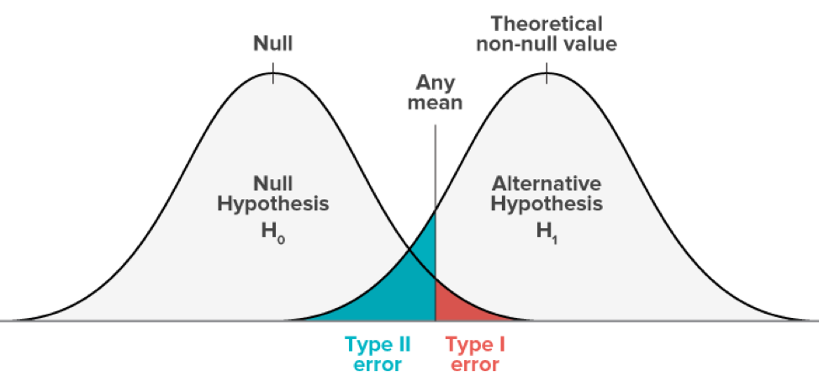
Chance
Definition
Differences between cases and controls in rates of outcomes have occurred due to random variation alone
Type I error (alpha-error)
A significant difference exists between 2 groups when they are not really different
α usually set at 0.05
Type II error (beta-error)
No significant difference exists when they really are different
β usually set at 0.10-0.20

Slide 91
Chance
Power
The likelihood of avoiding a Type II error in a study
Power = 1 - β
β usually 0.1 or 0.2, hence power is 80-90%
Affected by
Number of patients enrolled
Frequency of outcomes
Size of difference in outcomes between groups
Notes:
Power usually 80-90 %.

Slide 92
The “p” Value (α-level for significance) The probability under the null hypothesis of observing the set of observations obtained in an experiment. Essentially, the probability of rejecting the null hypothesis by mistake.
Algebraic calculation based on a specific population
P < 0.05 is an arbitrary value
Does not reflect the probability that a hypothesis is true
Never represents metaphysical certitude (even at p<0.0001)
Cannot be compared among different experiments
Small differences among populations or experimental biases can substantially alter “p”
Does not necessarily imply a “trend” or “similarity” if p = 0.06 (exceptions exist)
Blackwelder MC. Control Clin Trials 1982; 3: 345-53
Goodman SN. Epidemiol 2001; 12: 295-7
Koretz RL. Nutr Clin Pract 2005; 20: 303-7
Zinsmeister AR, et al. Am J Gastroenterol 2007; 103: 262-6
Notes:
P value should never be compared among different populations or experiments. Data is either statistically significant or not. P-values cannot detect a “trend” unless time is the independent variable and a t-test for trend is performed. Kaplin-Meier and repeated measured ANOVA can also be utilized in this way.
P value can be set at different levels. P<0.05 was first suggested by Fisher in the 19th century (of Fisher’s exact test.)
P value of 0.04 in one experiment is not more significant than 0.001 in another.
P<0.05 is not a sacred value.

Slide 93
Perils of the “p”
Statistical significance may not always be clinically significant (i.e., clinically relevant)
Provides no information on precision
Degree that results would vary if measured multiple times
As the number of statistical comparisons increases, so does the likelihood of an α (type I) or ß (type II) error
The more comparisons, the greater the chance of a finding a statistically significant difference by coincidence
Goal: Minimize number of statistical tests
Studies with large subject numbers may be “doomed to statistical significance”
Very small (clinical insignificant) differences become statistically significant
Rothman KJ. N Engl J Med 1978; 299: 1362-3
Langman MJS. BMJ 1986; 292: 716
Goodman SN. Epidemiol 2001; 12: 295-7
Notes:
Some journals have recommended deferring use of the p-value in favor of effect size with 95% CI.

Slide 94
Randomization
All techniques are not created equal!
Scheme
Evaluation
Not stated Unacceptable
Alternate assignment Dubious
e.g. chart number
Flipping coin/drawing cards Fair
Without blinding
Random number table Good
With blinding
Random permuted blocks Best
or computerization

Slide 95
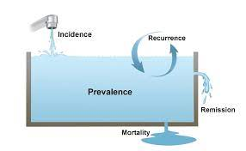
Other Terms and Concepts of Interest

Slide 96
Incidence
Cumulative Incidence
The probability (risk) of an individual developing the disease (outcome) during a specific period of time
Notes:
Incidence describes the number of new occurrences of disease in the study population during the time period being examined.
The association between prevalence and incidence is as follows:
Prevalence = Incidence x (average) Duration
Risk vs Rate
For a risk - Cumulative Incidence - you need the number of cases that developed divided by the total population “at risk” during the study time.
If you were studying two communities of 1200 persons each for 1 year:
In Town A - 120 died in January but no others died all year, the risk of death would be 120/1200 or 10%
In Town B - none died until December, then 120 died, and the risk of death would be 10%.
In Town C - 10 died per month, 120 total, risk of death = 10%
Which town would you prefer living in? Why?
The force of mortality is taken into consideration with the incidence density measure. CI: 10.00% 10.00% 10.00%
Person months 13080 14400 13740
ID: months 0.92% 0.83% 0.87%
ID: years 11.01% 10.00% 10.48%

Slide 97
Incidence
Incidence density
The probability (risk) of an individual developing the disease (outcome) during a specific period of time, using total person-time as the denominator. One subject followed one year contributes one person-year (PY)
Notes:
Pearl index for contraceptive failure is an example.

Slide 98
Prevalence
Numerator
All those with the attribute at a particular time
Denominator
The population at risk of having the attribute during that same time period

Slide 99
Measures of Disease Association
Ratios
Risk ratio or relative risk (all abbreviated RR)
odds ratio (OR), and prevalence ratios.
Difference measurements of disease frequencies include:
Attributable risk

Slide 100
Sensitivity and Specificity
Sensitivity (true positive rate)
Probability of a positive test result, conditioned on the individual truly being positive
Specificity (true negative rate)
Probability of a negative test result, conditioned on the individual truly being negative

Slide 101
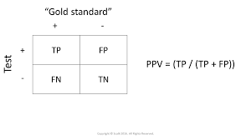
PPV and NPV
Positive predictive value
Probability that a patient with a positive (abnormal) test result actually has the disease
Negative predictive value
Probability that a person with a negative (normal) test result is truly free of disease

Slide 102
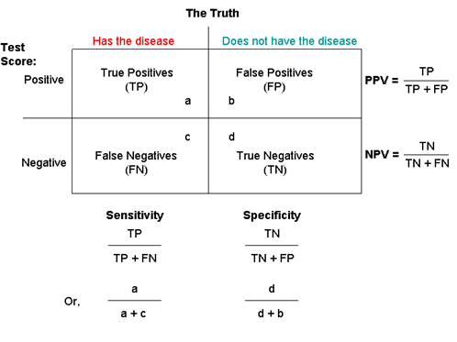
Calculations

Slide 103
The Evidence Hierarchy

Slide 104
Hierarchy of Primary Evidence Unfiltered Evidence
Randomized Controlled Trial
Observational Studies
(Cohort and Case-Control)
Descriptive Study
(Cross sectional study)
Case Reports

Slide 105
Hierarchy of Secondary Evidence Filtered Evidence
Meta-analysis
Systematic Reviews
Summary Reviews
Expert Opinion

Slide 106
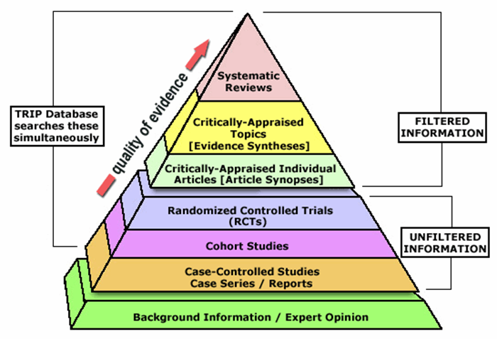
Hierarchy of Medical Evidence
Meta-Analysis
Notes:
Th

Slide 107
Meta-Analysis Definition
A statistical technique for combining data from multiple independent, comparable studies (systematic reviews) to assess outcomes related to a specific intervention
Provides single estimate of effect (diamond shape on forest plot)
Systematic Review
Meta-analysis

Slide 108
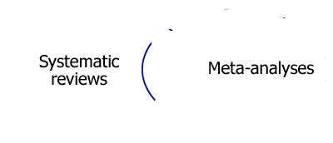
Meta-Analysis Characteristics
Extension of a systematic review
Statistically combines multiple studies providing a “weighted average”
Laborious yet powerful technique to answer a clinical question
Reviews all published (and unpublished, ie, “gray”) data
Each study is evaluated using strict entry rules
Results in larger sample size and statistical power
Highlights diversity of results (forest plot)
Sometimes can resolve question of conflicting data among similar studies
Can generate new hypotheses
Cochrane Collaborative
Notes:
In the US literature, the terms systematic reviews and metaanalysis are sometimes used synonymously, but they are not the same thing. One does have to have a systematic review before the metaanlysis can be done.

Slide 109
Meta-Analysis
Included studies must be substantially similar
PICOT
Populations
Interventions
Outcomes
Comparisons
Timing
Cochrane Collaborative
Notes:
In the US literature, the terms systematic reviews and metaanalysis are sometimes used synonymously, but they are not the same thing. One does have to have a systematic review before the metaanlysis can be done.

Slide 110
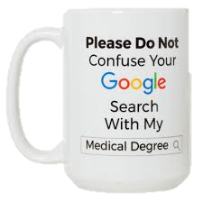
Final Thoughts

Slide 111
Final Thoughts Who said medicine was simple?
Evidence-based medicine is derived from good epidemiology
In 2024, there is a lot of “trash” published in journals
Retractions are at record levels
No absolute truths in the biological sciences
All we have are hypotheses
The more often hypotheses are tested and held up, the more likely are the hypotheses are true
Science and controversy are inseparable companions
We need to cultivate a tolerance for uncertainty

Slide 112
Are You Smarter than an Internist?
95% confidence interval
The range that would contain the true effect 95% of the time assuming study repeated multiple times
Power
The likelihood of avoiding a Type II error in a study
Continuous variable
Measurement that may in theory have an infinite number of possible values
Bias
Systematic flaw in study design, data accumulation, or the analysis and interpretation of results

Slide 113
Are You Smarter than an Internist?
Standard deviation (SD)
A statistic measuring the dispersion of a continuous dataset relative to its mean
$SD=\sqrt{Σ (x1−x}$)² / n-1
x = sample average, x₁ = population value
Standard error of the mean (SEM)
A statistic expressing how far the sample mean of the data is likely to be from the true population mean
$SEM= \frac{SD}{√n}$

Slide 114
Are You Smarter than an Internist?
Standard deviation (SD)
A statistic measuring the dispersion of a continuous dataset relative to its mean
P-value
The probability under the null hypothesis of observing the set of observations obtained in an experiment
Relative Risk (RR)
Numeric measure of an association between exposure and outcome

Slide 115
Questions
Robert.Kauffman@ttuhsc.edu

