Slide 1
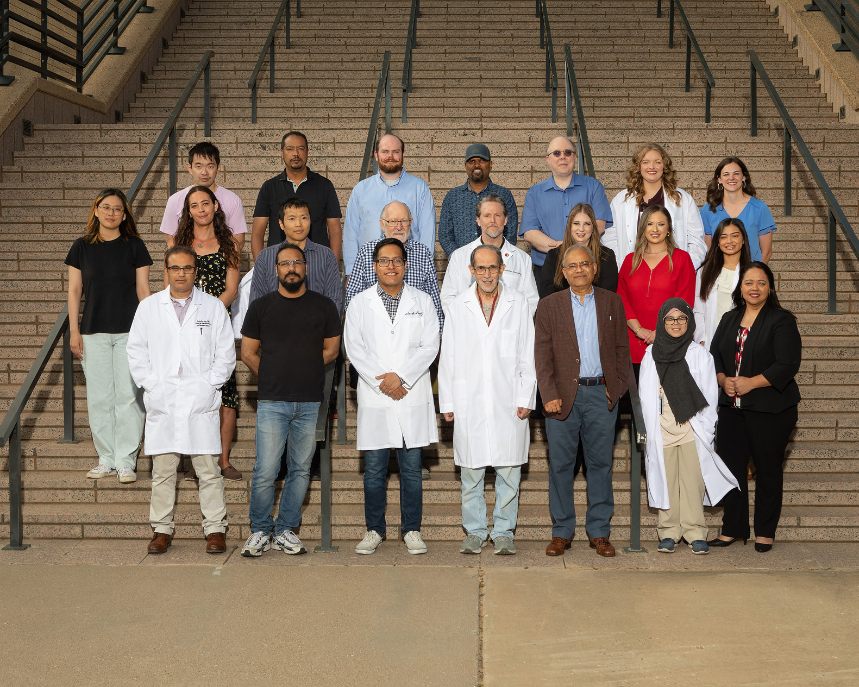
Department of Immunology and Molecular Microbiology
Texas Tech University Health
Sciences Center
School of Medicine
3601 4th Street, STOP 6591
Lubbock, TX 79430-6591
Tel: (806) 743-2638
Fax: (806) 743-2334
Got Questions?
We're here to help. Contact us if you have questions.
Julie Forrest-McDonald
(806) 743 - 1053
Julie.Forrest@ttuhsc.edu

Slide 2
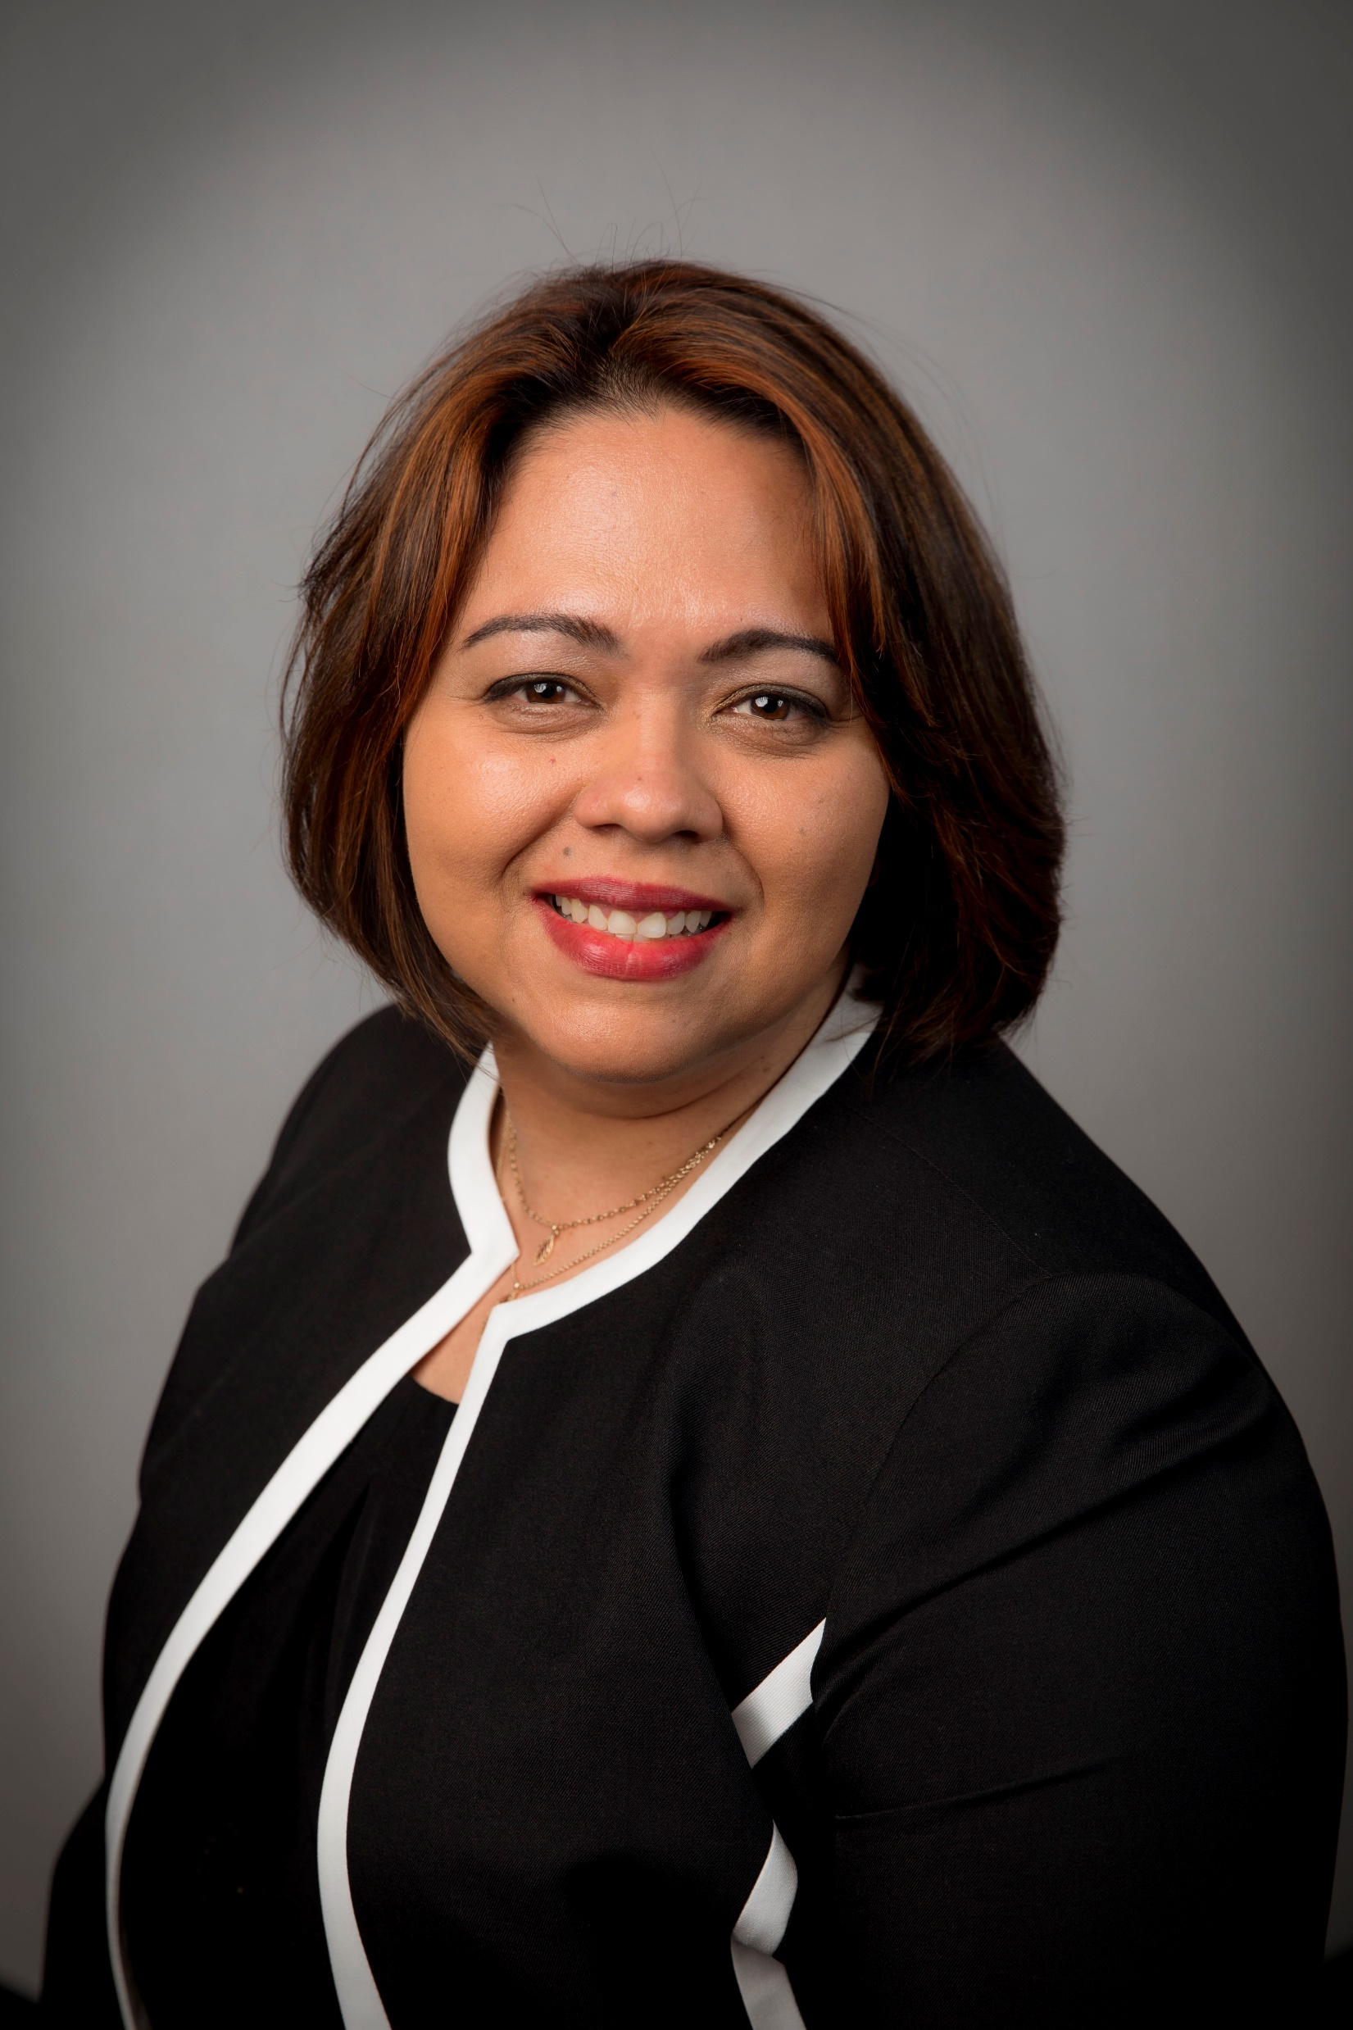
Sharilyn Almodovar-Camacho, ph.d
Assistant Professor, Department of Immunology and Molecular Microbiology

Slide 3
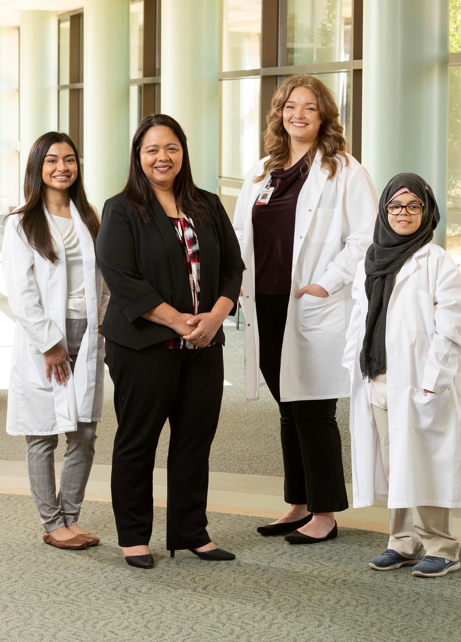
Sharilyn Almodovar-Camacho, ph.d
Cellular sources of HIV in chronic pulmonary disease
Microenvironment in the pulmonary microvasculature: Implications in HIV disease progression
HIV evolution in the lung in people using recreational drugs
Refinement of animal models for HIV-associated pulmonary hypertension and other infectious diseases
HIV evolution after COVID-19Long COVID in rural areas in Texas

Slide 4
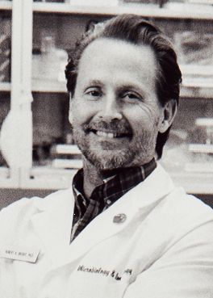
Robert bright, pH.d
Professor, Department of Immunology and Molecular Microbiology

Slide 5
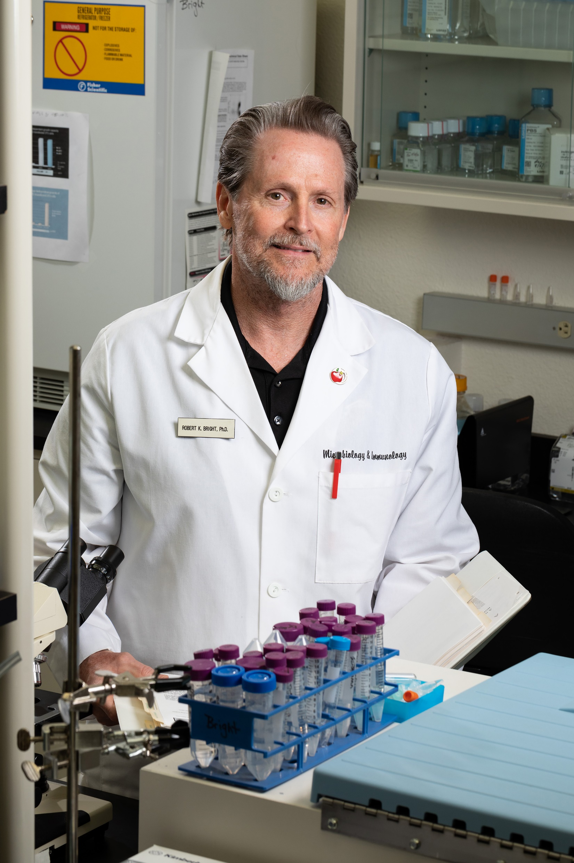
Robert bright, pH.d
Tumor vaccines
Immune check point/ tumor vaccine combination
Tumor antigen/ marker discovery & characterization
Tumor antigen specific T cell epitope characterization

Slide 6
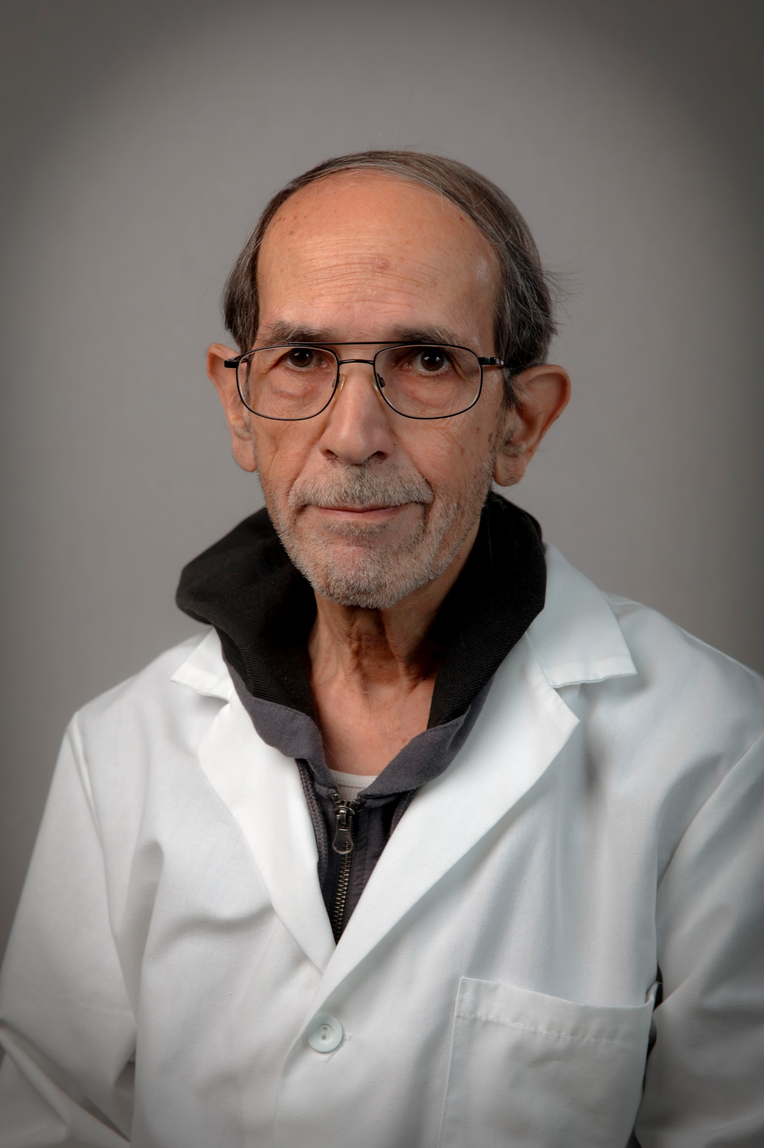
Abdul Hamood, ph.d
Professor, Department of Immunology and Molecular Microbiology
Adjunct Professor, Department of Surgery

Slide 7
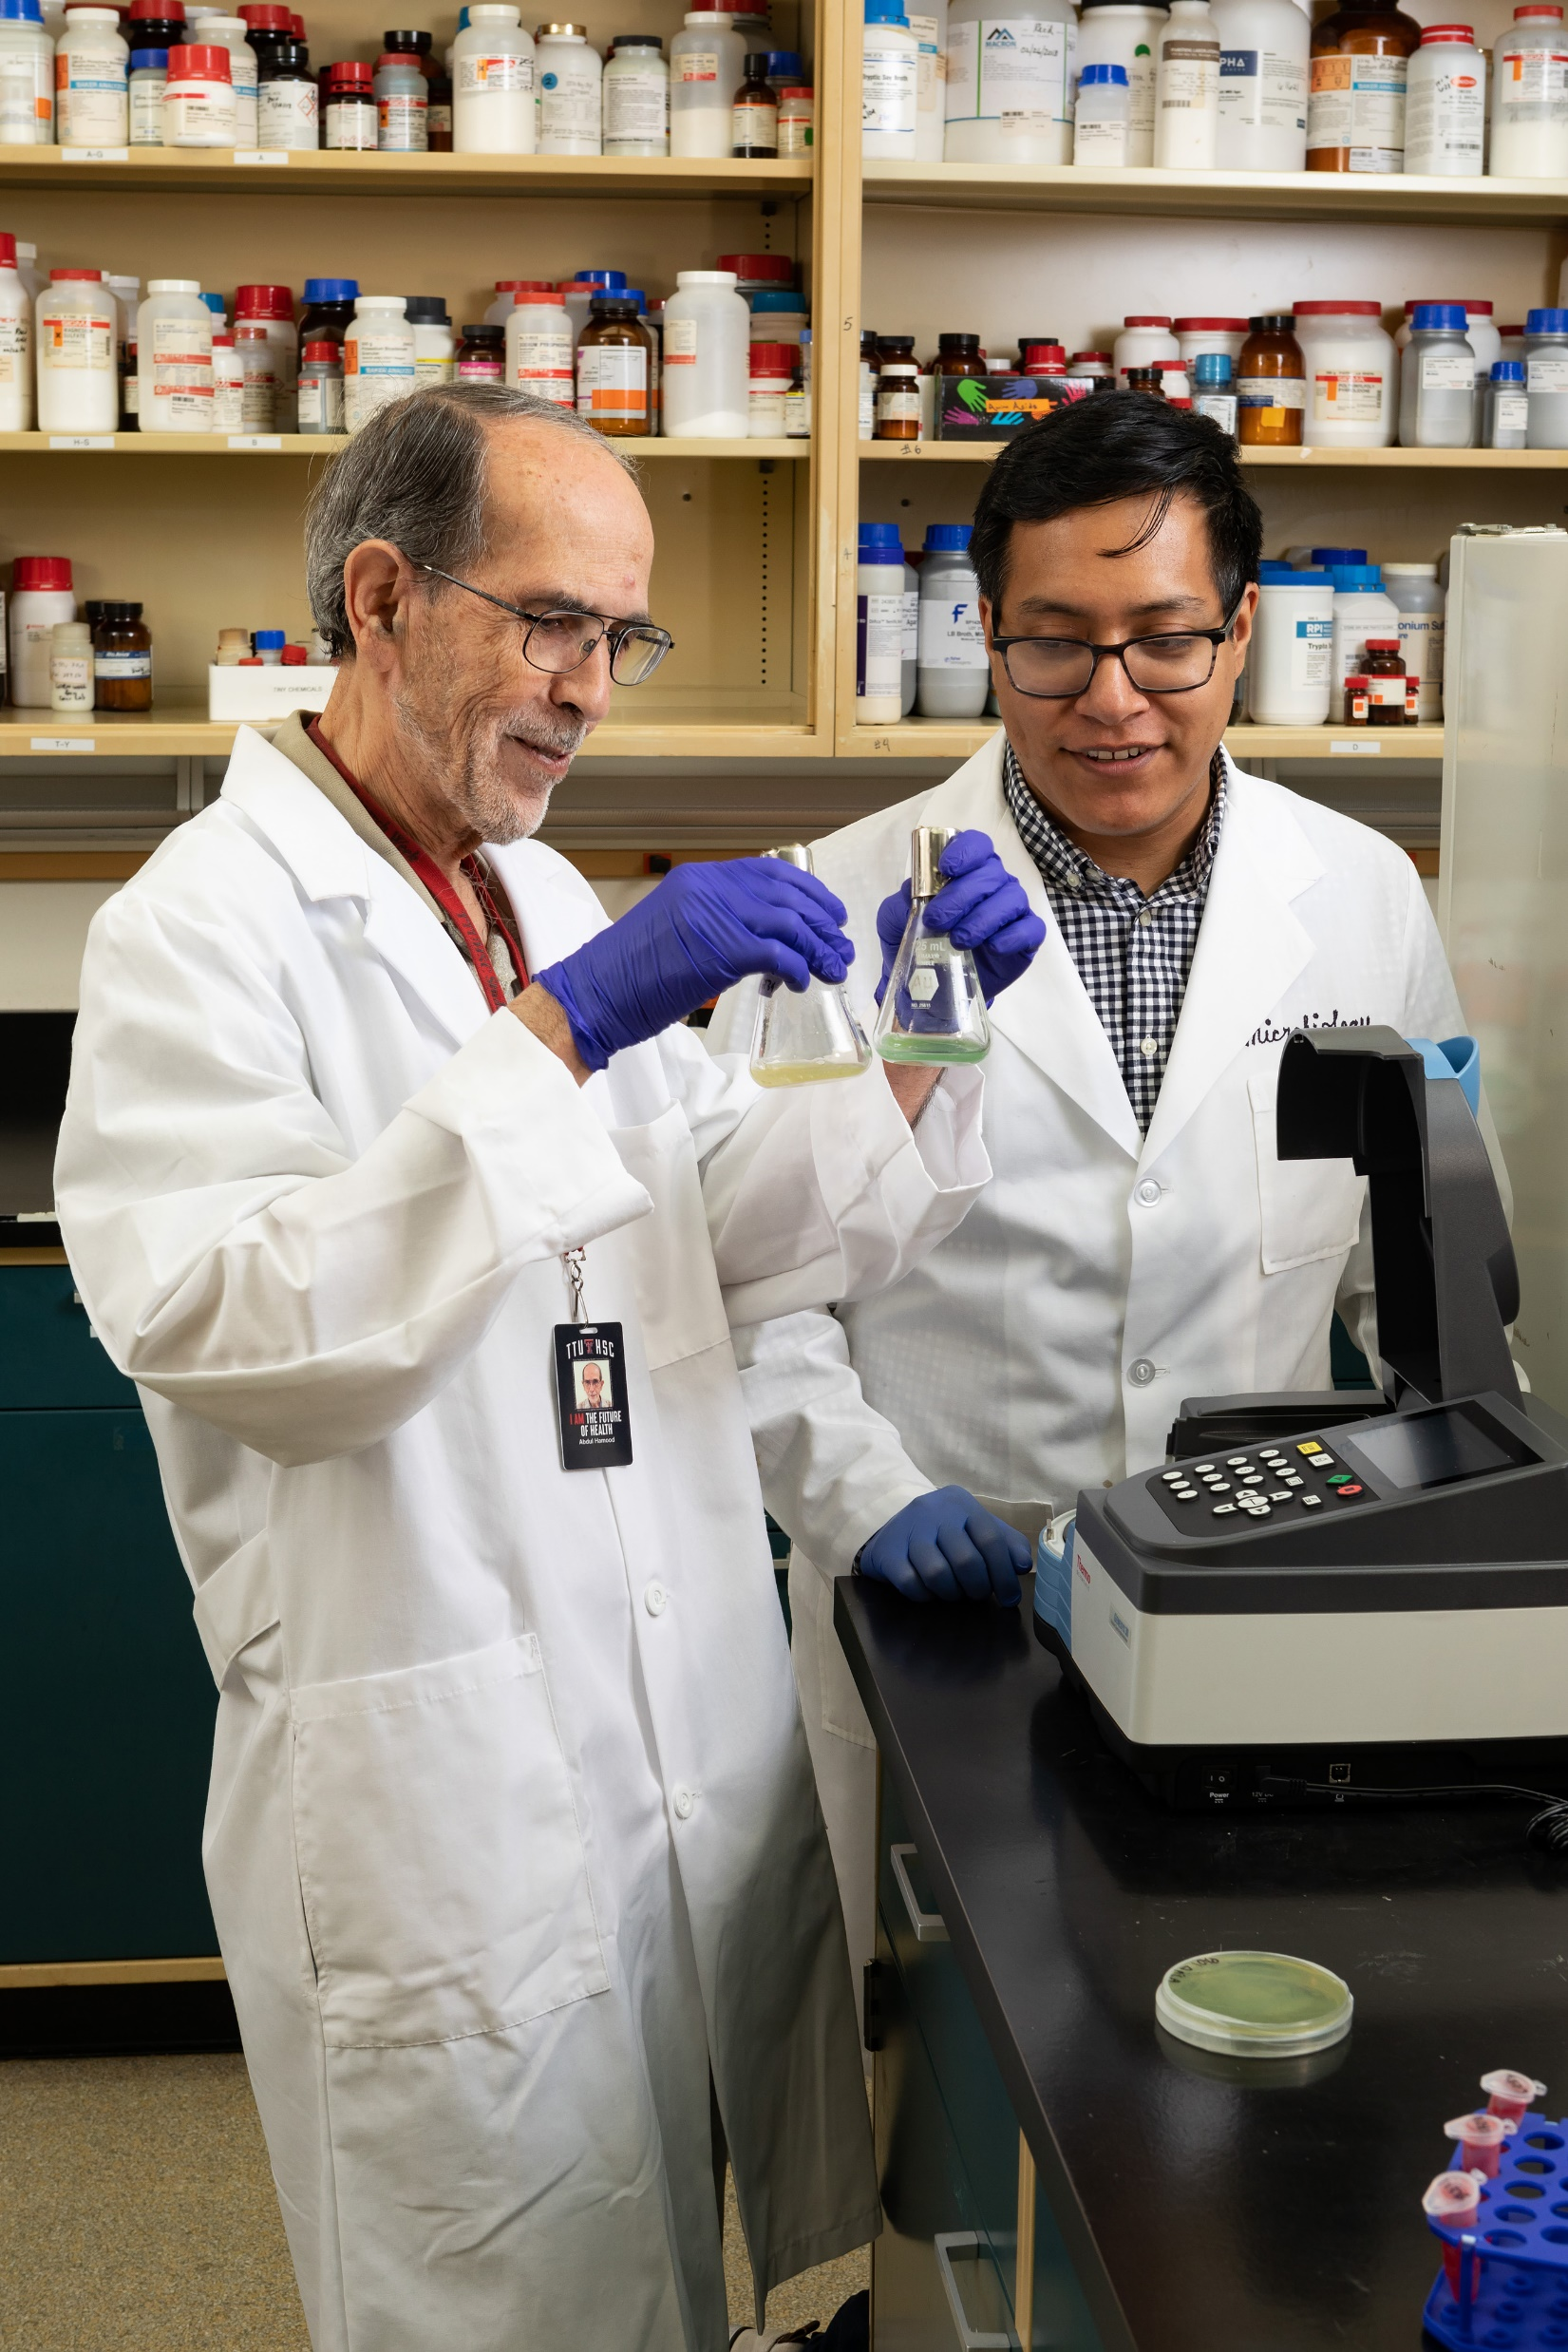
Abdul Hamood, Ph.D.
Pathogenesis of Pseudomonas aeruginosa during bacteremia in severely injured/infected patients
Pyocins as alternative antibacterial to treat Pseudomonas aeruginosa infections
Influence of blood on the transcriptomes of Gram-negative bacterial pathogens
Innovative approaches to eradicate bacteria biofilms

Slide 8
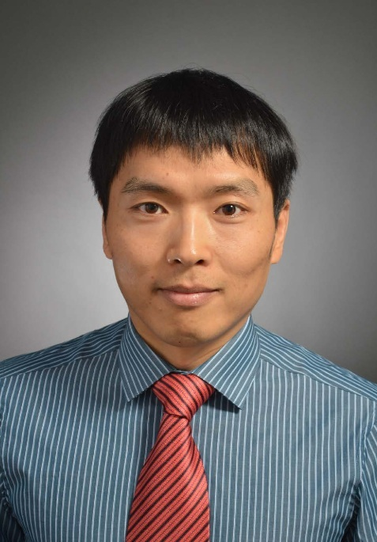
Dawei li, ph.d
Associate Professor, Department of Immunology and Molecular Microbiology

Slide 9
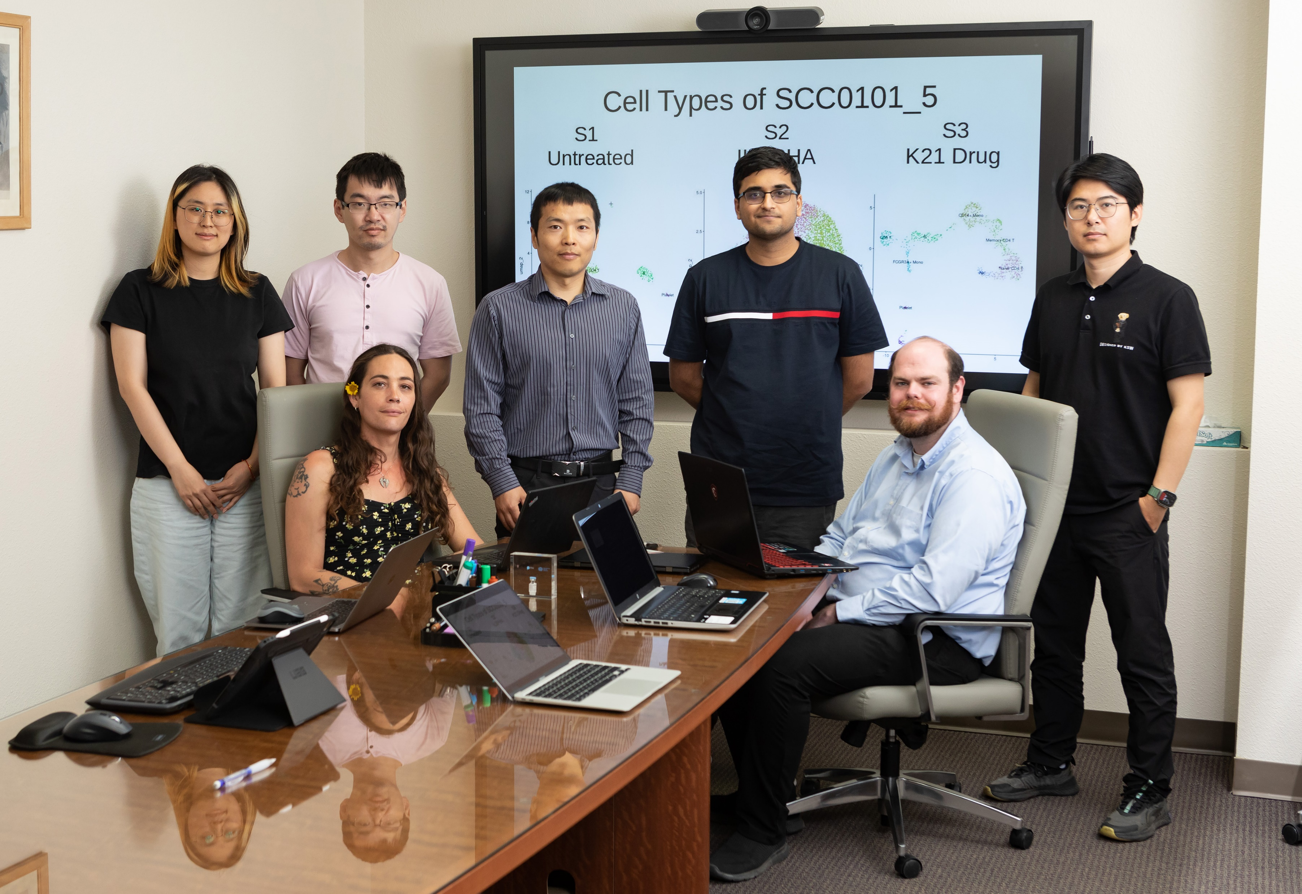
Dawei Li, Ph.D.
Genomic data-analyses (genome, transcriptome, methylome, etc.) from raw (FASTQ/BAM) files.
Integrative multi-omics analyses, transposable element analyses, and other genomic/bioinformatics analyses or development.
Design, develop, and implement new bioinformatics pipelines.
Method and software comparisons and benchmarking of available tools.

Slide 10
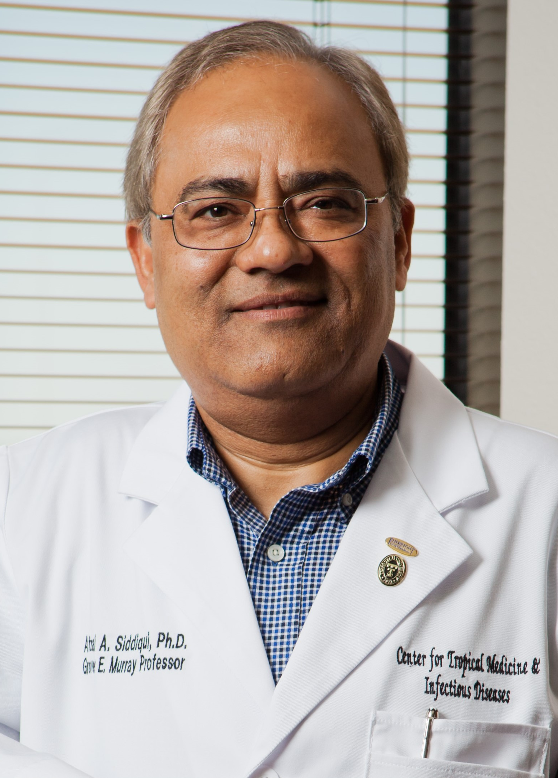
Afzal Siddiqui, ph.d
Chair, Department of Immunology and Molecular Microbiology

Slide 11
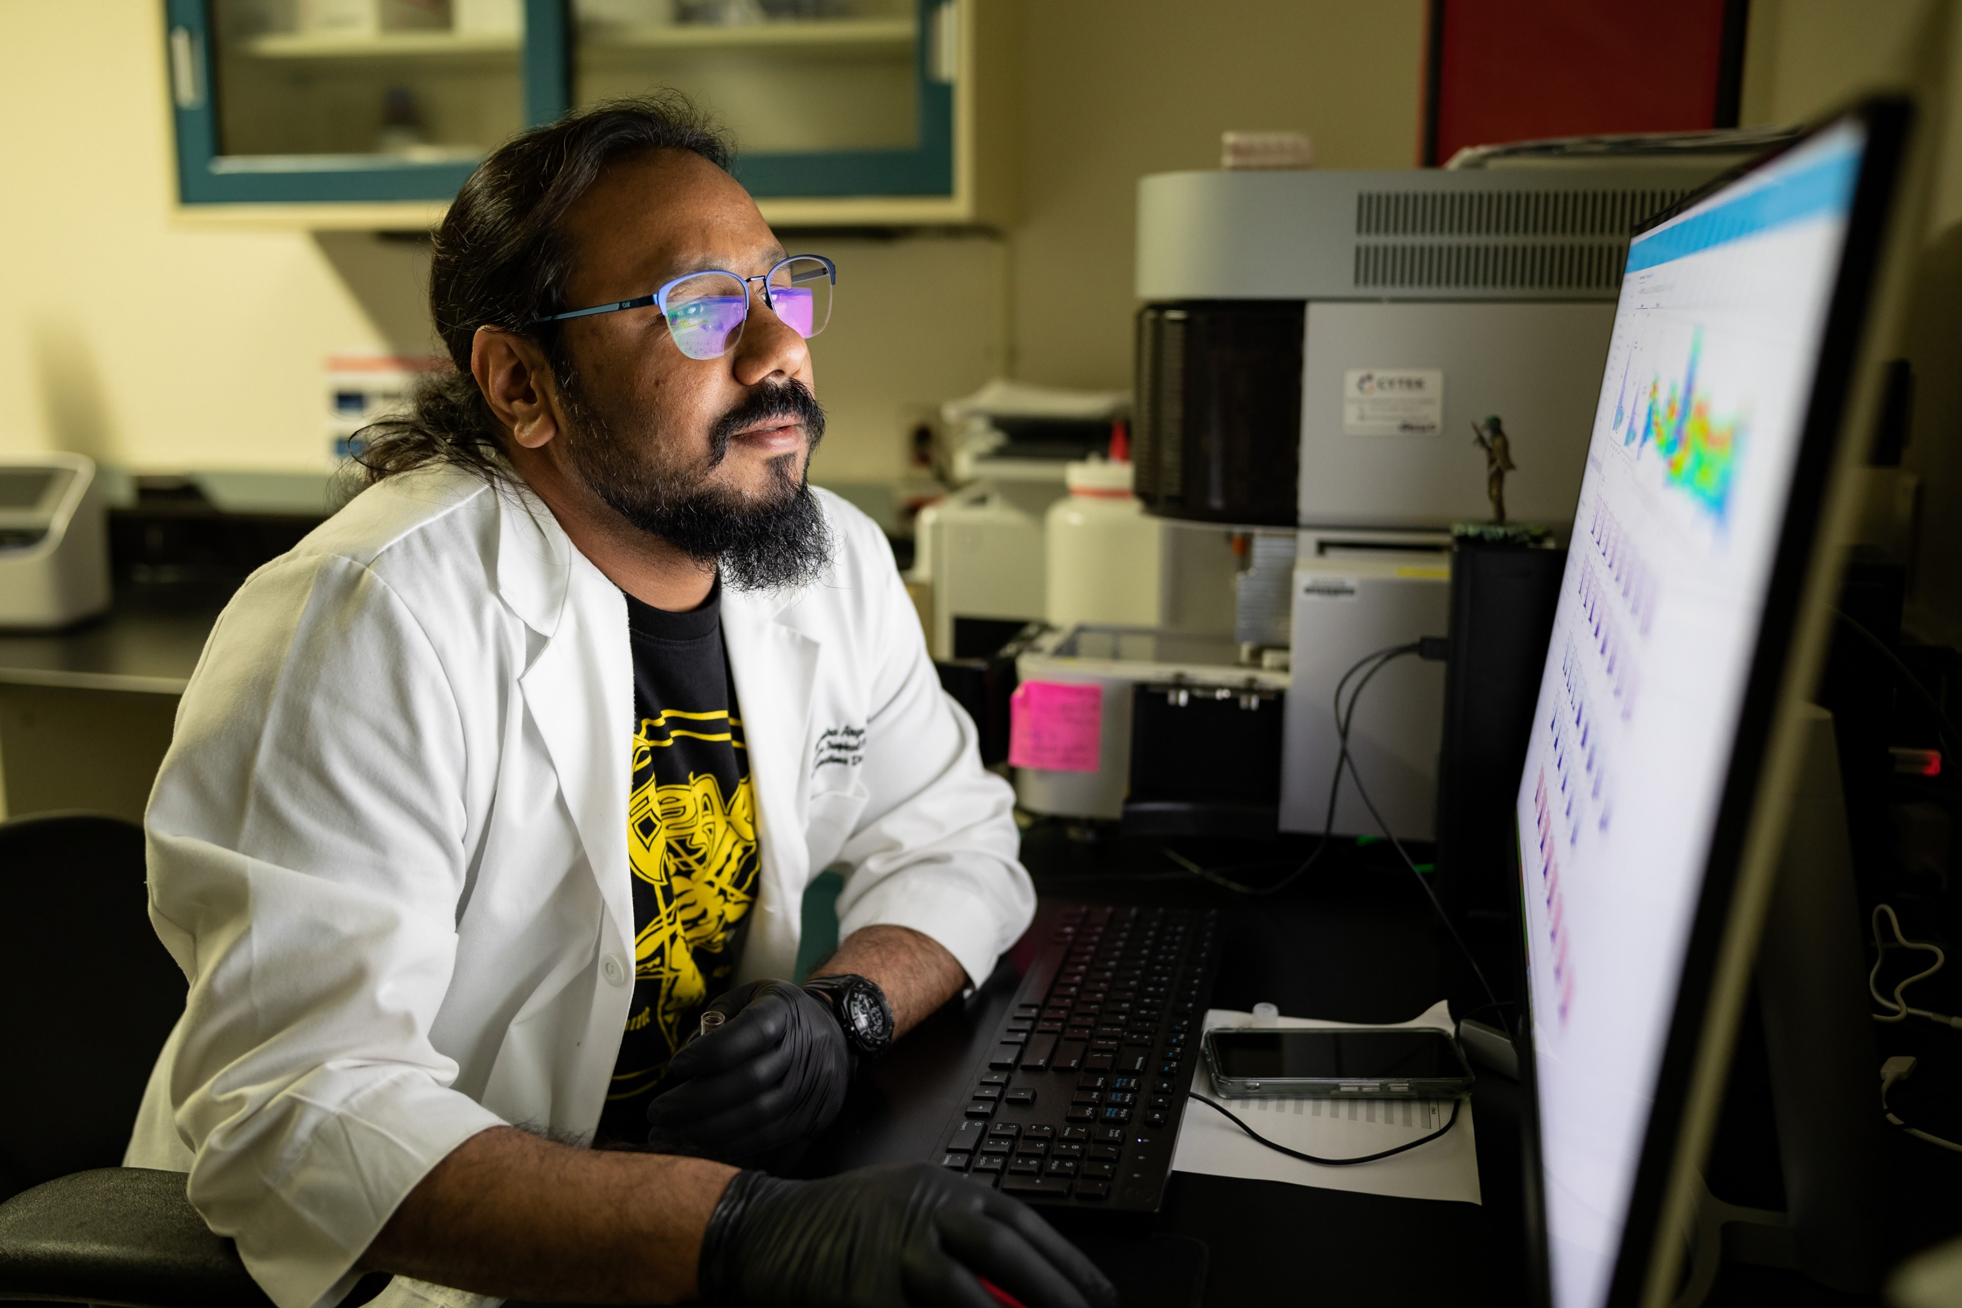
Afzal Siddiqui, PhD, MPhil, MS
Parasitology
Vaccine discovery, development and testing for human parasite Schistosoma mansoni
Stronglyloides stercoralis hyperinfection
Dr. Siddiqui’s Lab

Slide 12
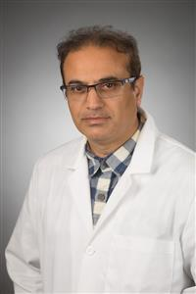
Mumtaz Yaseen, MS, Ph.D.
Associate Professor Research, Department of Immunology and Molecular Microbiology
Current Rersearch
Cause natural killer (NK) cell expansion
Prime cytotoxic CD8 T cell activation
Release of type I cytokine mainly IFNγ, TNFα, and IL15
Developing CARs against parasitic infections

Slide 13

Sm-p80-based vaccine trial in baboons: efficacy when mimicking natural conditions of chronic disease, praziquantel therapy, immunization, and Schistosoma mansoni re-encounter
Arif J. Siddiqui, Adebayo J. Molehin, Weidong Zhang, Pramodh K. Ganapathy, Eunjee Kim, Juan U. Rojo, Whitni K. Redman, Souad R. Sennoune, Justin Sudduth, Jasmin Freeborn, Derick Hunter, Kameswara R. Kottapalli, Pratibha Kottapalli, Ruwanthi Wettashinghe, Govert J. van Dam, Paul L.A.M. Corstjens, James F. Papin, David Carey, Workineh Torben, Gul Ahmad, Afzal A. Siddiqui

Slide 14
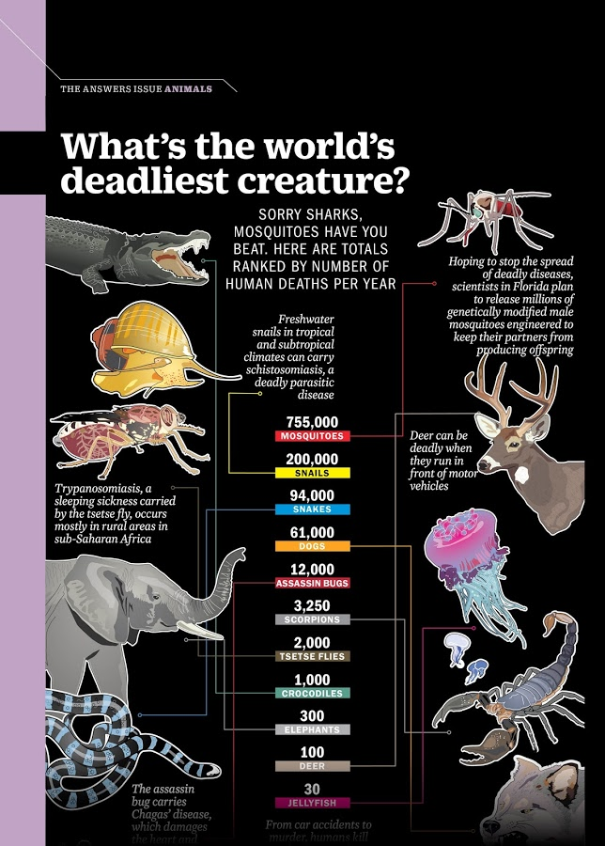
What's the World's Deadliest Creature?
Time Magazine
July 6 / July 13, 2015
Sorry Sharks, mosquitoes have you beat. Here are totals ranked by number of human deaths per year…

