Slide 1
Student Organization
Re-Registration &
Budget Request Training
Office of student life | Spring 2025

Slide 2
Agenda
Spending and Deadline Reminders
Organization Constitutions
Re-Registration Process
Budget Request Process

Slide 3
Spending Reminders
Purchase Request in HSC Net
  System for requesting use of Senate funds
  2 Week Prior Deadline – Failure to meet deadline means a 1% Senate budget deduction
Senate Funds do not rollover
No spending between August 17 and September 5 (Fiscal Year End)

Slide 4
Deadline Reminders
Deadlines for FY25 Senate Funds
  Deadline for Major Expenditures – June 6, 2025
  Deadline for Remaining Expenditures – August 1, 2025
Spend available Senate funds
  If not spending until after February 21, 2025, make sure to include plans for the funds within the budget request form.

Slide 5
Organization Constitutions
Review & Update with any necessary changes
  Make sure file is in Documents section of HSC Net
  Save file with “Update” and the year in the name

Slide 6
Required Elements
Name & Purpose
National & Affiliate Organizations
Membership Requirements
Officer List & Duties (President and Treasurer Required)
Officer Election & Removal Process
Financial Procedures
Faculty/Staff Advisor Responsibilities
Annual Programs

Slide 7
Name & Purpose
Article I – Name
Section 1. The name of the organization shall be the Bubble Blowing Society, a student organization at Texas Tech University Health Sciences Center.
Article II – Purpose
Section 1. The purpose of our organization is to bring together TTUHSC students that enjoy blowing bubbles or are interested in participating in bubble blowing competitions.

Slide 8
National & Affiliate Organizations
Article III – National & Affiliate Organizations
  Section 1. National Relationship:
  a. The Bubble Blowing Society has a relationship with the National Bubble Blowing Federation. The relationship includes an annual membership that enters the organization in regional and national competitions. They also provide standardized rules and instructions on how to hold competitions.
  Section 2. Affiliate Relationship:
  a. The Bubble Blowing Society has a relationship with the Panhandle South Plains Fair at which they sponsor a community Bubble Blowing Competition.

Slide 9
Membership Requirements
Article IV – Membership
  Section 1. Requirements
  Members must be interested in the art of blowing bubbles.
  Members must represent the organization and Texas Tech University Health Sciences Center in a positive light at all times.
  Membership is open to all students and from any school.
  Members are not allowed to participate in any activities or events hosted by the organization while intoxicated or under the influence of drugs.
  Members must always treat their fellow members or officers with respect.
  Members must uphold the Values-Based Culture of one team, kindhearted, integrity, visionary, and beyond service.

Slide 10
Officer List & Duties
Article V – Officers
  Section 1. List
  The officers of the organization will be made up of: President, Vice-President Internal, Vice-President External, Treasurer, and Secretary.
  Section 2. Duties
    President duties include:
      Overseeing and running regular, executive, and special meetings.
      Serve as the liaison to the advisor and the university administration.
      Attend bi-monthly meetings with the organization advisor.
      Manage member violation report process.

Slide 11
Officer Election
Article VI – Officer Election & Removal Process
    Section 1. Officer Election Process
    Nominations for officers will start in March of the spring semester by the person himself/herself or can be nominated by a regular member.
    Nominees can either accept or decline the nomination at the time the nomination is given or wait to the end of the 2-week period.
    Nominations will be open for 2 weeks.
    During the 2-week period nominees can either drop or be added to the candidacy list.
    On the day of elections, which should be in April, nominees will give a 4 min speech on why they are fit for the position, what they can contribute to the organization to make it better, and any ideas for the organization or the position.
    Voting will then only commence if quorum of majority is met. If quorum is not met before the meeting presides, then voting will commence at the next earliest meeting time.
    Voting will require a two-thirds vote of all eligible voters to elect a member to a position. The vote will be done using a secret ballot to be tallied by the advisor.

Slide 12
Officer Removal Process
  Section 2. Officer Removal Process:
  Any member or officer can submit an officer in violation of the organization purpose, their position responsibilities, or constitution to the president.
  If the officer in violation is the president then it should be submitted to the organization advisor.
  Once the president or advisor receives the violation it will be reviewed and a special meeting will be scheduled with the other officers to review the violation.
  If the remaining executive board finds the violation creditable then they will schedule a time for the officer to come speak to the executive board about the violation.
  After the meeting with the officer in question, the executive board will take a vote on whether to move forward with the removal process or not. A two-thirds vote of the remaining officers is required to move the process forward.
  If the vote passes to move the process forward, a vote will be brought to the entire membership for a vote to remove or not. A two-thirds vote is required to remove an officer from their position with an additional vote to determine removal from the organization.
  If the officer is not present at the meeting where the vote took place, they should be notified of the vote within 24 hours.

Slide 13
Financial Procedures
Article VII – Finances
  Section 1. Collection of Funds:
  Membership dues shall be collected at the first meeting in September and January.
  The Treasurer shall be responsible for applying for and documenting funds from the SGA and the School of Health Professions.
  Section 2. Management of Funds:
  Any costs occurred by the organization may be paid by the President or Treasurer.
  All expenditures must be documented with an itemized receipt by the Treasurer.
  All income must be deposited within 24 hours of receiving it. No cash is accepted only check or money orders, unless it comes from a fundraiser. Square can only be used if linked to the organization checking account.
  Section 3. Documentation:
  a. Documentation of any funds spent/gained must be added to the Financial Binder and available to all members with reasonable notice.
  Section 4. In the event that the organization ceases to exist, all assets shall be donated to the National Bubble Blowing Federation Foundation.

Slide 14
Faculty/Staff Advisor Responsibilites
Article VIII – Faculty/Staff Advisor
  Section 1. Responsibilities of the Advisor.
  Provide feedback by listening and giving perspective insight for the organization’s development.
  Support the organization in crises.
  Intervene when appropriate. Especially when conflicts arise between members or officers.
  Be knowledgeable of university or national policies that may impact the organization.
  Co-sign expenditures that are over $500.
  Provide connections to the group such as campus resources, etc.

Slide 15
Annual Programs
Article IX – Annual Programs
  Section 1. Panhandle South Plains Fair Bubble Blowing Competition
  The organization hosts this competition every fall semester to bring joy and recognition to the art of bubble gum blowing.
  Section 2. Holiday Bubble Blowing Invitational
  The organization attends the state invitational that is annually hosted at the Dallas World Aquarium.
  Section 3. National Bubble Blowing Competition
  a. The organization attends the National Bubble Blowing Federation Championship if any members qualify to compete.

Slide 16
Amendment Approval
_________________________ ___________________________
President – Print Advisor – Print
_________________________ ___________________________
President – Signature Advisor – Signature
_________________________
Approval Date

Slide 17
Re-Registration & Budget Requests
Deadline to submit: February 21st at 11:59 pm
  Failure to meet deadline makes the group ineligible for Senate funding
Annual process for all student organizations
Completed in HSC Net

Slide 18
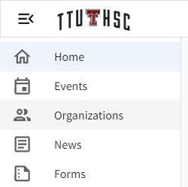
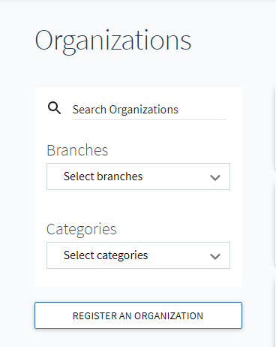
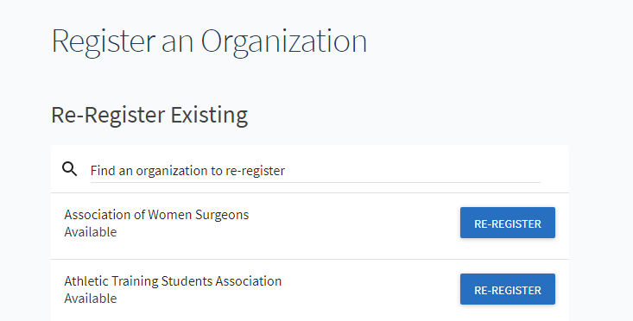
Re-Registration Process
To register your organization:

Slide 19
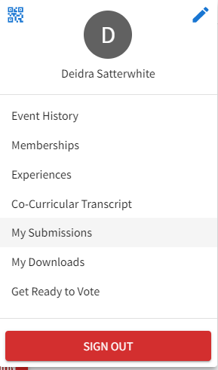
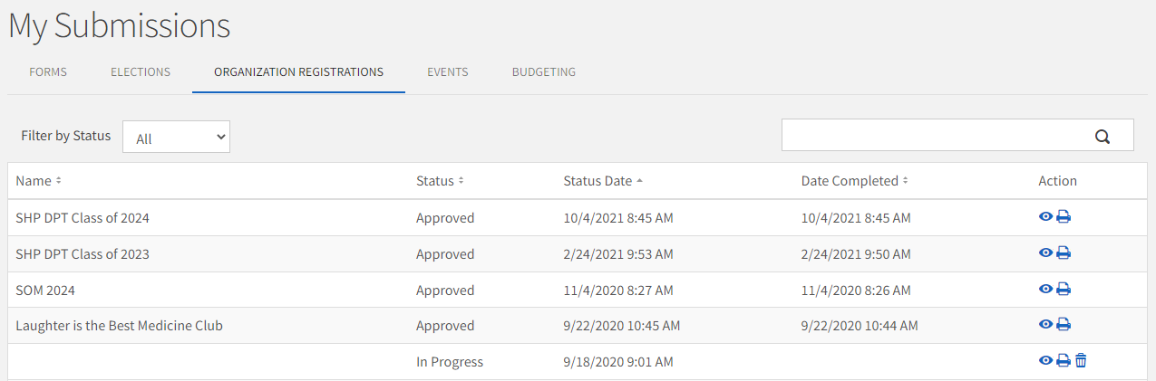
Re-Registration Process
To access your registration on another day:

Slide 20
Re-Registration Process
SIX STEP PROCESS
  Step 1: Instructions
  Step 2: Organization Profile
  Step 3: Organization Profile Picture
  Step 4: Organization Categories
  Step 5: Organization Roster
  Step 6: Registration Questions

Slide 21
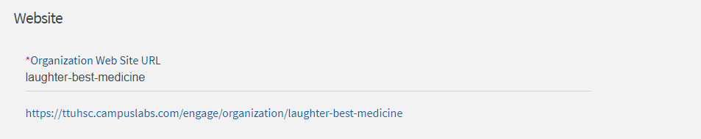
Organization Profile (Step 2)
General Information
Website
Social Media
Contact Information

Slide 22
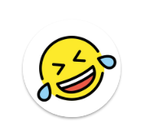
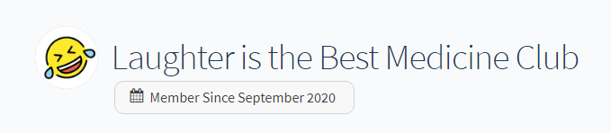
Profile Picture (Step 3)
Not Required
More Attractive
Circular

Slide 23
Categories (Step 4)
Advocacy/Activism
Campus
  Abilene
  Amarillo
  Dallas
  Lubbock
  Permian Basin
Cultural/International
Distance Ed
Faith-Based/Spiritual
Health/Wellness
Honor
Recreational/Sports
Service/Philanthropy
Special Interest
Student Governance

Slide 24
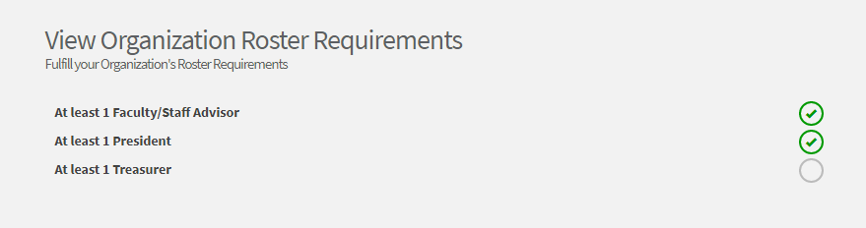
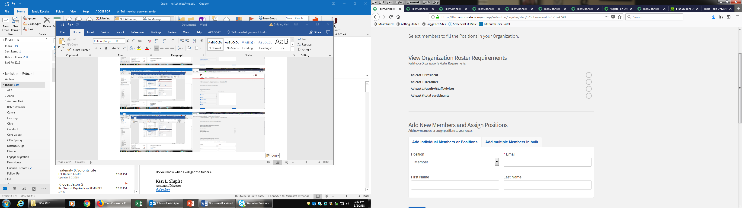
Roster (Step 5)

Slide 25
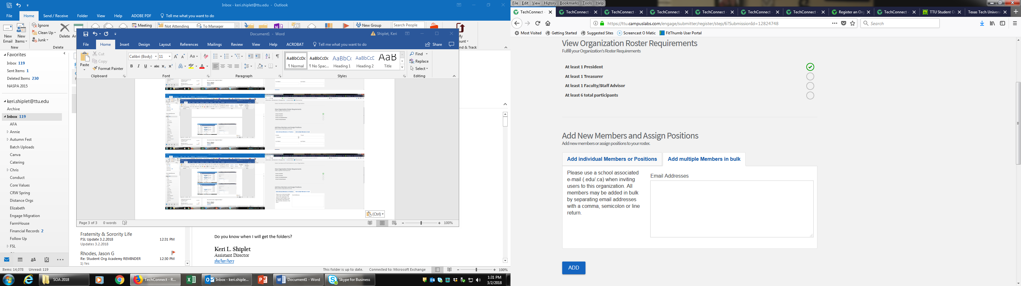
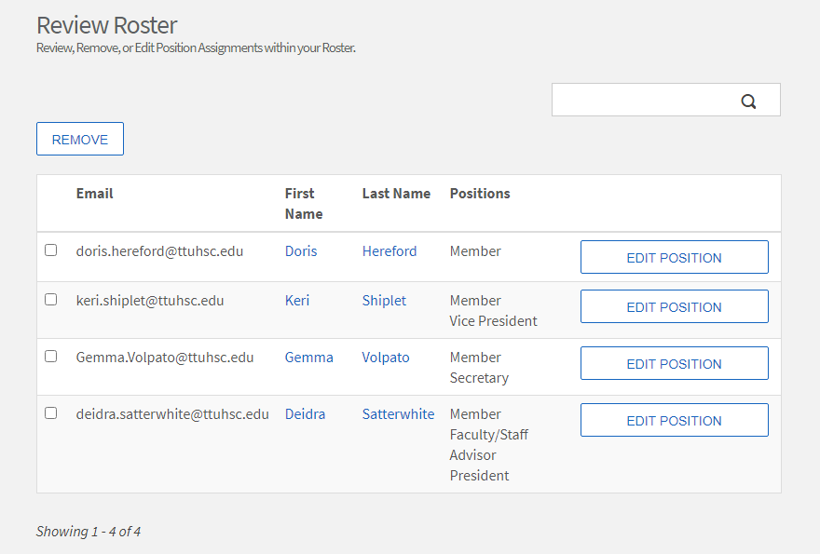
Roster (Step 5)

Slide 26
Registration Questions (Step 6)
General Organization Information
  Constitution & Bylaws
Officer Contact Information
Faculty/Staff Advisor Contact Information
Additional Advisor Contact Information
National or Affiliate Organization
Verification of Information & University Policy Agreement

Slide 27
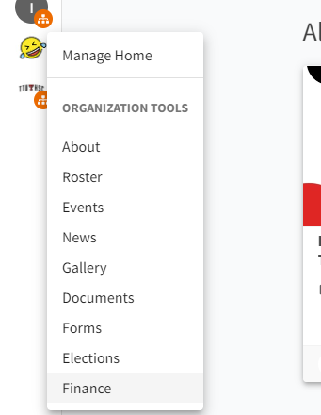
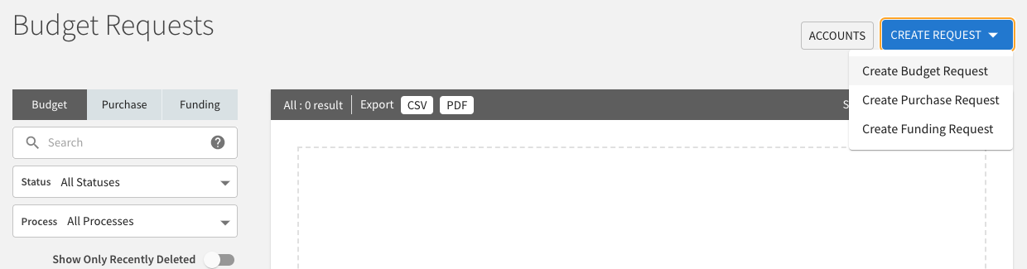
Budget Request Process

Slide 28
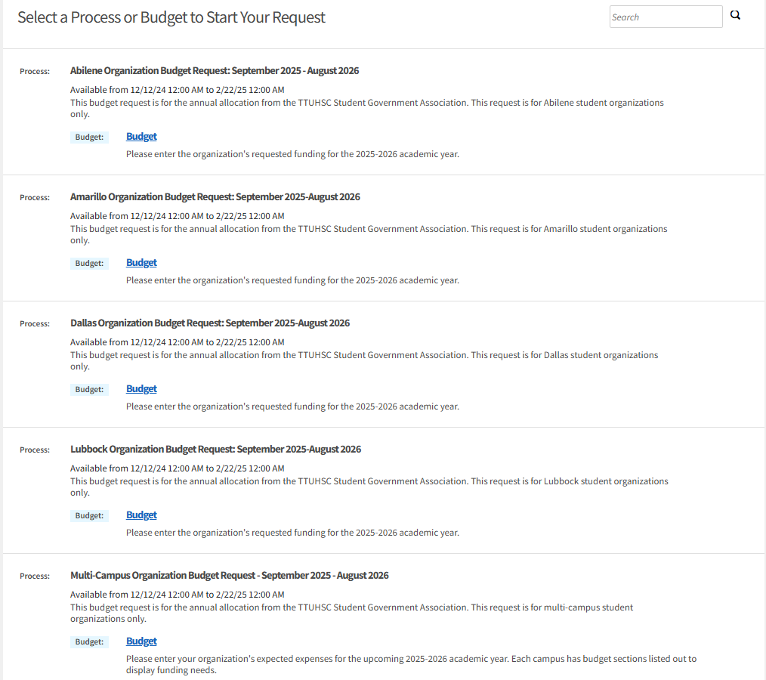
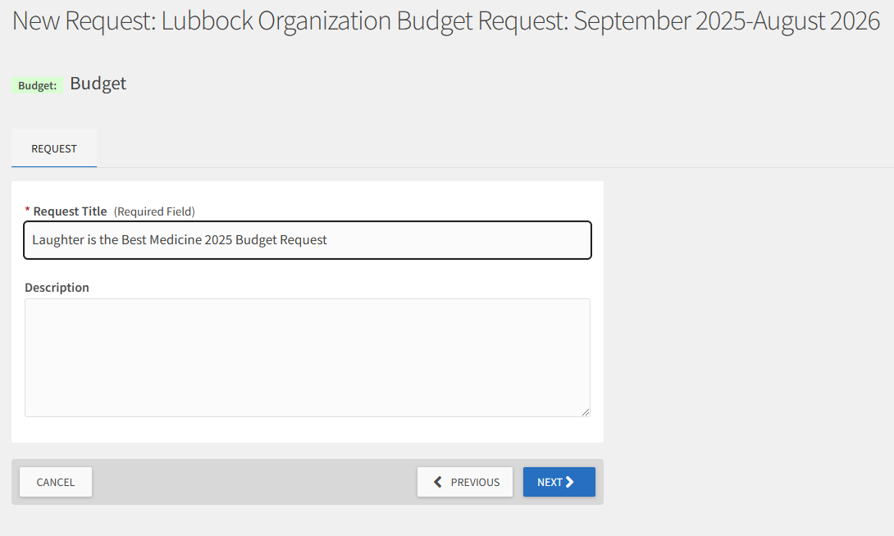
Budget Request Process

Slide 29
Budget Request Process
FOUR STEP PROCESS
Step 1: Organization Information
Step 2: Income
Step 3: Values Based Culture Questions
Step 4: Expenditures & Request Amount

Slide 30
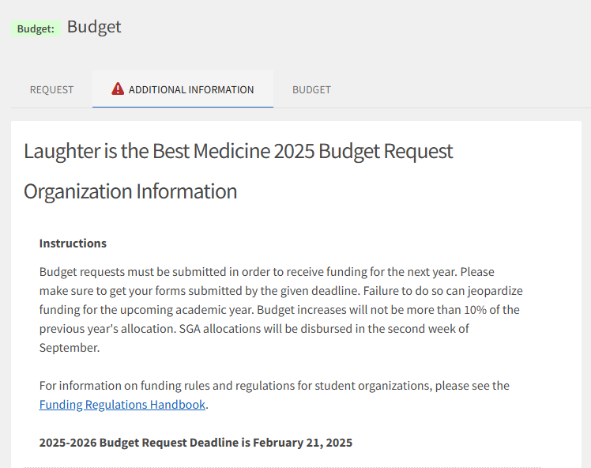
Organization Information (Step 1)
Name of the Student Organization
Number of Members in the Organization
Roster Update
Current Senate Account Total
Any planned spending past February 21, 2025?
Current Off-Campus/Agency Account Total
Why your organization needs Senate funding?
Current President & Treasurer’s Names
Incoming President & Treasurer’s Names (if elected)

Slide 31
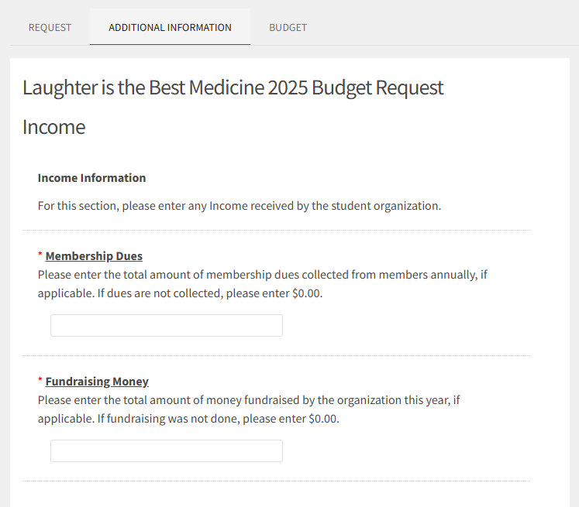
Income (Step 2)
Membership Dues
Fundraising

Slide 32
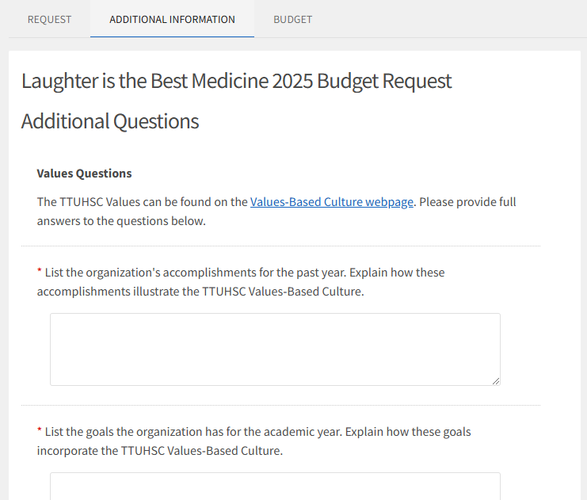
Values Based Culture Questions (Step 3)
Organization’s Accomplishments
Organization Goals for the Year
Community Service
How the organization enhances the image of TTUHSC
Value the organization Excels in
Value the organization could Improve

Slide 33
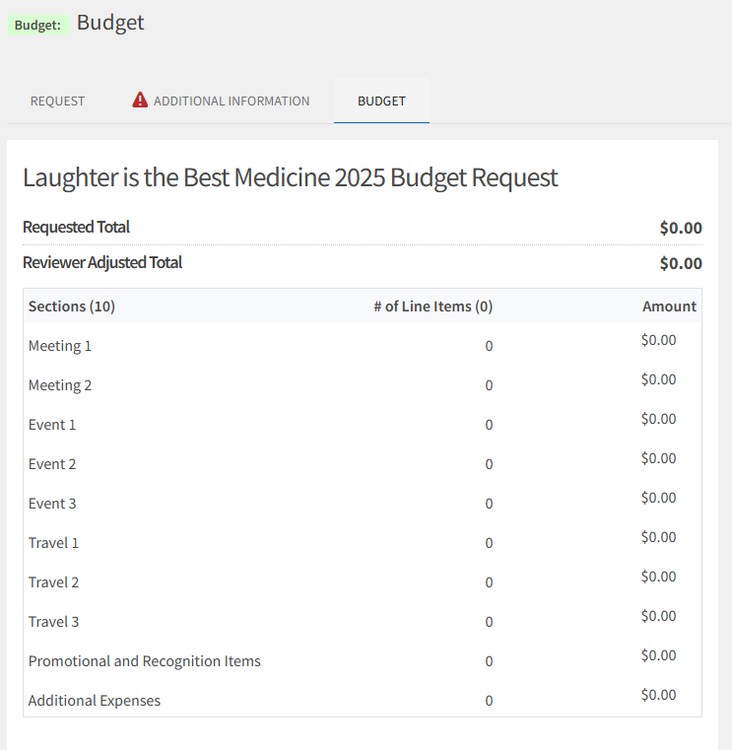
Expenses & Request Amount (Step 4)
Cost of Meetings
Cost of Events
Cost of Travel
Cost of Promotional and/or Recognition Items
Cost of Additional Expenses

Slide 34
Request Approval Process
Must submit Re-Registration to be eligible
  February 21st Deadline for BOTH Budget Requests & Re-Registration (no exceptions)
Reviewed by the TTUHSC SGA Finance Committee
  Student Organization Funding Bill is voted on by the full TTUHSC SGA
  Final approval is based on university budget availability
Budgets approved and allocations disbursed in new fiscal year (September)
  Make sure HSC Net is updated with the correct officers
  Mandatory Fall Training on spending processes (President & Treasurer)
  Fully signed SGA Funding Contract submitted to Student Life

Slide 35
Budget Resources
Funding Regulations Handbook
Budget Development Resources
  Budget Preparation document
  Budget Request Support document (spreadsheet)

Slide 36
Final Reminders
Training Requirement:
  Both the President and Treasurer must attend a training or group receives a 5% budget deduction
Re-Registration & Budget Request are due on February 21st
  If not requesting funding, let Student Life know.
Purchase Requests must be submitted at least 2 weeks prior to event/meeting
  1% deduction for late requests
Final date to submit a Purchase Request for 2024-2025 Senate Funds is August 1st

Slide 37
Questions?

