Slide 1
Student Organization Orientation
Office of Student Life | Fall 2024

Slide 2
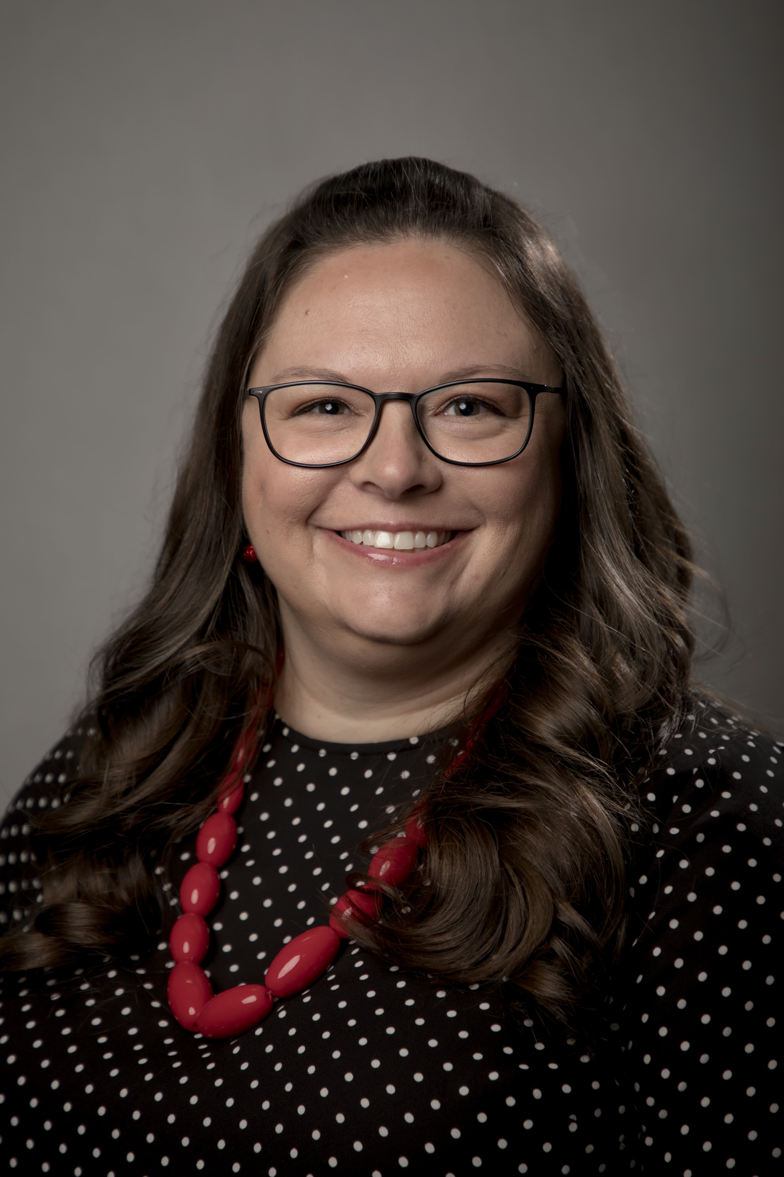
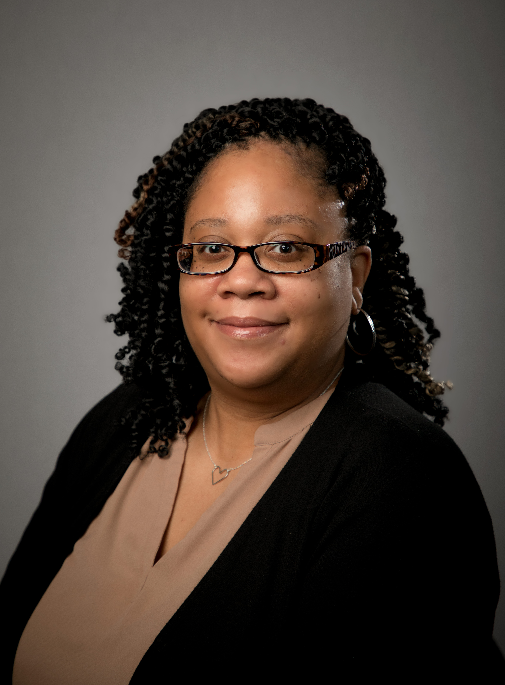
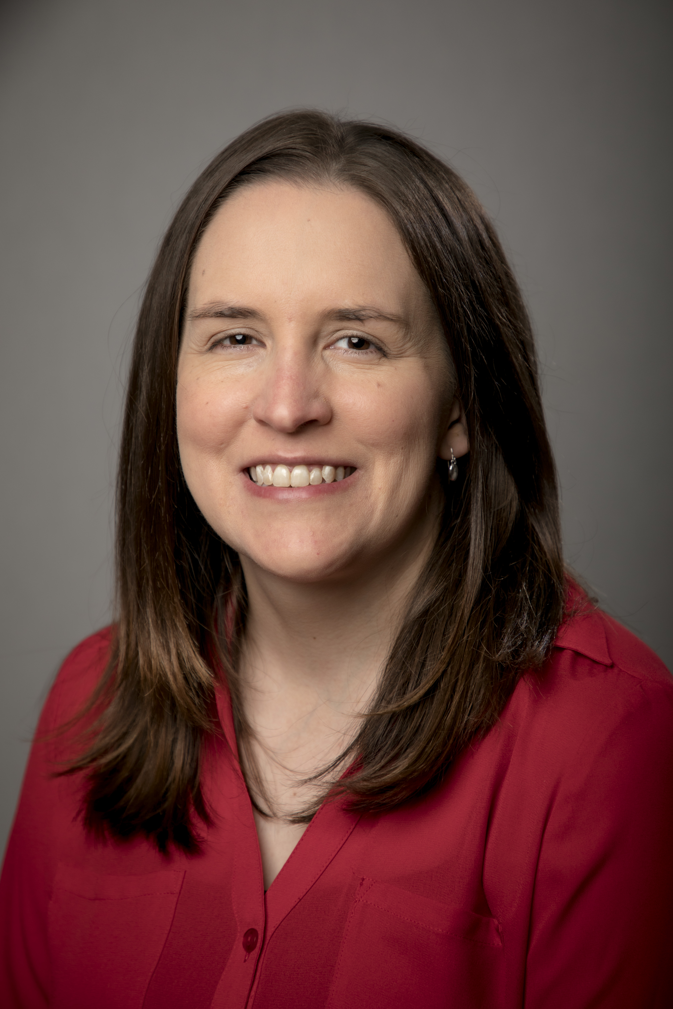
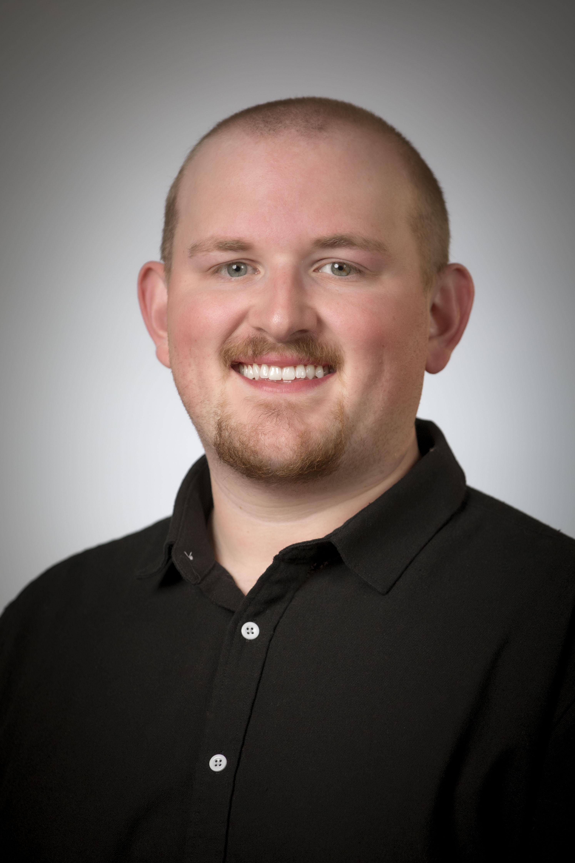
Student Life Overview & Introductions
Office Overview
Staff

Slide 3
Office Contact Information
Email: Student.Life@ttuhsc.edu
Phone: 806-743-2302
Website: www.ttuhsc.edu/student-life
Location: Lubbock Campus, 2C400 – HSC Student Affairs Suite

Slide 4
Institutional SGA
Represents all schools and campuses
Amarillo & Abilene have campus specific Senate/SGA

Slide 5
2024-2025 Funding Rules & Regulations
Funding Regulations Handbook
Senate Funding Cannot Pay For
Fundraising Purchases
Donations
Food Expenditures

Slide 6
2024-2025 Funding Rules & Regulations
Travel
Organization Related/Sponsored
Less than 10 – Reimbursement Process
Travel Process Documents
Conference Registration – can be paid ahead
Hotel Payment Policy
Pay your own expenses

Slide 7
2024-2025 Funding Rules & Regulations
New Guidelines for this year:
President & Treasurer Must Attend
Fall Student Org Training (5% deduction)
Spring Student Org Training (5% deduction)
Signed Funding Contract due by September 30th (1% deduction)
Purchase Requests submitted by 2-week prior deadline (1% deduction each instance)
Deductions will be to the 2024-2025 Allocation

Slide 8
SGA Special Projects Fund
Funds student organizations that are brand new or that have run out of funds.
For a one-time or unforeseen need
Form can be located in HSC Net under the Forms tab – SGA Special Projects Fund Request
Only available while SGA is in session to review (late September – early April)
Medicine organizations wanting to request for travel funding must first request from the Dean’s Contingency Fund (through MSG & SOM Dean’s Office)

Slide 9
Promotional Item Purchase Process
Approved Vendors
TTUHSC Printing Center
Advanced Graphix
Brand Ability
Design must be approved by Marketing
Payment is completed through a Purchase Order (check or direct deposit)

Slide 10
Coca-Cola Campus
TTUHSC is in contract with Coca-Cola, so only products by their company can be purchased.
This includes water and sports drinks.
Water – Dasani, Smartwater, Vitamin Water, and Topo Chico
Sports Drinks – Powerade

Slide 11
Reminder on Purchases
Our office must handle ALL purchases on your Senate account
DO NOT make a purchase yourself
Personal Reimbursements are Not Allowed
If purchase is using on-campus Agency Funds (SOM groups), please use the Spending Request Form – Medicine Organization Agency Funds Only in HSC Net

Slide 12
Senate Spending Requests
Purchase Request System in HSC Net
Must submit at least 2 weeks prior to event/meeting
If for a large event or travel, please submit at least 30 days prior.
Our office will contact you with any questions for any further information we need

Slide 13
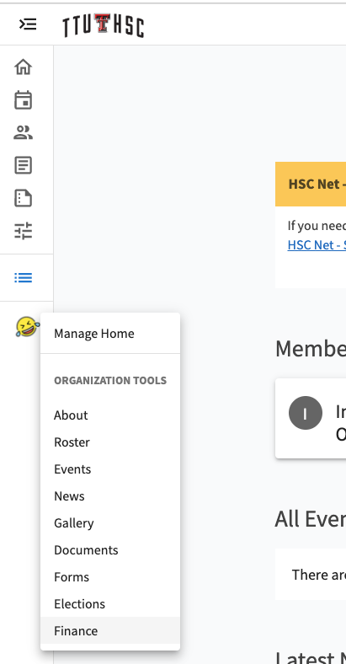
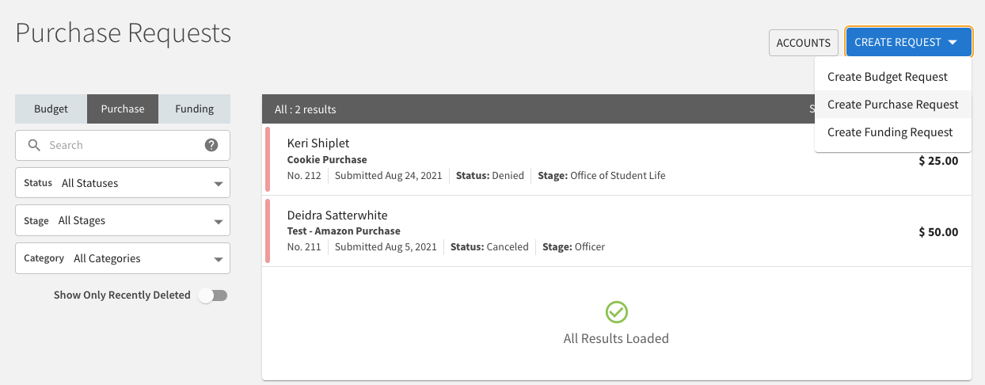
Purchase Request Process
Go to the Finance Tab
Click “Create Request”
Select “Create Purchase Request”

Slide 14
Purchase Request Process
Enter Request Information
Select your Senate Account
If a Multi-Campus org, please select the correct Campus’ Senate Account

Slide 15
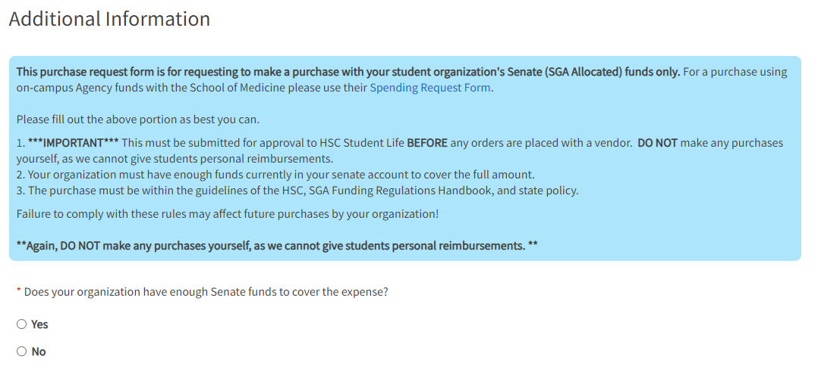
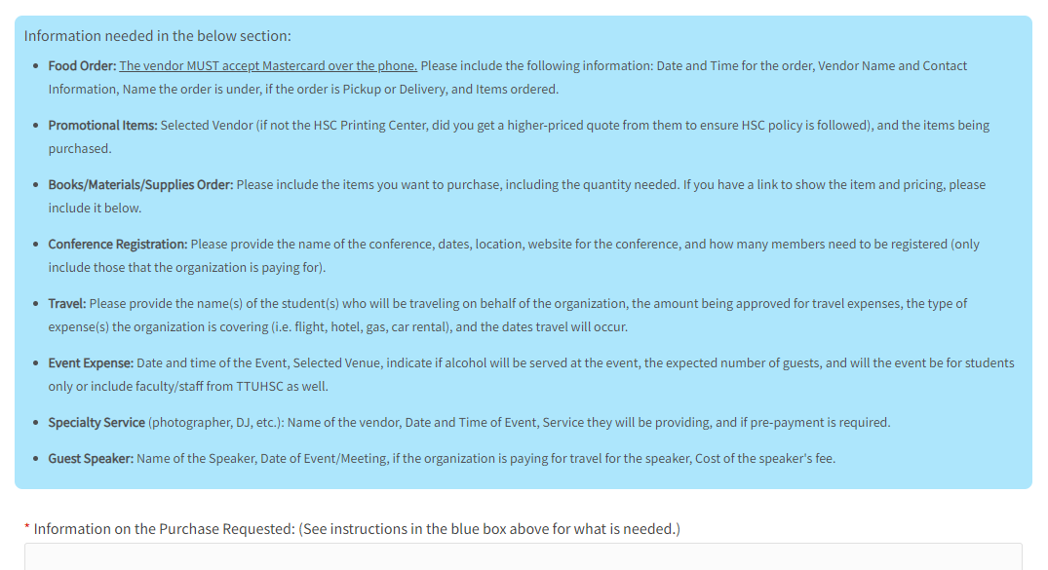
Purchase Request Process
Additional Information section
Follow instructions for the type of purchase you are requesting.
Required File Upload
RSVP List
Once finished, click “Submit Request”

Slide 16
HSC Net - ttuhsc.campuslabs.com/engage/
Roster
Privacy Settings
Events
Finance
Elections

Slide 17
Funding Contract
Sign and Email to Student Life (student.life@ttuhsc.edu)
President, Treasurer and Advisor
Must be returned to Student Life by September 30th
Once submitted, Senate spending may begin.

Slide 18
Key Reminders
New regulations
2-Week Deadline for Purchase Requests
Items purchased with Senate funds cannot be sold
Travel Forms
Officer Transition
Rosters

Slide 19
Reminders
Use of TTUHSC name/logo
Contacting Media

Slide 20
Important Dates
March 1, 2025 – Deadline
2025-2026 SGA Budget Request Form
Re-Registration
June 6, 2025 – Deadline
Major Senate Expenditures
August 1, 2025 – Purchase Request Deadline
Final 2024-2025 Year Senate Expenditures

Slide 21
Questions?

